Slide 1




The subjective well-being of children in care and care leavers
Professor Julie Selwyn, The Rees Centre, Department of Education, University of Oxford, julie.selwyn@education.ox.ac.uk
Linda Briheim-Crookall, Coram Voice, linda.briheim@coramvoice.org.uk

Slide 2

Children and young people as ‘experts’ in their lives

Slide 3

Children and young people as ‘experts’ in their lives
Official statistics
Objective measures and professional assessments
Children in care and care leavers’ viewpoints
Are they happy, safe and feel they are doing well?
Helps local authorities
systematically listen to
their children in care
and care leavers
about the things that
are important to them
Bright Spots Well-being indicators
Your Life, Your Care
Your Life Beyond Care
Subjective Well-being: Feeling good and doing well at both the individual and interpersonal levels.
Notes:
Currently official statistics only provide a partial picture of children in care and care leavers’ lives. Data focuses on adult perspectives, objective outcomes measures - where children live, education.
None of this information tells us about young people’s own viewpoints: are they happy, safe and feel they are doing well?
Bright Spots programme seek to address these gaps
Helps LAs systematically listen to their children in care and care leavers about the things that are important to them.

Slide 4
What makes life good? Care leavers views on their well-being
History & Development

Slide 5

The ‘Your Life Your Care’ and ‘Your Life Beyond Care’ Surveys
Began in 2013 when we were asked to identify LAs whose children had a good care journey, identify how (Bright Spots) and disseminate to other LAs. Could not answer the research question.
  ADCS aims of care system – protect child from further harm, address a child’s needs for good parenting, improve their outcomes and enable them to recover from trauma
  But national data focused on process issues with some broad objective (mainly negative) outcome measures
  No data collected systematically on how children feel they are doing
  NAO (2019) £4.2 billion spent by LAs on children in care - no indicators that measure efficacy of care system.

Slide 6
Aims
What do looked after children and young people say is important to their well-being?
Are there similar domains to those identified by children in the general population or unique domains for children in care ?
Is it possible to create an on-line measure that children will find meaningful? What should the lower age limit be?

Slide 7

Method
International literature review
Round table of professionals
21 focus groups with 140 children in care from 9 different LAs asking ‘What makes a good life?’
Individual interviews with children with a disability and with asylum seeking young people.
Method repeated for the development of the Care Leaver survey

Slide 8
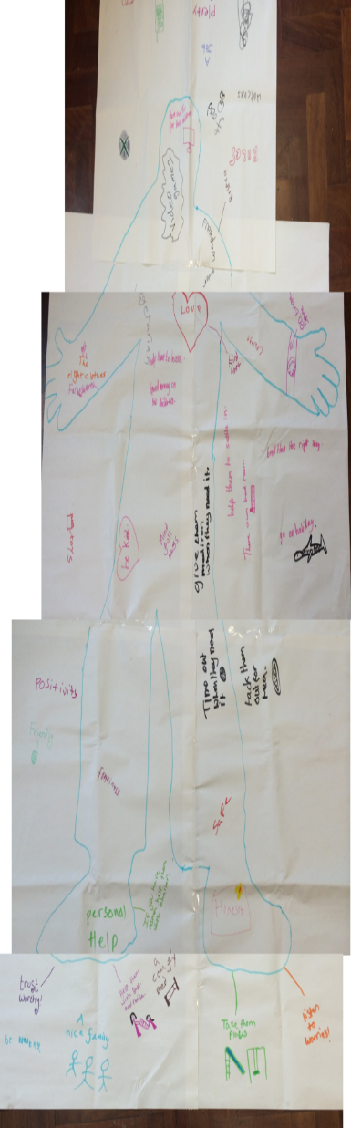
Children in care: what did we find?
Good relationships with family, friends, sws and carers,
Trust
Positive sense of self and positive view of being in care
Creativity, play, access to the natural world
Opportunities-care for pets, to be trusted and given responsibility
Helping others, faith, purpose in life
Physically & mentally healthy, support dealing with adversity
Nurtured, loved, belonging
Life satisfaction, enjoyment, joy, happiness, life getting better
Support for learning, learning life skills
Security & safety, free from bullying & abuse
Autonomy, choices in own life , feeling included ( UNCRC Article 12 &13)

Slide 9


On-line surveys
Three confidential on-line surveys created : 4-7yrs, 8-10yrs, 11-18yrs. A Care Leaver survey was added later
Four key themes: relationships, rights, resilience, recovery
Questions on well-being for comparison with ONS general population data
Are children flourishing in care?
Subjective well-being chosen as our theoretical framework. Allowed us to examine a basket of indicators that make up well-being. SWB defined as: “feeling good and functioning well at an individual and interpersonal level”.
Piloted in schools with 85 children in care

Slide 10
Cognitive interviewing
To understand…
Did they understand the question in the way we intended? (e.g – Do you feel settled at home?) - Comprehension
Could they recall the answer. E.g. how many social workers have you had in the last 12 months? - Retrieval
Were they happy with the response options? E.g. Most of the time sometimes, hardly ever, never. - Measurement
Do they feel OK about being asked the different questions e.g. did they mind being asked about birth family contact? Response
The acceptable time to complete a survey
Any key questions missing?

Slide 11
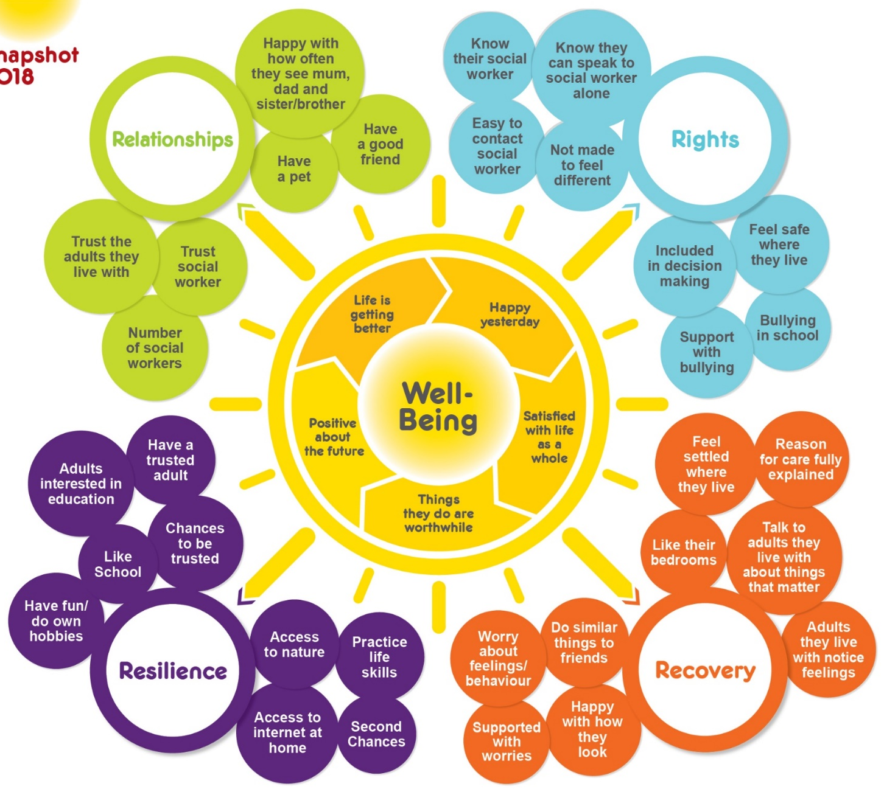
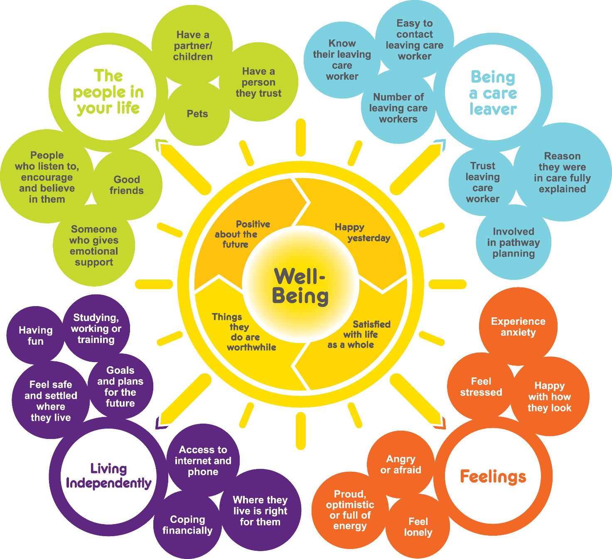
Bright Spots domains and indicators of well-being
Your Life Beyond Care
Your Life Your Care
Notes:
Here are the Bright Spots well-being indicators produced with children in care
Based on what they say matters to their well-being
Being in care
Your feelings
People you know
Chances you have to do things
Some of the questions are the same questions used in surveys to the general population – this lets us directly compare how children in care are doing compared to children in general population.
Lots of things in survey be familiar e.g. how involved feel in decision making – whether they have stable placements and workers.
Trust was a really core issues for children in care and we ask about whether they have an adult they can trust, trust social worker and their carers, as well as whether they get opportunities to be trusted.
Some of the areas included are ones that children said were important to them but they may not be areas that services regularly look at
e.g. pets – children said they were important – they love you unconditionally, they don’t judge you – they can teach you things like responsibility but as services do we acknowledge their importance to some children e.g. when children have moved placements and left a pet behind have we asked about this ? For children who want a pet but do not have one – has anyone explored other options ? For example in one LA who undertook the survey some of those living in children’ home would like a pet – staff have taken own dog in to meet children and manager looking at whether home could get a children home dog of own
Friends – really important to all of us – including children – in the care leaver survey results in other LAs friends are often the top source of emotional support once children leave care – but as services do we support children to maintain / strengthen friendships – and recognise their importance?
Reason
TAKE COPIES OF SNAPSHOT WITH YOU? If there copies on table then tell people to look inside red booklet and can see poster with the indicators
Encourage people to look closely at the areas – now going to look at how your children in East Sussex doing in relation to these well-being indicators

Slide 12
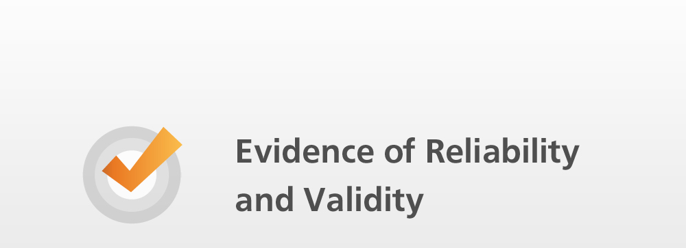
Meeting survey standards European Statistical System Quality Dimensions 2013
Accessibility – template and letters provided to help the LA distribute
Coherence and comparability –general population norms & benchmarking against other LAs
Relevance – Good face validity (as developed with children), content validity ( expert group/LA feedback)
Reliability – Cronbach’s alpha girls 0.82 and boys 0.77. Little missing data. Factor analysis and IRT completed – a psychometrically robust tool
Timeliness – reports received within 3 months
OFSTED - "The local authority is striving to be child focused and to shape its services in response to the wishes and views of children in its care. The annual 'Bright Spot' survey is an effective mechanism for communicating with children, and it has led to new initiatives, … resulted in improvements in services for children in care and care leavers.

Slide 13
History & development
Questions, comments and reflections?

Slide 14
What makes life good? Care leavers views on their well-being
Research findings

Slide 15

2015
55
local authorities
15,249*
2021
* Total number of responses collected, incl surveys not yet closed
Notes:
Over the past ﬁve years, we have sought to address this gap by collecting over 14,000 care experienced voices through our Your Life, Your Care and Your Life Beyond Care surveys.
These ‘voices’ give an unprecedented insight into children in care and care leavers’ subjective well-being. The surveys were developed together with almost 200 children and young people as part of the Bright Spots programme, a partnership between Coram Voice and the University of Oxford.

Slide 16
Latest research
What Makes Life Good, Care leavers’ Views on their Well-being’ (Nov 2020)
  Linda Briheim-Crookall, Olivia Michelmore, Claire Baker, Oluwanifemi Oni, Sarah Taylor, Julie Selwyn
Bright Spots Snapshot, Our Lives Our Care: looked after children’s views on their well-being in 2018 (Nov 2018)
  Linda Briheim-Crookall, Dr. Claire Baker and Professor Julie Selwyn
Our Lives Our Care 2017 (Feb 2018)
  Professor Julie Selwyn, Levana Magnus and Dr Bobby Stuijfzand
https://coramvoice.org.uk/for-professionals/bright-spots-2/bright-spots-publications/

Slide 17
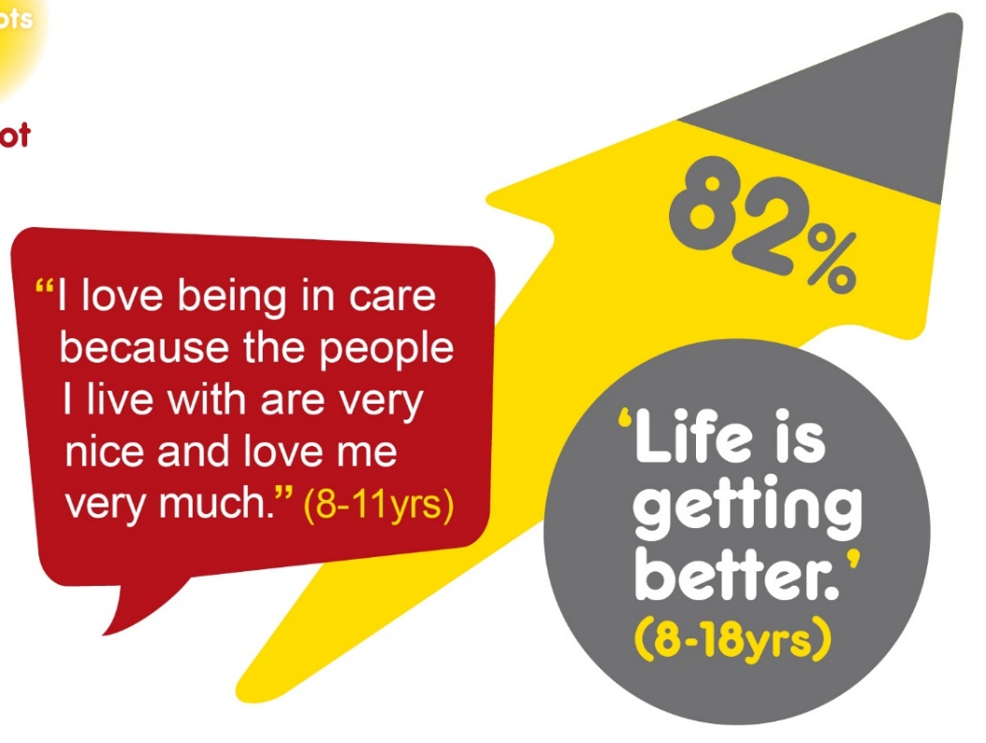
Many children in care are positive about their lives

Slide 18
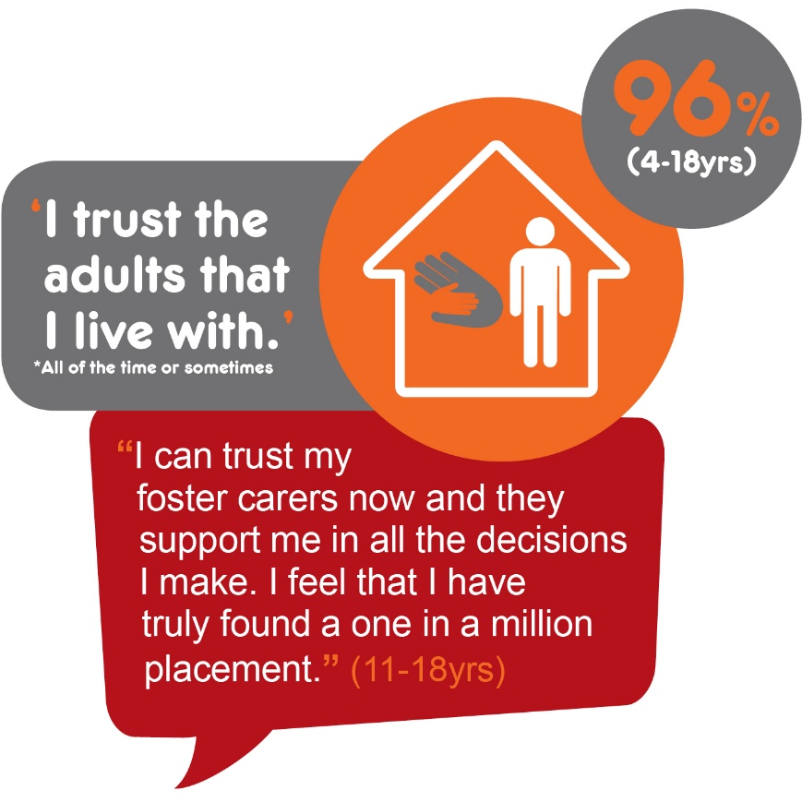
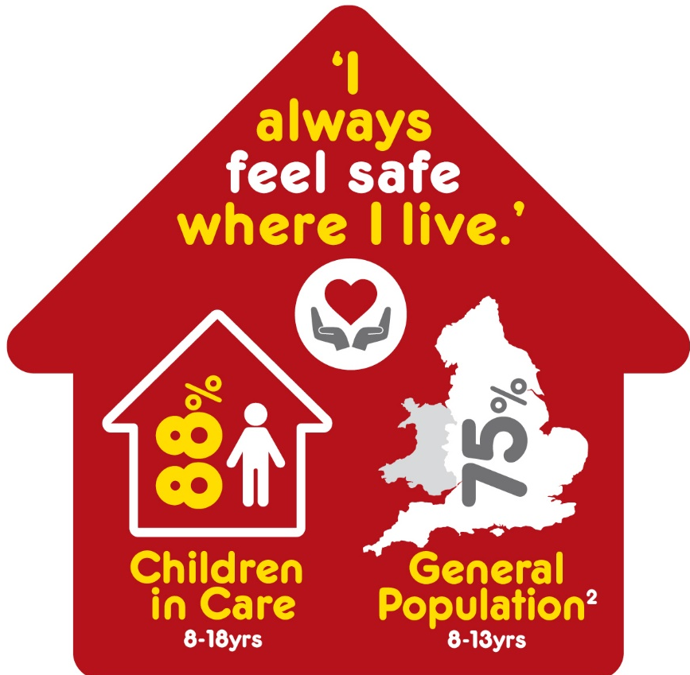
Compared with the general population a higher percentage of children in care felt safe where they lived.
My foster cares
rear me like their own daughter in the family which is really nice because I feel safe
(11-18yrs)
The majority of children in care trusted their carers

Slide 19

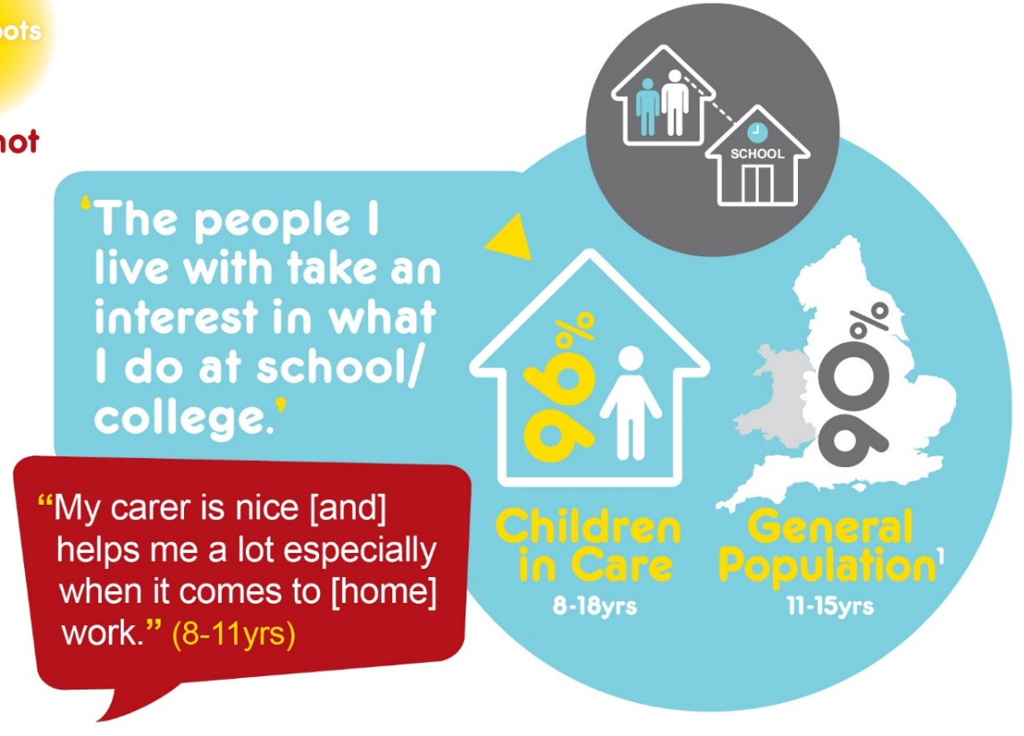
School and support with learning
In comparison to young people in the general population, more boys liked school; and more children in care felt that their carers were interested in what they were doing in school.

Slide 20
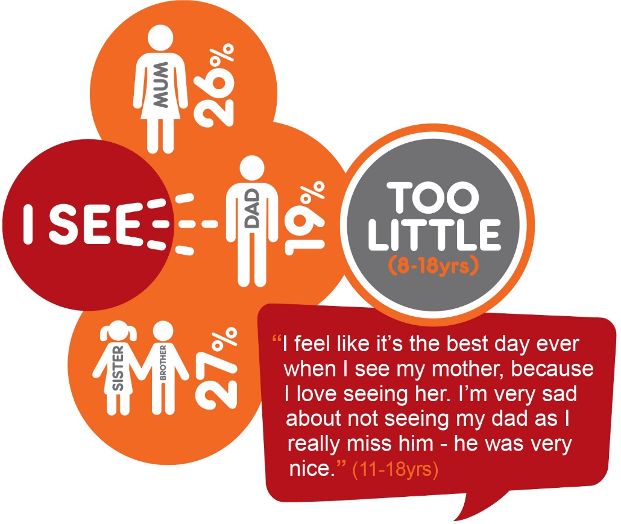
Relationships – important people in your life
Contact with family is among the most common issues raised in the survey.
It’s sad because I only
get to see my mum a little.
I miss my dad too. (4-7 yrs)
Mum and
dad are a
waste of space,
useless.
(11-18yrs)
I would like to see my family for longer than the 2 hours at a time. Ideally I would like to see them for a whole day.
(8-11yrs)
Being friendless was associated with moves in care and not having access to a computer/tablet outside of school.
They don’t let u go on the internet or go and see your friends (11-18yrs)

Slide 21
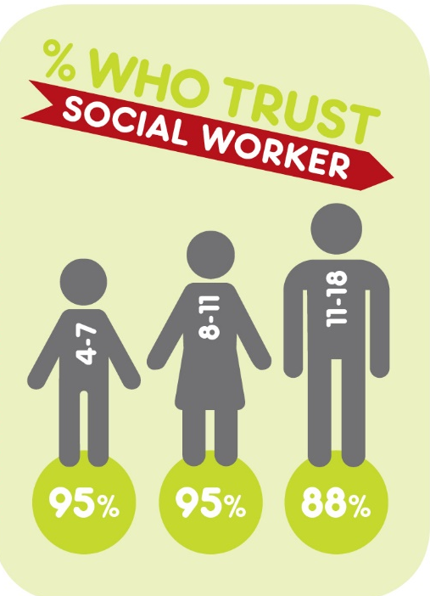
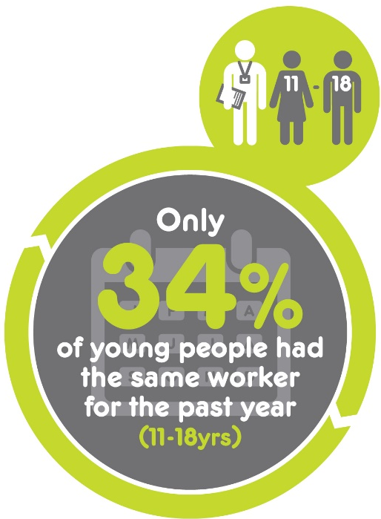
Relationship with social workers
I think that social workers shouldn’t move around as much because they just get to know your life story and you have to try to trust them but how can you trust them when you don’t even know them or have hardly ever met them?
(11-18yrs)
Statistically signiﬁcant association with lack of trust and having had three or more social workers.

Slide 22
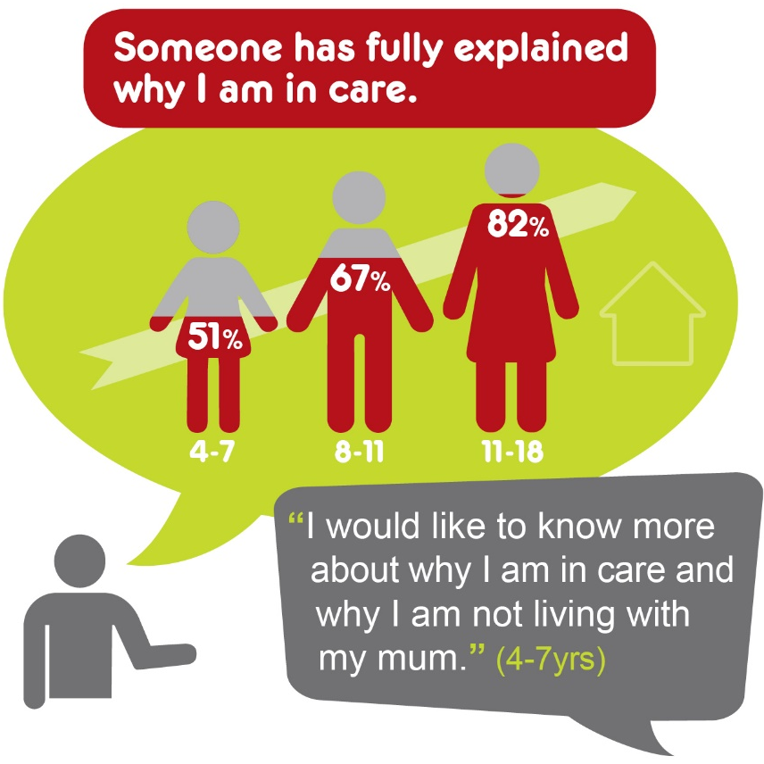
Understanding reason for being in care
.
I would like someone to talk to about my feelings and tell me about my past. I would like to see a picture of my dad so I know what he looks like. I would like to see a picture of me as a baby. I have never seen a picture of me. I have a lot of questions that no-one answers.
(11-18yrs)

Slide 23
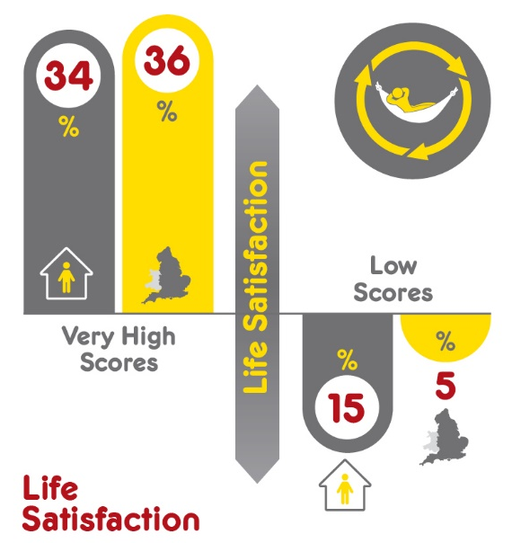
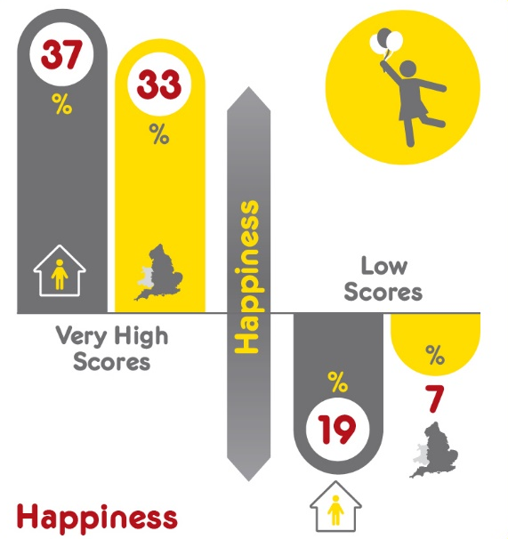
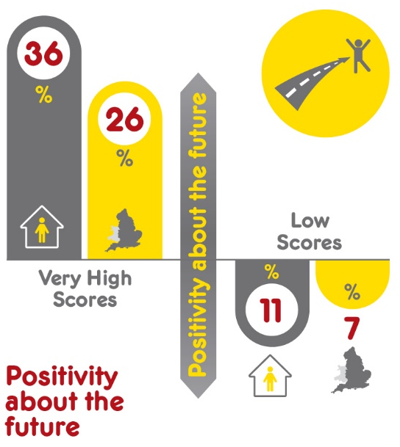
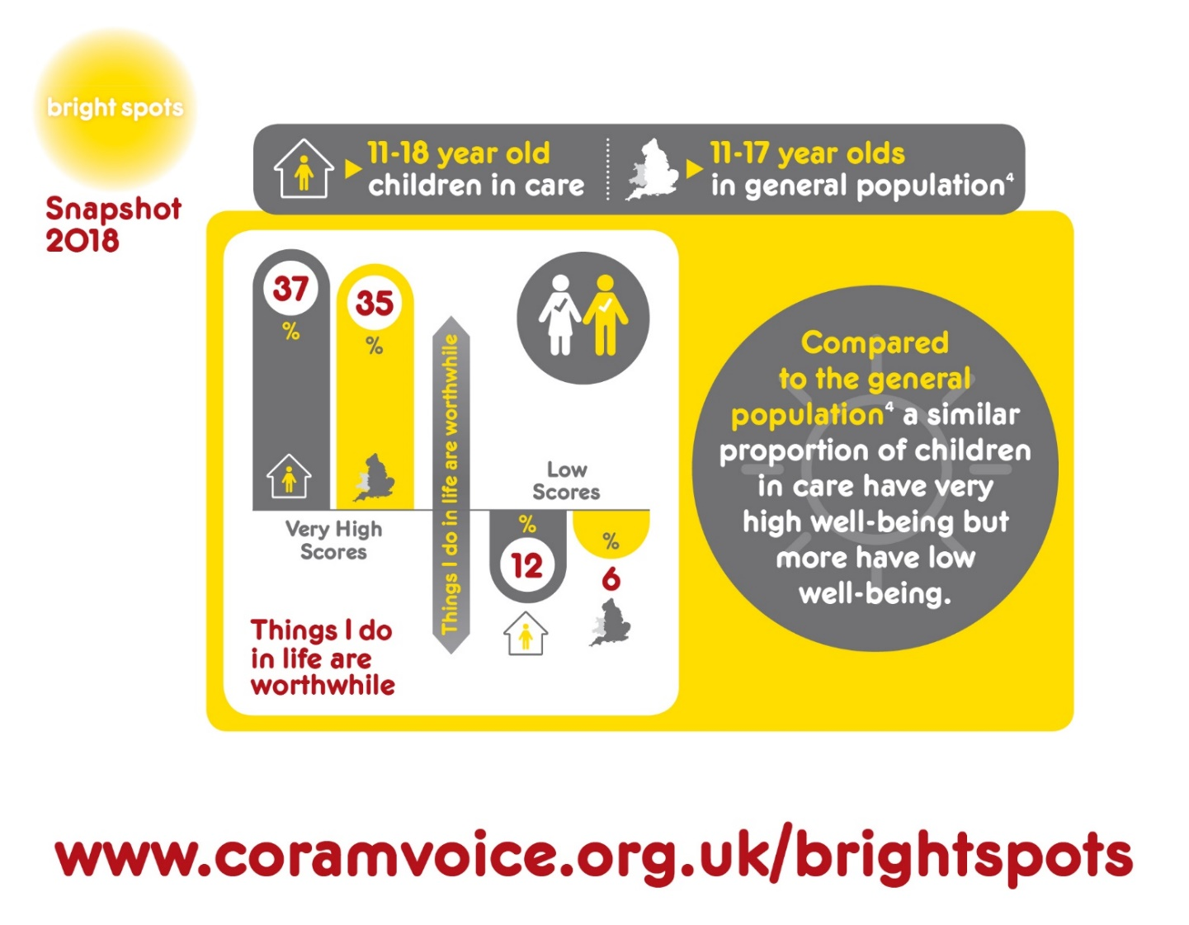
Well-being measures – 11-18 year olds
Compared to the general population, a similar proportion of children in care have very high well-being, but more have low well-being

Slide 24
97%
had moderate to high well-being
96%
had moderate to high well-being
82%
had moderate to high well-being
I would like to
know for absolutely certain that I will
always stay with mummy (foster carer). I love her and she loves me.
(4-7 yr old)
I wouldn’t
change anything
except not having
to eat avocados
and courgettes.
(8-11 yr old)
Being in care is
the best thing that has happened to me. So many amazing opportunities have opened… like my attendance
is significantly improved and
I have so much support around me. I am
very happy.
(11-18 yr old)

Slide 25
97%
had moderate to high well-being
96%
had moderate to high well-being
82%
had moderate to high well-being
Of those with low well-being:
Didn’t feel why they were in care had been explained
Did not know social worker.
Felt unsettled, didn’t trust carers or feel they noticed their feelings
Did not have good friend
Those with low well-being tended to
Not feel safe or settled in their placements.
Not have a trusted adult
Not trust their social worker
Not feel included in decision-making.
Not have a good friend.
Associated with low well-being
Unhappy with appearance
Not given opportunity to be trusted
Not like bedrooms or feel safe in placements
Not have a trusted adult
Not feel included in decision making
Not like school
Afraid of going to school due to bullying
Not taught life skills

Slide 26
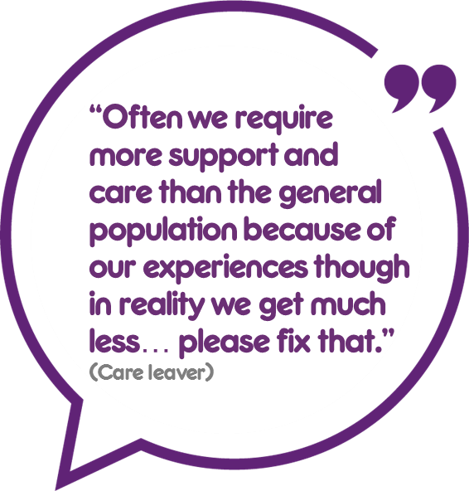
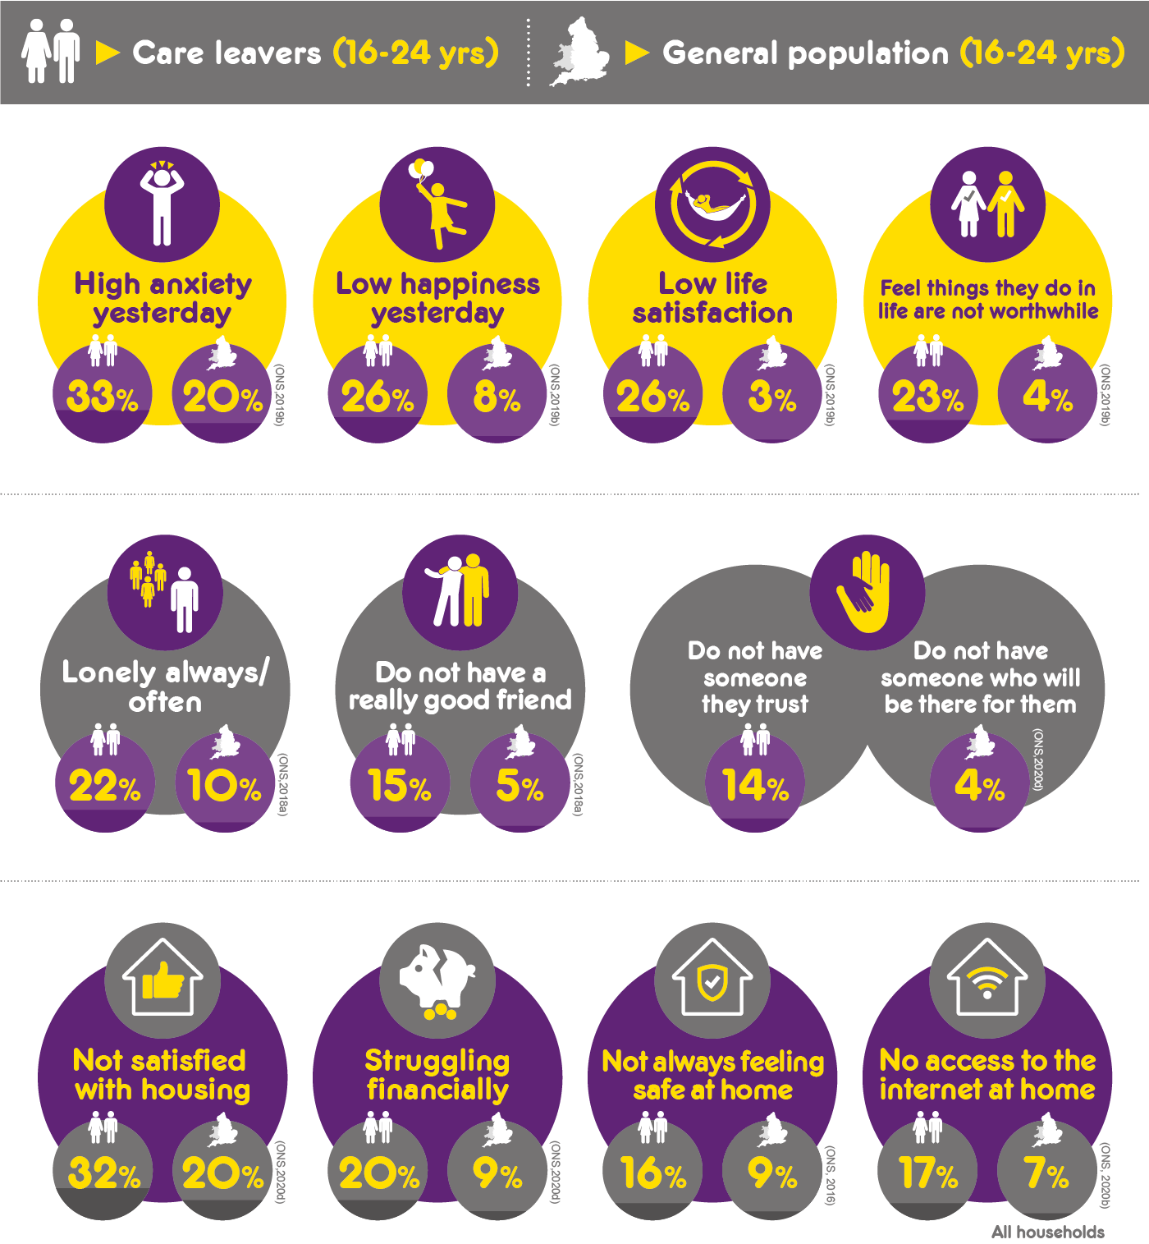
Care leavers did worse than the general population on a range of measures.
A higher percentage experience high anxiety, feel unhappy, feel dissatisfied with life and do not think that the things they do in their life are not worthwhile.
For example, more care leavers had higher anxiety, lower life satisfaction, felt lonely and were less likely to have trusted supportive people in their lives
Notes:
Many care leavers do worse than young people in the general population – experience higher anxiety, feel unhappy, dissatisfied with life and that the things they do in their life are not worthwhile.

Slide 27
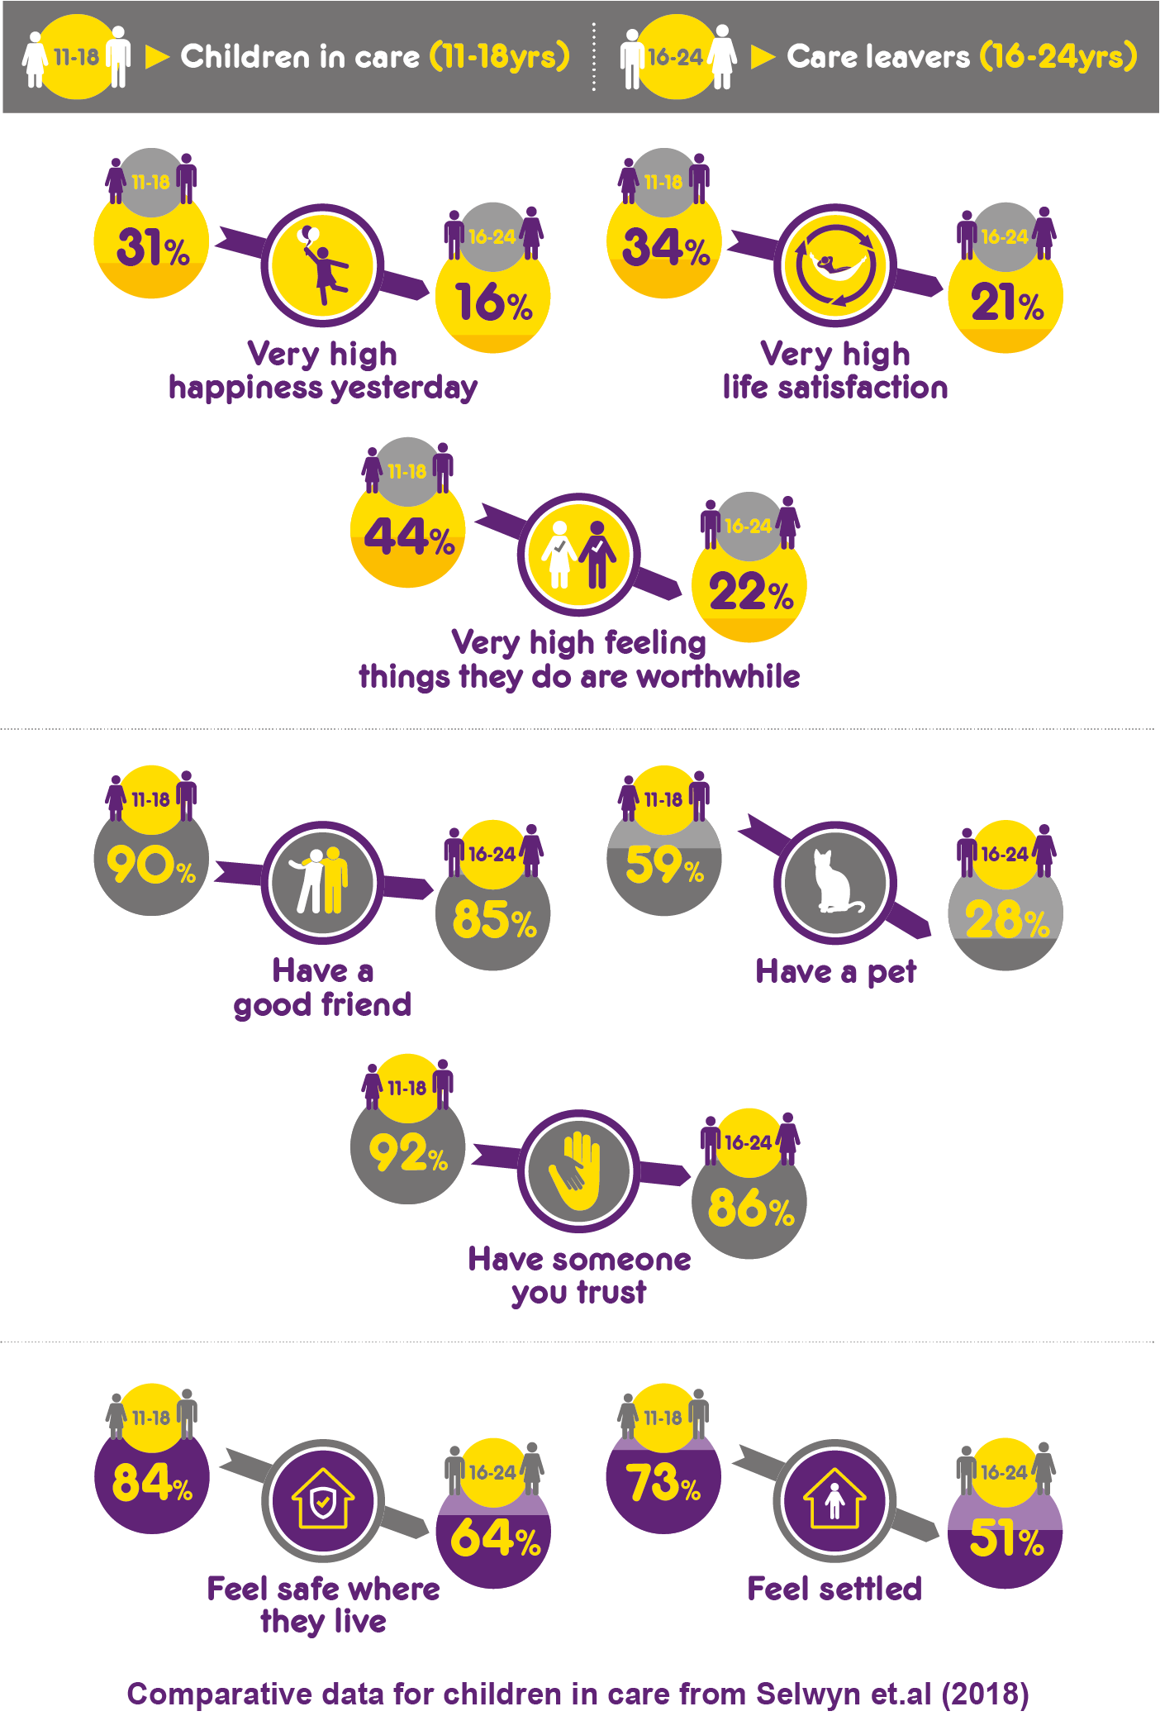
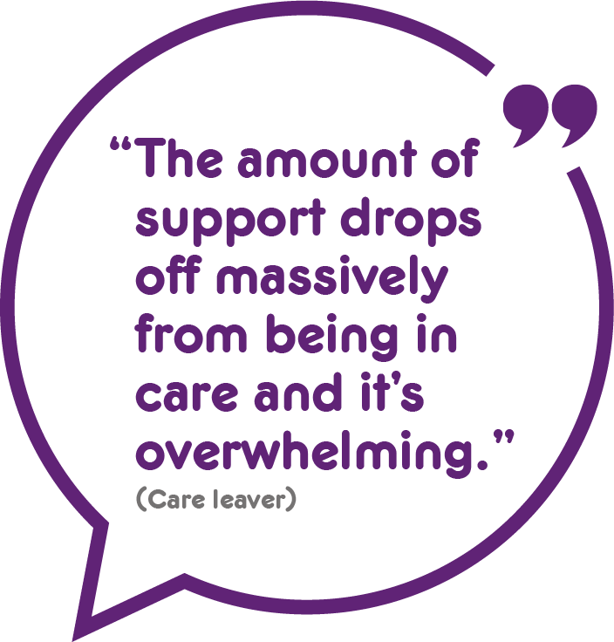
There was a steep decline in well-being when young people left care.
We found that compared with children in care a higher percentage of care leavers felt unhappy, unsafe and unsettled where they lived.

Slide 28
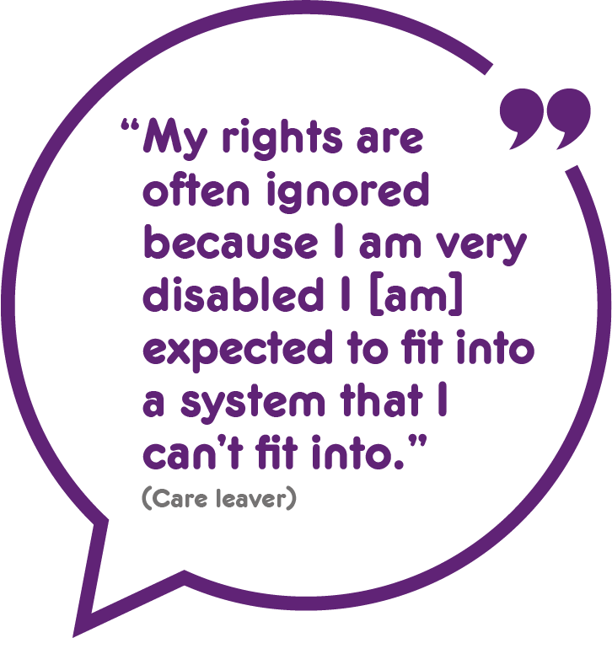
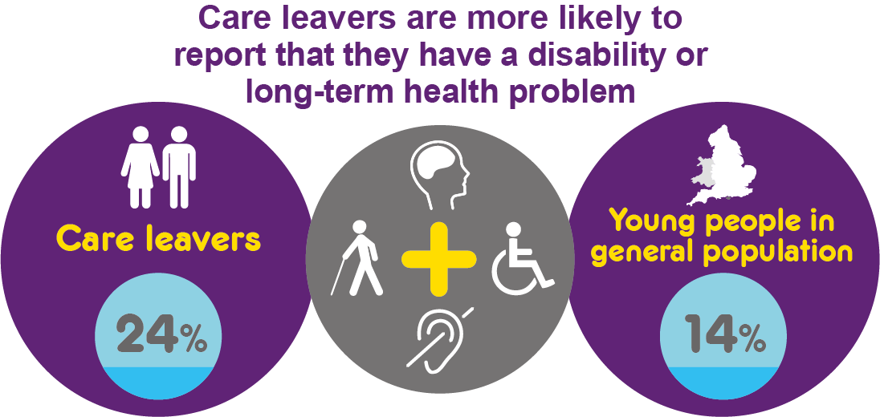
Care leavers who reported that they had a disability or long-term health problem were particularly vulnerable.
They had lower well-being and were lonelier and less likely to have goals and plans for the future. Compared with other care leavers fewer felt safe and settled where they lived and more struggled financially.

Slide 29
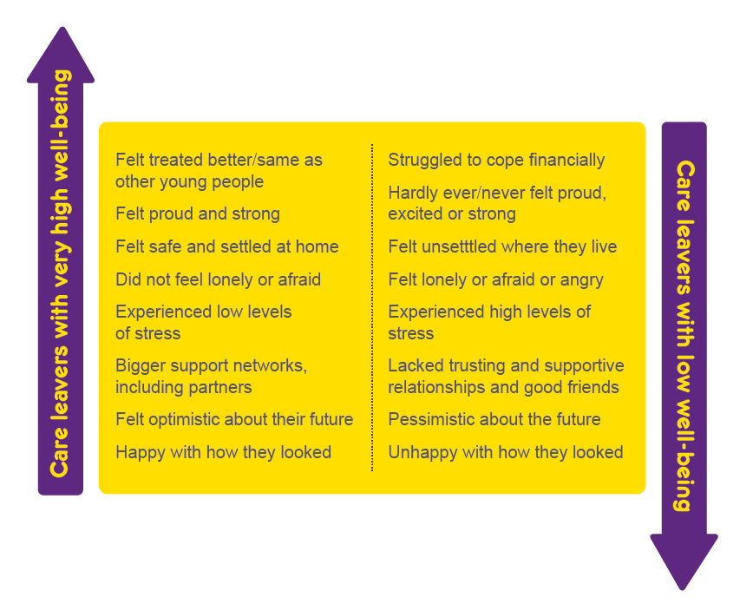
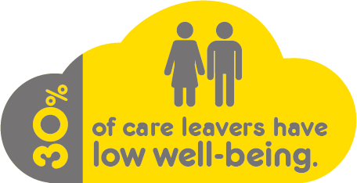
Overall, although a majority of care leavers had moderate to high well-being 30% had low well-being.
Our analysis identified the factors associated with high and low well-being.

Slide 30
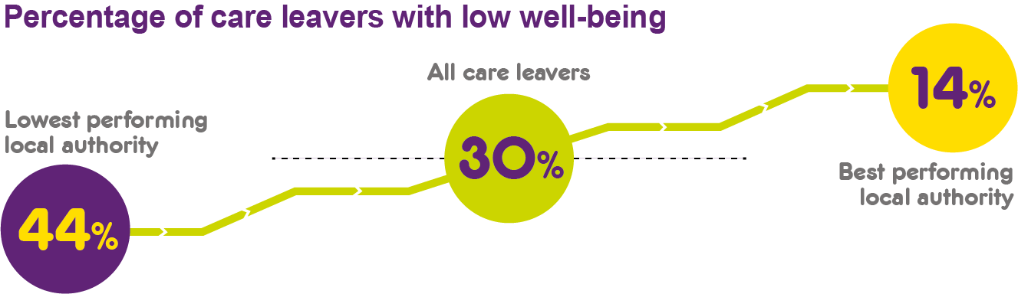
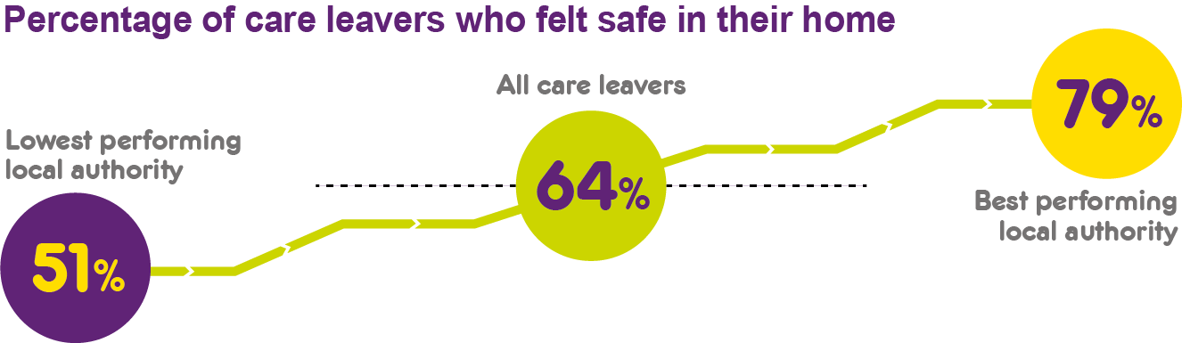
The care system can get it right. We can learn from the positive experiences of those with high well-being. We also found that care leavers do better in some local authorities than in others.

Slide 31
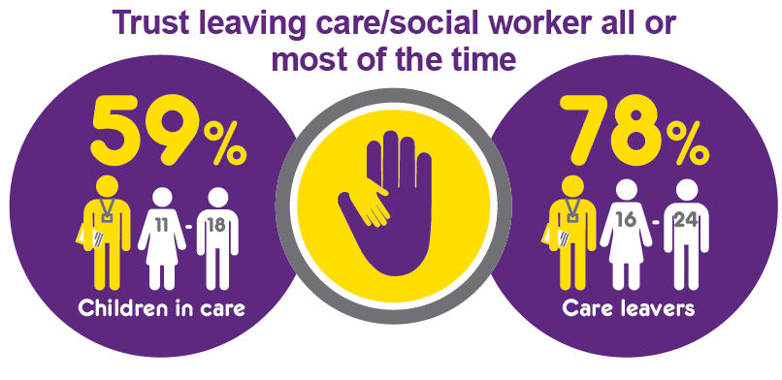
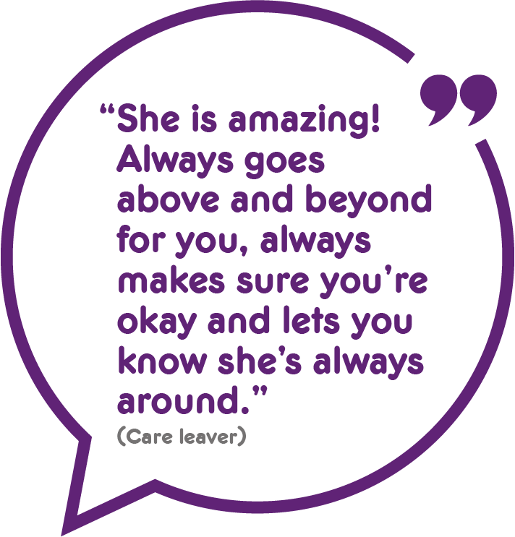
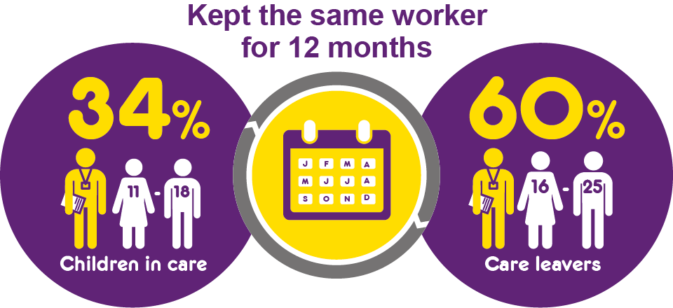
Many young people were very positive about the support they received from their leaving care personal advisers (PAs).
Care leavers reported higher levels of trust and more stability of workers compared with children in care.

Slide 32
Findings
Questions, comments and reflections?

Slide 33
Impact: learning from Bright Spots Programme partners

Slide 34
Shift in emphasis onto children and young people’s priorities
Are services focusing on what children and young people say is important?
Will children in care and care leavers feel that their lives improved as a result?

Slide 35
Bright Spots domains and indicators of well-being
Your Life Beyond Care
Your Life Your Care
Notes:
Here are the Bright Spots well-being indicators produced with children in care
Based on what they say matters to their well-being
Being in care
Your feelings
People you know
Chances you have to do things
Some of the questions are the same questions used in surveys to the general population – this lets us directly compare how children in care are doing compared to children in general population.
Lots of things in survey be familiar e.g. how involved feel in decision making – whether they have stable placements and workers.
Trust was a really core issues for children in care and we ask about whether they have an adult they can trust, trust social worker and their carers, as well as whether they get opportunities to be trusted.
Some of the areas included are ones that children said were important to them but they may not be areas that services regularly look at
e.g. pets – children said they were important – they love you unconditionally, they don’t judge you – they can teach you things like responsibility but as services do we acknowledge their importance to some children e.g. when children have moved placements and left a pet behind have we asked about this ? For children who want a pet but do not have one – has anyone explored other options ? For example in one LA who undertook the survey some of those living in children’ home would like a pet – staff have taken own dog in to meet children and manager looking at whether home could get a children home dog of own
Friends – really important to all of us – including children – in the care leaver survey results in other LAs friends are often the top source of emotional support once children leave care – but as services do we support children to maintain / strengthen friendships – and recognise their importance?
Reason
TAKE COPIES OF SNAPSHOT WITH YOU? If there copies on table then tell people to look inside red booklet and can see poster with the indicators
Encourage people to look closely at the areas – now going to look at how your children in East Sussex doing in relation to these well-being indicators

Slide 36


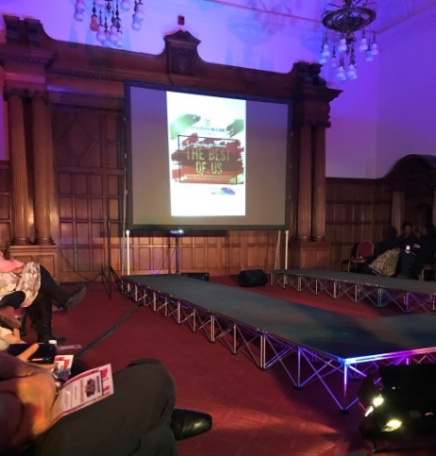
Sheffield
Fashion show to promote positive body image
e.
Why? Improving how children and young people feel about how they look chosen as priority issue by children and staff.
What?
Working group of young people to develop/progress ideas
Decided to host a fashion show to inspire younger children in care about “loving ourselves and yourself as you are”.
linked with local community organisations and engaged their help with music, staging and lighting for the event.
worked with a dancer and drama coach to improve their confidence and movement.
Children chose backing tracks & positive message to say.
Opportunity to have their hair or make-up done, to use fancy dress in the photo booth and enjoy food together.
June 2020
Impact: 150 attendees with positive feedback. Corporate parenting board challenged to develop action plans to respond to the Bright Spots findings (incl. improving positive body image), scrutinised by new youth panel
Case study available to download on https://coramvoice.org.uk/for-professionals/bright-spots-2/how-to-make-life-good/
Notes:
Case study for presentations or online video

Slide 37

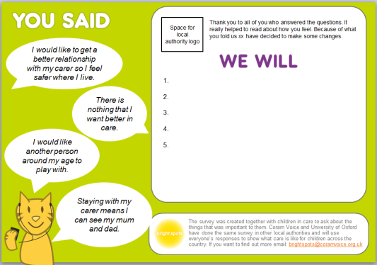
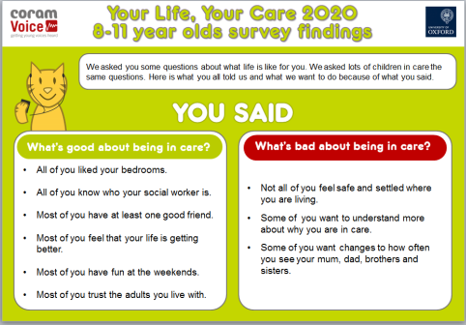



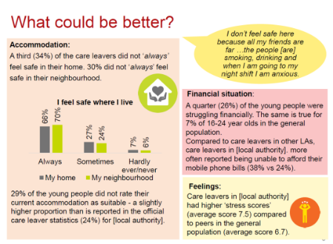


Local approach
Tailored approach to distribute survey
Detailed analysis
Disseminate & consider findings
Respond to findings – feedback to CYP & staff
Repeat
Changes to individual practice
Specific projects
Strategic & systems change

Slide 38

Identifying Bright Spots & effecting change based on children & young people’s voices
I hate that when the register comes up on the screen and others in the class can see that I am a CLA. It winds me up … I don’t like to be different.
(11-18yrs)
East Riding
87% of care leavers felt they had a full explanation for why they were in care compared to 77% elsewhere
?
In Pathway plan
What happened?
LA called all schools and told them not to put CLA next to children’s names.

Slide 39

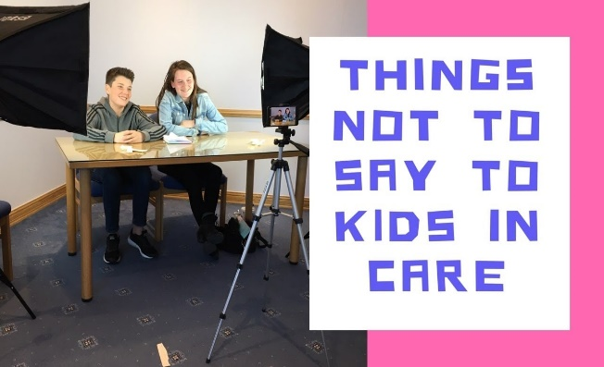
West Sussex
‘Treat me the same’
e.
Why? Bright spots survey findings highlighted experience of stigma.
When I'm out in public they always make a scene about me being in care and I hate it.
11-18yrs
June 2020
What?
West Sussex Children in Care Council organised ‘Treat me the same workshops’ with professionals focused on children being taken out of class to attend meetings and reviews.
Led to changes in the way meetings were held e.g. holding meetings outside of school and health assessment in holidays.
Videos for schools, professionals and young people in care shared on the Tools for Schools website.
Impact: Videos viewed 500+ times; the workshops were highlighted in Ofsted 2019 report as a positive example of involving children and young people.
https://www.youtube.com/watch?v=7fix5CYICt8&feature=emb_logo
Notes:
Case study for presentations or online video

Slide 40

North Somerset
‘Words and pictures’ & case summaries to improve understanding of why you are in care.
e.
Bright Spot of
practice
Why?
Children in care, especially 4-7 year olds (50%) reported that adults had not fully explained why in care.
June 2020
What?
‘Words and Pictures’ (Part of Signs of Safety approach) work with all children in care – using story boards with pictures and age appropriate explanation developed with the child and their family.
Expectation that all Case summaries include explanation to ensure consistent messaging and emphasise the importance of understanding why you are in care.
Embedded in policy and rolled out through social workers, progress Monitored through audits, supervision, & Performance Board chaired by the DCS.
Further information about approach: https://knowledgebank.signsofsafety.net/
Impact: 32% increase in 4-7 year olds reporting they had full understanding (82%), significantly better than other LAs
Case study available to download on https://coramvoice.org.uk/for-professionals/bright-spots-2/how-to-make-life-good/
Notes:
Case study for presentations or online video

Slide 41
The Evaluation – Dr Shirley Lewis ( Rees Centre)
The evaluation focused on understanding whether involvement in the Bright Spots Programme had directly or indirectly led the LA to make changes to policies and influenced practice.
Sample: Six English local authorities took part.

Slide 42

Methodology
Data Collection:
Documents (e.g. promise, care plans, participation strategy)
Focus groups with children and young people in four of the six LAs.
Interviews (n=57) directors, senior managers, social workers and other professionals
What worked?
Results?
What was
achieved?
What helped?
Suggestions
Data analysis:
Spreadsheet of evidence of changes to policy/practice
Highlighted strengths and gaps

Slide 43
The power of a collective voice
We’ve seen placement moves as a
‘number’ in our strategic meetings. We know it’s something we need to focus on. [ Bright Spots gives] connects to the … human element. This is actually about children. (Principal SW)
It gives you that evidence base on how children feel, which is the true measure on how you’re doing as a local authority.
It’s all around being as least identifying as possible. So, if we’re talking about contact with family, we won’t use that language. It will be, ‘You’re going to visit your mum’. (Participation worker)
Social workers have been complaining that foster carers
often don’t invite kids home for tea …. it all gets dealt with individually … There’s always a reason why [inviting friends round] can’t happen …. Bright Spots helped us to say, ‘‘You will be promoting, supporting, enabling friendships. This is what we expect.’ …From a strategic perspective it allows you to go back to the problem … This is what [children] say.
This is what we’re doing.
(Principal SW)

Slide 44
The importance of a trusted adult
That phrase ‘trusted adult’, that’s something that we use more widely than we did before Bright Spots… It was agreed following… the results from the Bright Spots… We had that discussion about how we all needed to be using the same language, so we made sure through training that we were using that phrase trusted adult.
(Virtual Headteacher)
It’s about what we want for our children, it’s in all our documents… it’s all about trusted adults where people feel safe … and that’s become part of our everyday language. … We’re much more mindful of how children feel … that is part of our conversation in a way that I don’t think it was.
(Development Officer)

Slide 45
Drivers, Enablers and Barriers
Bright Spots of practice/ changes occurred where there was:
A stable workforce
An established Children in Care Council
Support from senior management
Senior participation role in the senior management team,
The involvement of the virtual school
A culture that encouraged reflective practice.
Barriers:
High level of staff turnover
The key LA person for Bright Spots having insufficient authority
Poor transitions between social work teams
The participation team having a peripheral role
Top down approaches to implementing change

Slide 46
Resilience
Virtual schools were involved in using the findings to change policy and practice in schools
Virtual schools played a key role. Examples
Changes to the PEP
Introduction of mentoring
Supporting education within the home
Closer working between LA and virtual school
LAs focus on hobbies and activities:
Leisure cards for whole foster family
Groups and activities
Community allotment
The allotment came out of trying to create a nice space with multiple layers of purpose… You can socialise. You can learn…it offers young people the opportunity to meet other people and learn from them…
Notes:
use text about the sample size if relevant: Although XX% is an [acceptable/good] response rate for a survey, be mindful of the sample size (n=XX) when interpreting the findings
Complete this and the next slide when all the analysis has been done.
Add overall response rate as bullet points
Add key findings from the report and ensure that ‘What is working well’ and ‘What could be improved’ are complementary as these are the three sections that are used in the summary document.

Slide 47

Isle of Wight
Community allotment
Why? Access to nature + hobbies & activities can reduce stress & improve well-being; gardening beneficial for mental health.
June 2020
What?
Can be used by all children in care & care leavers
Rent free, materials & plants raised through community fundraising
LA offers award in Horticulture
Accessible: Raised beds for Wheelchairs.
“It’s a lovely space. It’s a wonderful place.”
Leaving care team leader
Next?
therapeutic mental health group
‘shed project’ learn to make things from wood and pallets
Impact: “It’s a place to go where you can socialise, you can learn. It’s a community allotment, so it offers young people the opportunity to meet other people and learn from them.” (Leaving care team leader)
Notes:
Case study for presentations or online video

Slide 48
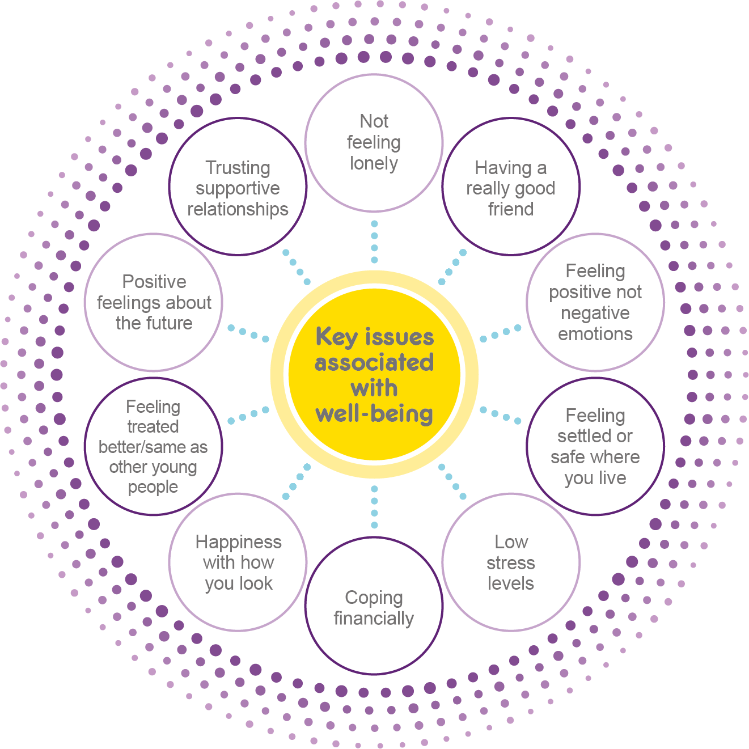
Improve connections and relationships
Notes:
Recommendation
Pay particular attention to the specific areas care leavers highlight locally, as well as the ten key issues we find are associated with well-being, i.e.
Improve connections and relationships (to develop friendships, trusting supportive relationships and addressing loneliness);
Provide emotional and mental health support (to address stress, high negativity and low positivity and help care leavers feel good about their future);
Provide money management and financial support (to support care leavers to cope financially);
Improve accommodation support (to help care leavers feel

Slide 49

East Riding
5-a-side football team
“How are we going to
help this young person to … develop their own social network or community network?”
Pathway Team
Leader
Why? Care Leavers wanted more activities that they could do as a group. Group activities can combat loneliness & help you feel part of the community.
June 2020
What?
5-a side football team that meets weekly started by staff on a voluntary basis
“Kids have to get there themselves but we’ve funded it “(Pathway Team Leader)
Impact:
Built a sense of community between young people and allowing them to have fun.
LA showed that it listened to young people and took action
Next? Aim is for the group to get to a stage where it can continue without the staff there.
Notes:
Case study for presentations or online video

Slide 50
Improve connections and relationships
Support emotional well-being and mental health
Notes:
Recommendation
Pay particular attention to the specific areas care leavers highlight locally, as well as the ten key issues we find are associated with well-being, i.e.
Improve connections and relationships (to develop friendships, trusting supportive relationships and addressing loneliness);
Provide emotional and mental health support (to address stress, high negativity and low positivity and help care leavers feel good about their future);
Provide money management and financial support (to support care leavers to cope financially);
Improve accommodation support (to help care leavers feel

Slide 51
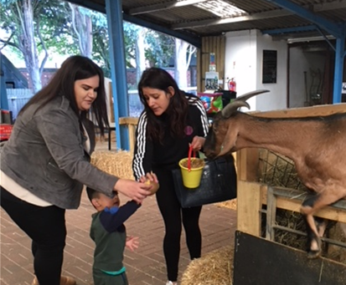
Coventry
Building connection and trust with leaving care workers/PAs
e.
Bright Spot of
practice
Why? When developing YLBC survey care leavers stressed importance of leaving care workers being easy to get hold of and someone you can trust.
June 2020
What?
Local authority have invested in, and actively encourage, the use of social media: e.g. PAs use WhatsApp, Instagram; Leaving Care service Facebook page; care leaver apprentice develops social media links.
LA Ethos - catch ups/interactions used as opportunities to check out how young people are feeling.
PAs act like parent and catch up/spend time as opposed to conduct statutory visit
PAs have purchase card to pay for e.g. coffee/meal or gift to celebrate success.
YLBC survey in lockdown opportunity to check in/discuss issues raised.
Impact: Higher % of care leavers trusted PA ‘all or most of the time’ (86% vs 78%) and felt they could easily get in touch with their PAs (79% vs 71%) than in other LAs
Notes:
Case study for presentations or online video

Slide 52
Improve connections and relationships
Support emotional well-being and mental health
Provide money management and financial support
Notes:
Recommendation
Pay particular attention to the specific areas care leavers highlight locally, as well as the ten key issues we find are associated with well-being, i.e.
Improve connections and relationships (to develop friendships, trusting supportive relationships and addressing loneliness);
Provide emotional and mental health support (to address stress, high negativity and low positivity and help care leavers feel good about their future);
Provide money management and financial support (to support care leavers to cope financially);
Improve accommodation support (to help care leavers feel

Slide 53

Sheffield
‘Reality Cheque’
e.
Why? Bright Spots finding: Care leavers 3 x more likely to struggle financially than general population.
June 2020
What?
Care leavers’ ‘Reality Cheque’ project: corporate parents living on average weekly budget for CL
Challenge pack & rules: £24 for 5 days & share progress through social media
Encouraged to send in budget recipes → recipe book for care leavers
Impact: 90+ people took part (incl. DCS); local press attention; raised the profile of care leavers’ money worries & new ideas about what more can be done; Other local authorities want to run in their areas.
Read more: https://bit.ly/2YRJ3NG
Notes:
Case study for presentations or online video

Slide 54
Improve connections and relationships
Support emotional well-being and mental health
Provide money management and financial support
Improve accommodation support
Notes:
Recommendation
Pay particular attention to the specific areas care leavers highlight locally, as well as the ten key issues we find are associated with well-being, i.e.
Improve connections and relationships (to develop friendships, trusting supportive relationships and addressing loneliness);
Provide emotional and mental health support (to address stress, high negativity and low positivity and help care leavers feel good about their future);
Provide money management and financial support (to support care leavers to cope financially);
Improve accommodation support (to help care leavers feel

Slide 55

Isle of Wight
Involving care leavers in commissioning new supported living accommodation
Why? Some care leavers report they feel unsafe or unsettled where they live & that it is not right for them.
June 2020
What?
1-year process getting care leavers involved in commissioning process & ensure fit for purpose
Questions included in the tender application form for tender written by young people.
information session for providers co-hosted by young people
Young people helped to score applications
“It blew their mind that they were able to have an input into something at a strategic level.” Participation worker
Impact: Demonstrates that it is possible to involve young people complex decision-making. For those young people involved they felt listened to and increased confidence.
Available to download on https://coramvoice.org.uk/for-professionals/bright-spots-2/how-to-make-life-good/
Notes:
Case study for presentations or online video

Slide 56
Impact
Questions, comments and reflections?

Slide 57
What makes life good? Care leavers views on their well-being
Summary and next steps

Slide 58
Ongoing analysis
Exploring LA variation in low and very high wellbeing
Children’s views on contact with their families
Age group | Number | Minority ethnicity | Percentage completed after lockdown | Number of comments on What would make care/being a care leaver better
4-7yrs | 1, 483 | 17% | 6% | 292
8-10yrs | 2,426 | 28% | 8% | 453
11-18yrs | 5,645 | 37% | 12% | 3,500
Total | 9,554
Care leavers 18-25yrs | 4,365 | 35% | 53% | 4,000

Slide 59
Messages for the care review
‘will children in care and care leavers feel that their lives got better as a result?’
When developing policy and practice in the care system, the key question should be
Questions to consider - How can the care system:
  Build rather than break trusting, supportive relationships?
  Involve children & young people in decisions about their lives and ensure they understand the system & why they are there?
  Help them manage the challenges in their lives and give them opportunities to learn and enjoy life? – be mindful of cliff edge of care for care leavers
  Support them to feel better about themselves & their futures? – be mindful of needs of particular groups e.g. disabilities & long term health problems.

Slide 60

Find out more about the Bright Spots programme and read more about what we do on our website
www.coramvoice.org.uk/brightspots
brightspots@coramvoice.org.uk

