Slide 1


What the research suggests might be the most effective use of the Pupil Premium (Plus) for improving educational outcomes of looked after children
Judy Sebba
Rees Centre for Research in Fostering and Education
University of Oxford Department of Education
Judy.sebba@education.ox.ac.uk

Slide 2
What I will cover
The aims of the Rees Centre
Context for looked after children in England
What does the evidence tell us about possible effective use use of Pupil Premium (Plus) for looked after children?
International research
Rees Centre research
What schools and other services can do to progress this

Slide 3
Rees Centre for Research in Fostering and Education
The Rees Centre aims to:
identify what works to improve the outcomes and life chances of children and young people in foster care
We are doing this by:
reviewing existing research in order to make better use of current evidence
conducting new research to address gaps
working with service users to identify research priorities and translate research messages into practice
employing foster carers and care experienced young people as co-researchers
Centre is funded by the Core Assets Group but as grants from a range of other funders

Slide 4
Provision for children in care in England
68,110 children in care;
50,260 (75%) in foster care, 6% are in kinship care;
9% in children’s homes, secure units & hostels;
4% placed for adoption;
12% other includes residential (special) schools;
32% fostered children placed outside of their area;
39% of fostered children are placed by independent providers;
Virtual school function is statutory, Pupil Premium Plus of £1900.

Slide 5
Some outcomes of children in care in England
15% achieve expected grades at 16 years compared to 58% of all children – a gap of 43%;
achievement gap is lower at KS2 (26% for Maths, 23% reading, 28% writing);
Two times as likely to be permanently excluded;
Three times as likely to have a fixed term exclusion;
Only 8% access HE compared to > 50% of general population;
educational experiences and outcomes contribute to later health, employment (22% unemployment rate), involvement in crime (27% of those in prison).
DfE (2013) Statistical First Release 11 Dec 2013

Slide 6
The longer in care, the better the performance (source DfE, 2013)
11

Slide 7
The fewer changes in placement, the better the performance (source DfE, 2013)
10

Slide 8
Pupil Premium Plus
From 2014, LAC are eligible if looked after on the date of the local authority census (March each year);
Schools have a responsibility to ensure that the money has a positive impact on the child’s learning;
Ofsted requirement that schools evidence how PPP was spent and how it has benefited LAC;
Virtual School Head is responsible for allocation of Pupil Premium Plus in practice;
If the child’s education is at direct LA expense (e.g. permanently excluded to a PRU or in a ‘private’ education provision), LA deploys PPP as it sees fit.

Slide 9
Designated Teachers
Designated Teacher for CLA should:
    know and understand the child’s legal status and dates of any change;
    know which local authority the child is in the care of and thereby responsible;
    know who their local Virtual School Head is and how they can be contacted;
    take the lead in monitoring the child’s targets in the PEP, and implementing any actions;
    tracks the spend of pupil premium for CLA within the broader pupil premium cohort but not at the level of individual children.

Slide 10
What does the international research evidence tell us about improving educational outcomes?
Some foster carer training in behaviour (e.g. Fostering Changes, Briskman & Scott 2012) improve education outcomes;
Flynn et al. (2012) reported enhanced sentence comprehension and reading outcomes when carers undertook 2.5 hours reading activities a week;
Osborne et al. (2010) - improvements in reading using paired reading with foster carers and primary school children;
Points of transition e.g. school transfer, are particularly problematic for children in care (Berridge, 2012);
Mentors, maximizing placement and school stability, aggressively pursuing educational supports, and treating mental health problems that may act as barriers to classroom success (Pecora et al, 2012).

Slide 11
    What are the risk and protective variables for the education of children in care? Aoife O’Higgins
32 studies from US, England & Canada:
Pre-care experiences such as maltreatment have an important role to play but children in care continue to have lower educational outcomes independently of other factors;
Early experiences of maltreatment/neglect, poverty before entering care, length of time in care, age of entry into care and school and placement stability can all have a negative effect on educational outcomes;
Caregiver characteristics were identified as protective variables, in particular aspirations, home-based involvement and support of the caregiver.

Slide 12
The Educational Progress of Looked After Children in England: funded by the Nuffield Foundation
Research questions:
What are the key factors contributing to the low educational outcomes of children in care in secondary schools in England?
How does linking care and educational data contribute to our understanding of how to improve their attainment and progress?

Slide 13
Questions that are being addressed
  What are the links between individual characteristics (e.g. gender, SEN) and educational outcomes?
  What factors contribute to any association between placement stability, school stability and higher attainment?
  Is any link between length of time in care and higher attainment explained by the reasons for entry into care or age of admission?
  Are issues linked with transfer from primary to secondary school or does widening of the gap occur gradually over time?
  How do foster carers’ characteristics (e.g. aspirations) influence educational outcomes?
  What can LAs, schools (DTs), Virtual Schools, social workers or foster carers do to improve attainment and progress?
  What difference can the relationship between services make to outcomes (fragmentation of services is a key issue)?

Slide 14
The Educational Progress of Looked After Children in England
How we are doing this?
Linking national data sets on the education (NPD) and care experiences of these children in England (SSDA903)
  to explore the relationship between educational outcomes, the children’s care histories and individual characteristics, and practice and policy in different local authorities
Interviews with 36 children in six local authorities and with their carers, teachers, social workers and Virtual School staff
  to complement and expand on the statistical analyses, and to explore factors not recorded in the databases (e.g. foster carers’ attitudes to education, role of the Virtual School)

Slide 15
Leeds has significantly improved LAC outcomes
Systemic approach with all schools;
1-to-1, trained teacher, in the pupils home, outside the school day
  Supplements and support learning but doesn’t replace it
  The tutored cohort annually out-perform their non-tutored peers at KS2 and KS4
  Engages carer with learning
Also use Letterbox Club (Years 3, 5 and 7), mentoring (less effective but cheaper).

Slide 16
What can schools and fostering services do to improve outcomes?
School can provide stability, a safe place in a turbulent world, an opportunity to excel, and a route out of their difficulties into a more positive future;
School success can affect placement stability & vice versa (Sinclair et al, 2005). Do schools reach out to foster carers/residential workers? 40% do not attend parents’ evenings;
Positive aspects of ordinary care predisposes LAC to benefit from interventions targeted at improving mental health;
High quality teaching benefits most pupils, those receiving PP(P) especially so. Every teacher has a responsibility
http://educationendowmentfoundation.org.uk/toolkit/

Slide 17
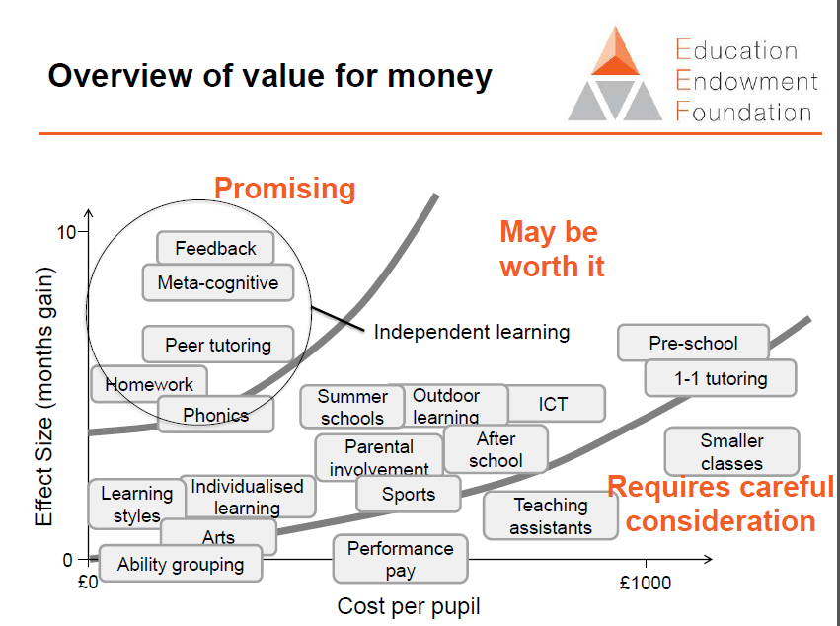

Slide 18
What can schools and fostering services do to improve outcomes?
Ofsted (2012) evaluation of the impact of virtual schools, noted that the best PEPs had a sharp focus on educational attainment taking into account behavioural, social and emotional needs.
But are the ways we work together (or don’t) more important than written plans? Improve social workers’ understanding of the child’s education needs and teachers’ understanding of safeguarding, attachment etc and both of foster carers’ role?
The strategies with the strongest evidence base are tutoring (by carers or others), mentoring and supporting carers to support education – the PPP enables all three to be done.
Listen to young people in care – not stereotyping, support and not identifying them as in care – see http:www.youtube.comwatchv=DNlZt_6zsEU&feature=youtu.be

Slide 19
How you can be involved
Express interest in being involved in future possible research projects;
Come along to lectures & seminars;
Join our mailing list and receive newsletters 5 times/year rees.centre@education.ox.ac.uk;
Web - http://reescentre.education.ox.ac.uk/;
Comment on our blog – or write for us;
Follow us on Twitter - @ReesCentre

Slide 20
References
Berridge, D., 2012. Educating young people in care: What have we learned? Children and Youth Services Review, 34(6), pp.1171–1175.
Briskman, J. & Scott, S.(2012). RCT of the Fostering Changes Programme, The National Academy for Parenting Research, Report for DfE.
DfE (2011) Raising the aspirations and educational outcomes of looked after children: a data tool for local authorities. http://www.education.gov.uk/childrenandyoungpeople/families/childrenincare/a00192332/
DfE (2012) Statistical First Release. London, DfE. https://www.gov.uk/government/uploads/system/uploads/attachment_data/file/191969/SFR32_2012Text.pdf
Flynn, R., et al.(2012) Effects of individual direct-instruction tutoring on foster children's academic skills: A RCT. Children & Youth Services Review 34, 1183-1189
Ofsted (2012) The impact of virtual schools on the educational progress of looked after children www.ofsted.gov.uk/resources/120165
Osborne, C., Alfano, J. and Winn, T (2010) Paired reading as a literacy intervention for foster children. Adoption and Fostering, 34, 4, 17-26
Pecora, P. et al. (2012) Maximizing educational achievement of youth in foster care and alumni: Factors associated with success. Children and Youth Services Review, 34(6), 1121–1129.
Sinclair, I., Wilson, K. & Gibbs, I. (2005) Foster Placements: Why they succeed and why they fail. London: Jessica Kingsley Publications

