Slide 1



The subjective well-being of children in care and care leavers
Professor Julie Selwyn, The Rees Centre, Department of Education, University of Oxford, julie.selwyn@education.ox.ac.uk

Slide 2

Children and young people as ‘experts’ in their lives

Slide 3

What makes life good? Care leavers views on their well-being
History & Development

Slide 4

The ‘Your Life Your Care’ and ‘Your Life Beyond Care’ Surveys
Began in 2013 when we were asked to identify the geographical areas where children had a good care journey, identify how (Bright spots) and disseminate to other regions. Could not answer the research question.
  Aims of care system – protect child from further harm, address a child’s needs for good parenting, improve their outcomes and enable them to recover from trauma
  But national data focused on process issues with some broad objective (mainly negative) outcome measures
  No data collected systematically on how children feel they are doing
  In 2022-23, £10 billion spent by government on children in care - no indicators that measure efficacy of care system.

Slide 5

Method
International literature review
Round table of professionals
21 focus groups with 140 children in care from 9 different areas asking ‘What makes a good life?’
Individual interviews with children with a disability and with asylum seeking young people.
Method repeated for the development of the Care Leaver survey

Slide 6
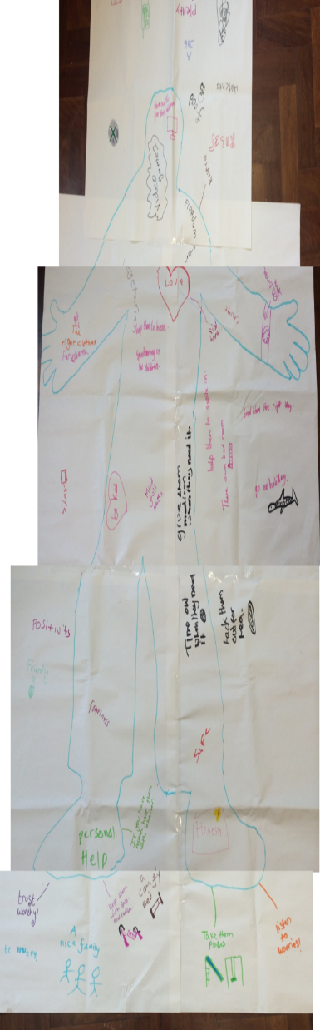
Children in care: what did we find?
Good relationships with family, friends, sws and carers,
Trust
Positive sense of self and positive view of being in care
Creativity, play, access to the natural world
Opportunities-care for pets, to be trusted and given responsibility
Helping others, faith, purpose in life
Physically & mentally healthy, support dealing with adversity
Nurtured, loved, belonging
Life satisfaction, enjoyment, joy, happiness, life getting better
Support for learning, learning life skills
Security & safety, free from bullying & abuse
Autonomy, choices in own life , feeling included ( UNCRC Article 12 &13)

Slide 7


On-line surveys
Three confidential on-line surveys created : 4-7yrs, 8-10yrs, 11-18yrs. A Care Leaver survey was added later
Four key themes: relationships, rights, resilience, recovery
Questions on well-being for comparison with general population data
Are children flourishing in care?
Subjective well-being chosen as our theoretical framework. Allowed us to examine a basket of indicators that make up well-being. SWB defined as: “feeling good and functioning well at an individual and interpersonal level”.
Piloted in schools with 85 children in care

Slide 8
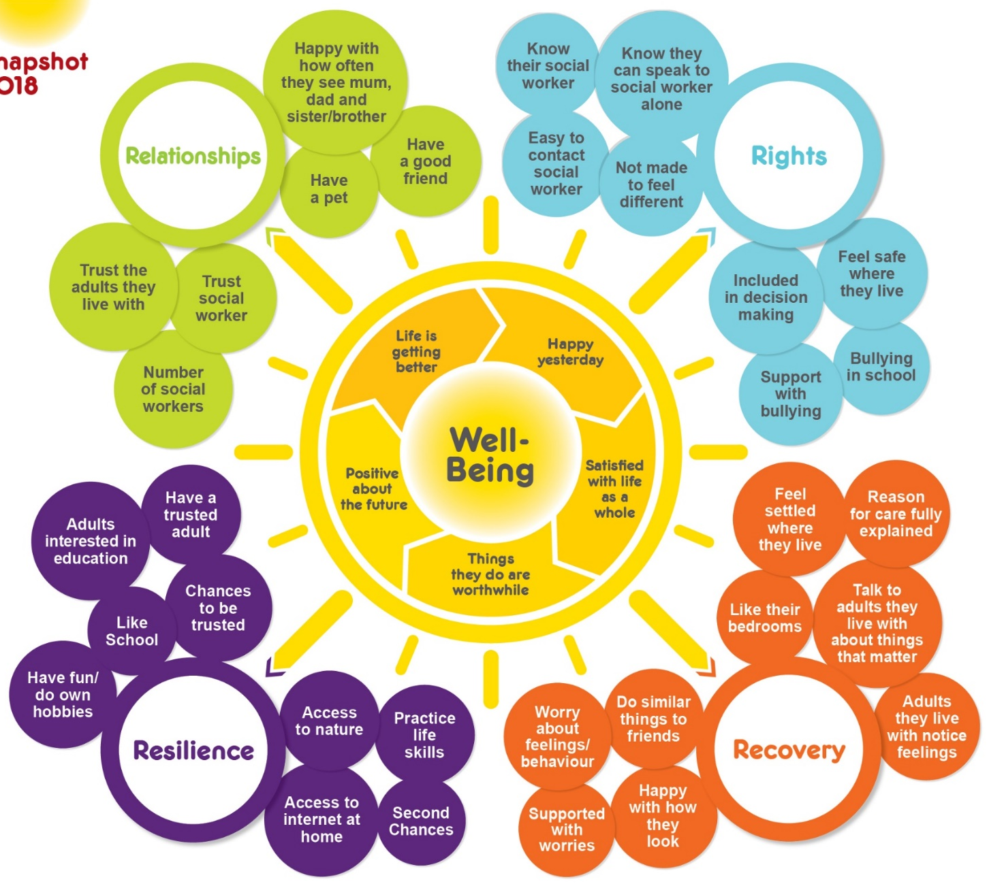
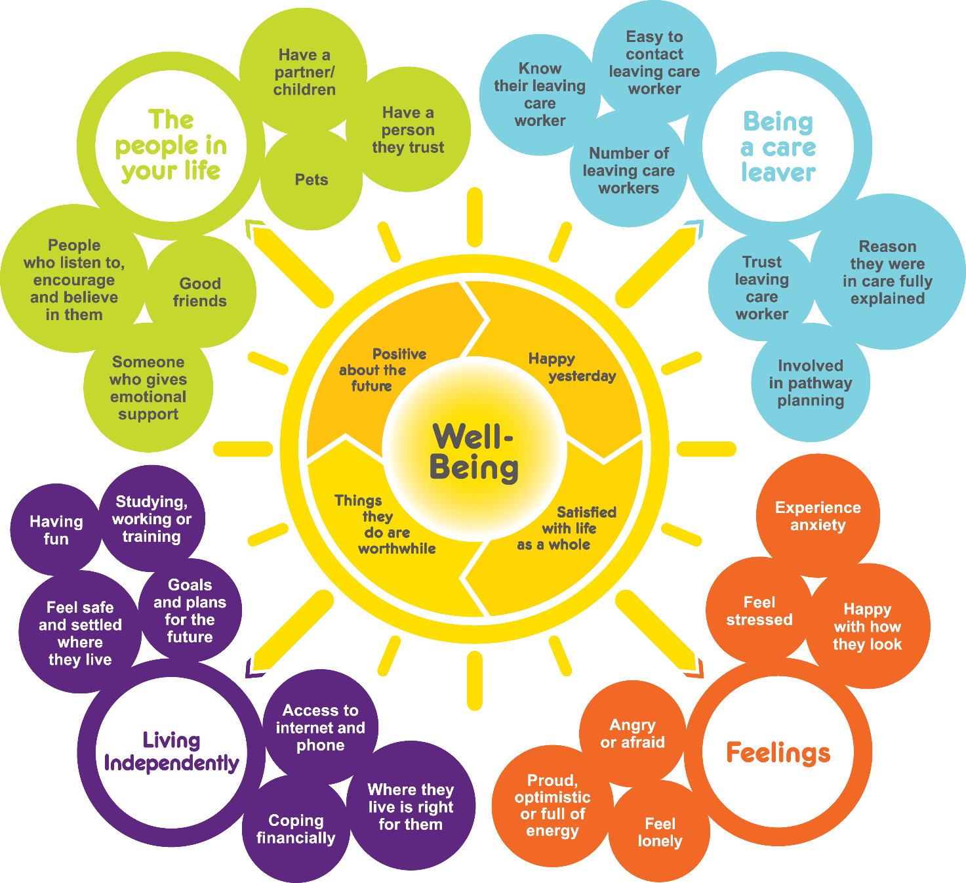
Bright Spots domains and indicators of well-being
Your Life Beyond Care
Your Life Your Care
Notes:
Here are the Bright Spots well-being indicators produced with children in care
Based on what they say matters to their well-being
Being in care
Your feelings
People you know
Chances you have to do things
Some of the questions are the same questions used in surveys to the general population – this lets us directly compare how children in care are doing compared to children in general population.
Lots of things in survey be familiar e.g. how involved feel in decision making – whether they have stable placements and workers.
Trust was a really core issues for children in care and we ask about whether they have an adult they can trust, trust social worker and their carers, as well as whether they get opportunities to be trusted.
Some of the areas included are ones that children said were important to them but they may not be areas that services regularly look at
e.g. pets – children said they were important – they love you unconditionally, they don’t judge you – they can teach you things like responsibility but as services do we acknowledge their importance to some children e.g. when children have moved placements and left a pet behind have we asked about this ? For children who want a pet but do not have one – has anyone explored other options ? For example in one LA who undertook the survey some of those living in children’ home would like a pet – staff have taken own dog in to meet children and manager looking at whether home could get a children home dog of own
Friends – really important to all of us – including children – in the care leaver survey results in other LAs friends are often the top source of emotional support once children leave care – but as services do we support children to maintain / strengthen friendships – and recognise their importance?
Reason
TAKE COPIES OF SNAPSHOT WITH YOU? If there copies on table then tell people to look inside red booklet and can see poster with the indicators
Encourage people to look closely at the areas – now going to look at how your children in East Sussex doing in relation to these well-being indicators

Slide 9
What makes life good? Care leavers views on their well-being
Research findings

Slide 10

2015
55
local authorities
15,249*
2021
* Total number of responses collected, incl surveys not yet closed
Notes:
Over the past ﬁve years, we have sought to address this gap by collecting over 14,000 care experienced voices through our Your Life, Your Care and Your Life Beyond Care surveys.
These ‘voices’ give an unprecedented insight into children in care and care leavers’ subjective well-being. The surveys were developed together with almost 200 children and young people as part of the Bright Spots programme, a partnership between Coram Voice and the University of Oxford.

Slide 11
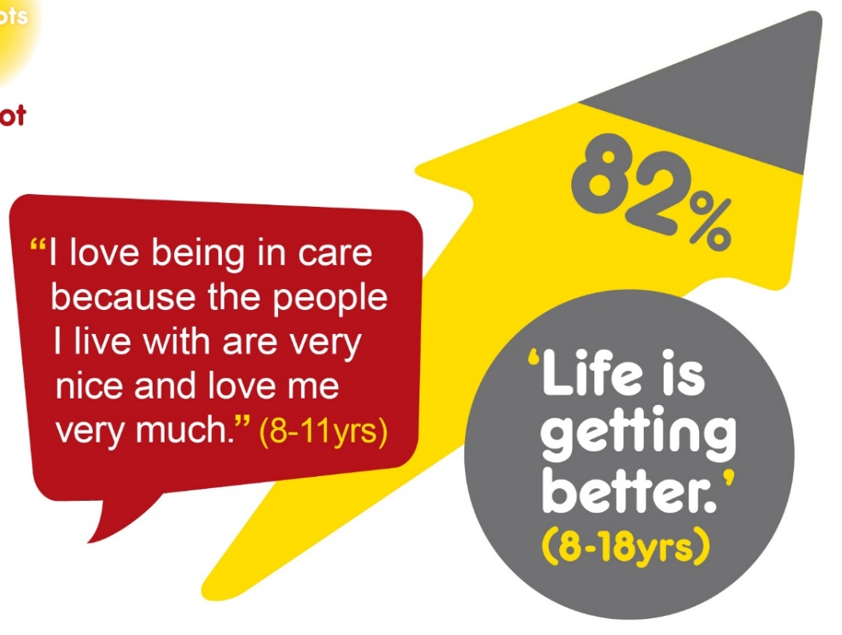
Many children in care are positive about their lives

Slide 12
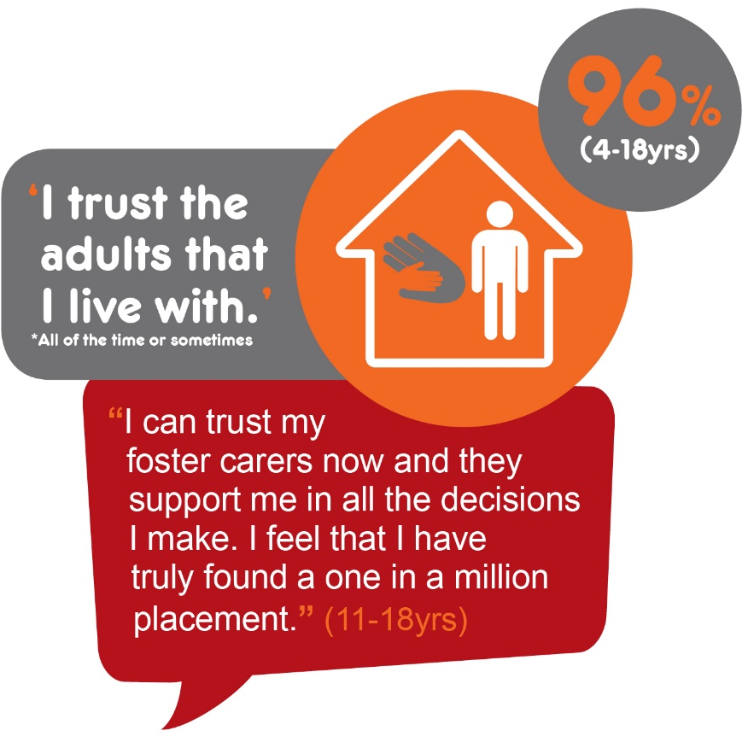
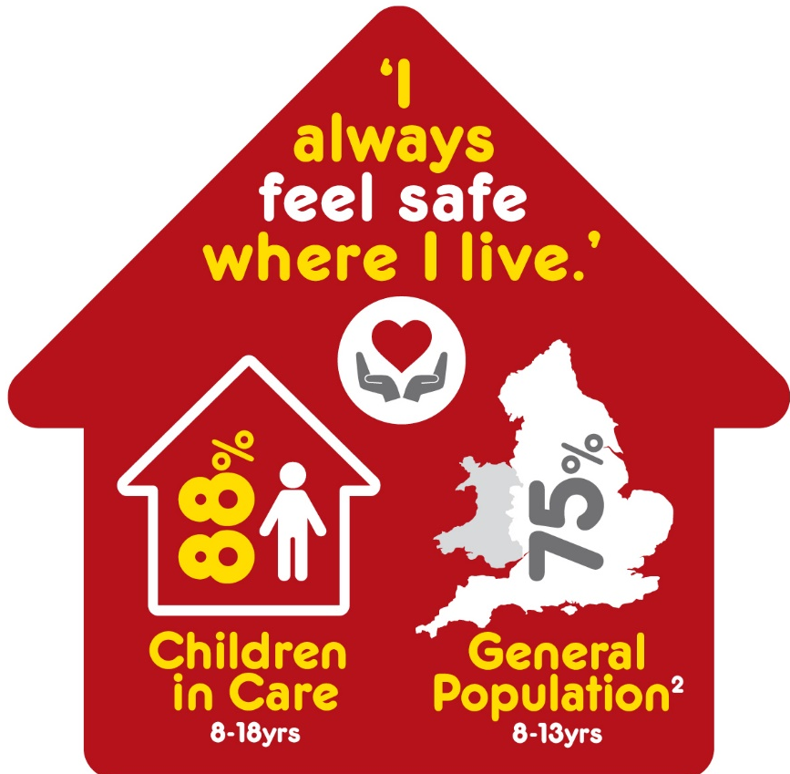
Compared with the general population a higher percentage of children in care felt safe where they lived.
My foster cares
rear me like their own daughter in the family which is really nice because I feel safe
(11-18yrs)
The majority of children in care trusted their carers

Slide 13

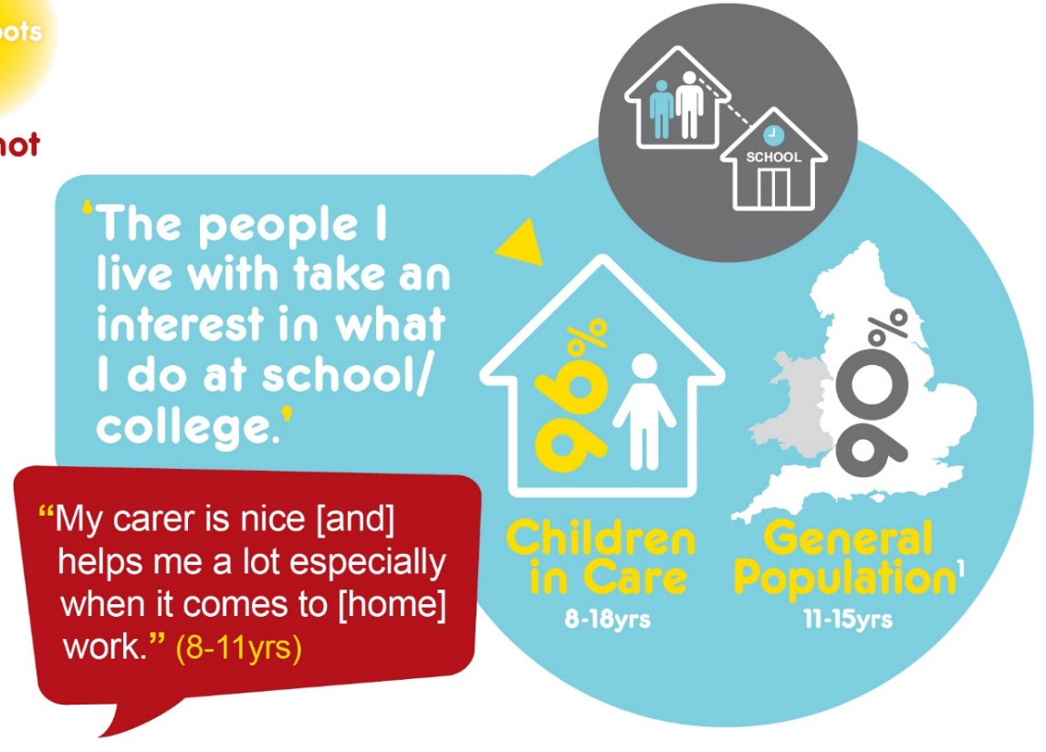
School and support with learning
In comparison to young people in the general population, more boys liked school; and more children in care felt that their carers were interested in what they were doing in school.

Slide 14
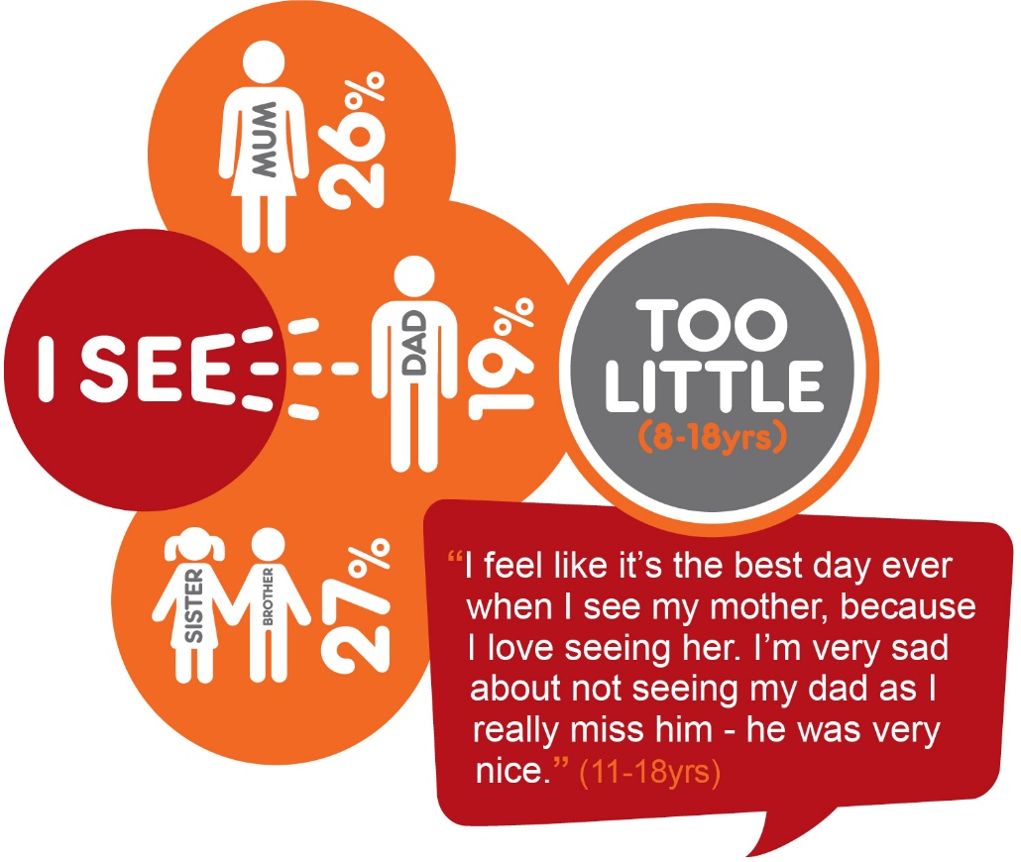
Relationships – important people in your life
Contact with family is among the most common issues raised in the survey.
It’s sad because I only
get to see my mum a little.
I miss my dad too. (4-7 yrs)
Mum and
dad are a
waste of space,
useless.
(11-18yrs)
I would like to see my family for longer than the 2 hours at a time. Ideally I would like to see them for a whole day.
(8-11yrs)
Being friendless was associated with moves in care and not having access to a computer/tablet outside of school.
They don’t let u go on the internet or go and see your friends (11-18yrs)

Slide 15
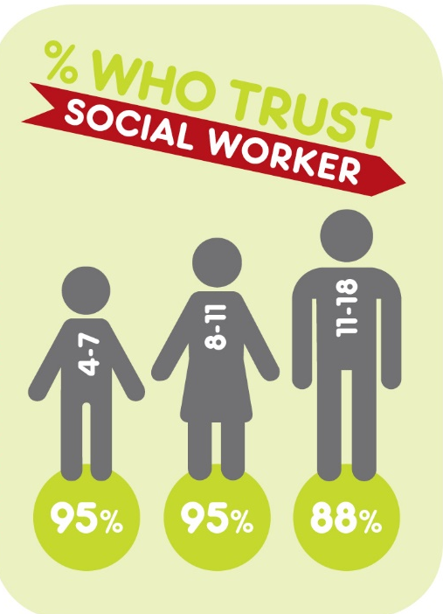
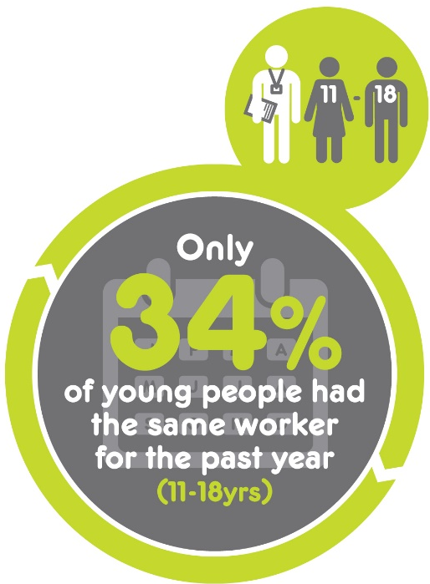
Relationship with social workers
I think that social workers shouldn’t move around as much because they just get to know your life story and you have to try to trust them but how can you trust them when you don’t even know them or have hardly ever met them?
(11-18yrs)
Statistically signiﬁcant association with lack of trust and having had three or more social workers.

Slide 16
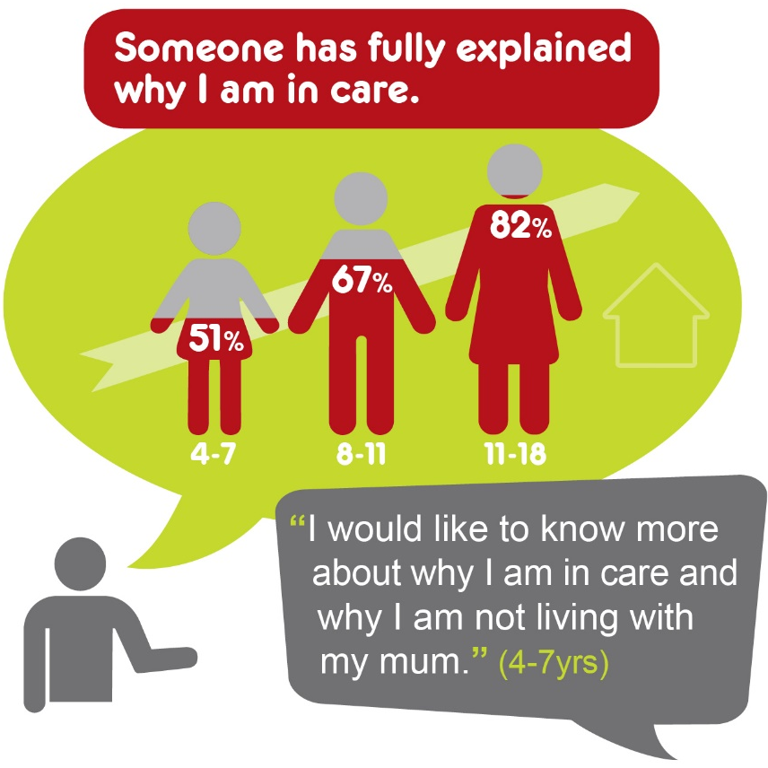
Understanding reason for being in care
.
I would like someone to talk to about my feelings and tell me about my past. I would like to see a picture of my dad so I know what he looks like. I would like to see a picture of me as a baby. I have never seen a picture of me. I have a lot of questions that no-one answers.
(11-18yrs)

Slide 17
97%
had moderate to high well-being
96%
had moderate to high well-being
82%
had moderate to high well-being
I would like to
know for absolutely certain that I will
always stay with mummy (foster carer). I love her and she loves me.
(4-7 yr old)
I wouldn’t
change anything
except not having
to eat avocados
and courgettes.
(8-11 yr old)
Being in care is
the best thing that has happened to me. So many amazing opportunities have opened… like my attendance
is significantly improved and
I have so much support around me. I am
very happy.
(11-18 yr old)

Slide 18
97%
had moderate to high well-being
96%
had moderate to high well-being
82%
had moderate to high well-being
Of those with low well-being:
Didn’t feel why they were in care had been explained
Did not know social worker.
Felt unsettled, didn’t trust carers or feel they noticed their feelings
Did not have good friend
Those with low well-being tended to
Not feel safe or settled in their placements.
Not have a trusted adult
Not trust their social worker
Not feel included in decision-making.
Not have a good friend.
Associated with low well-being
Unhappy with appearance
Not given opportunity to be trusted
Not like bedrooms or feel safe in placements
Not have a trusted adult
Not feel included in decision making
Not like school
Afraid of going to school due to bullying
Not taught life skills

Slide 19
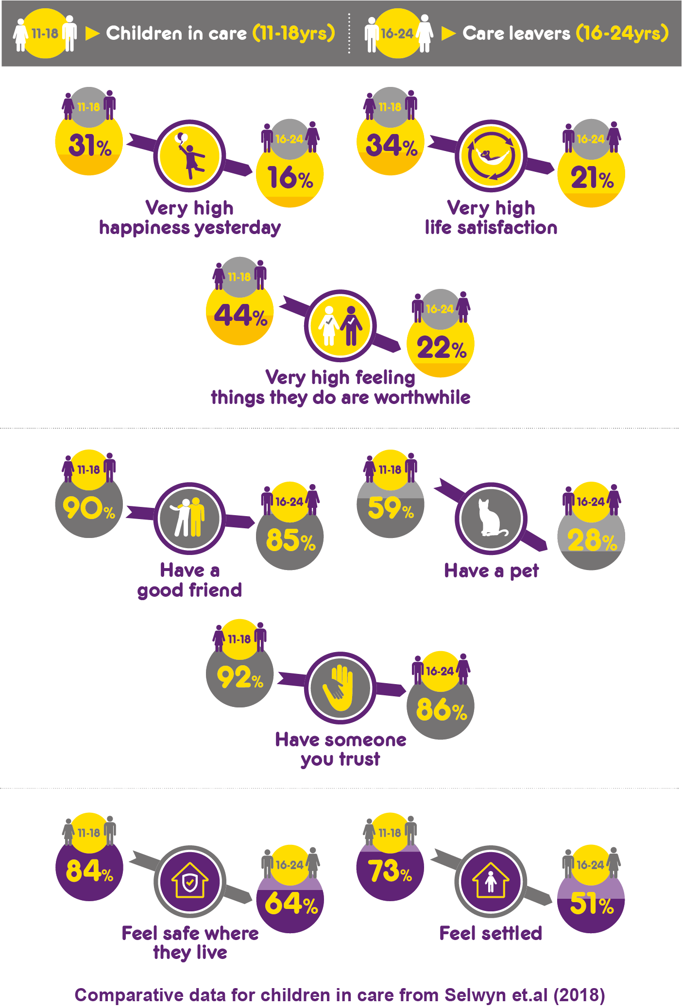
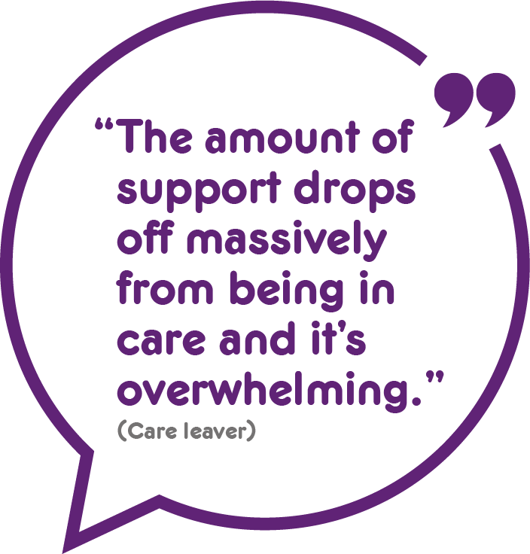
There was a steep decline in well-being when young people left care.
We found that compared with children in care a higher percentage of care leavers felt unhappy, unsafe and unsettled where they lived.

Slide 20
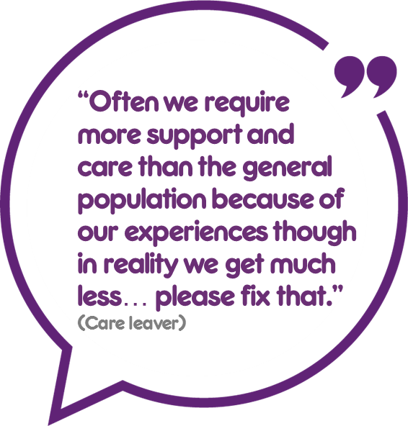
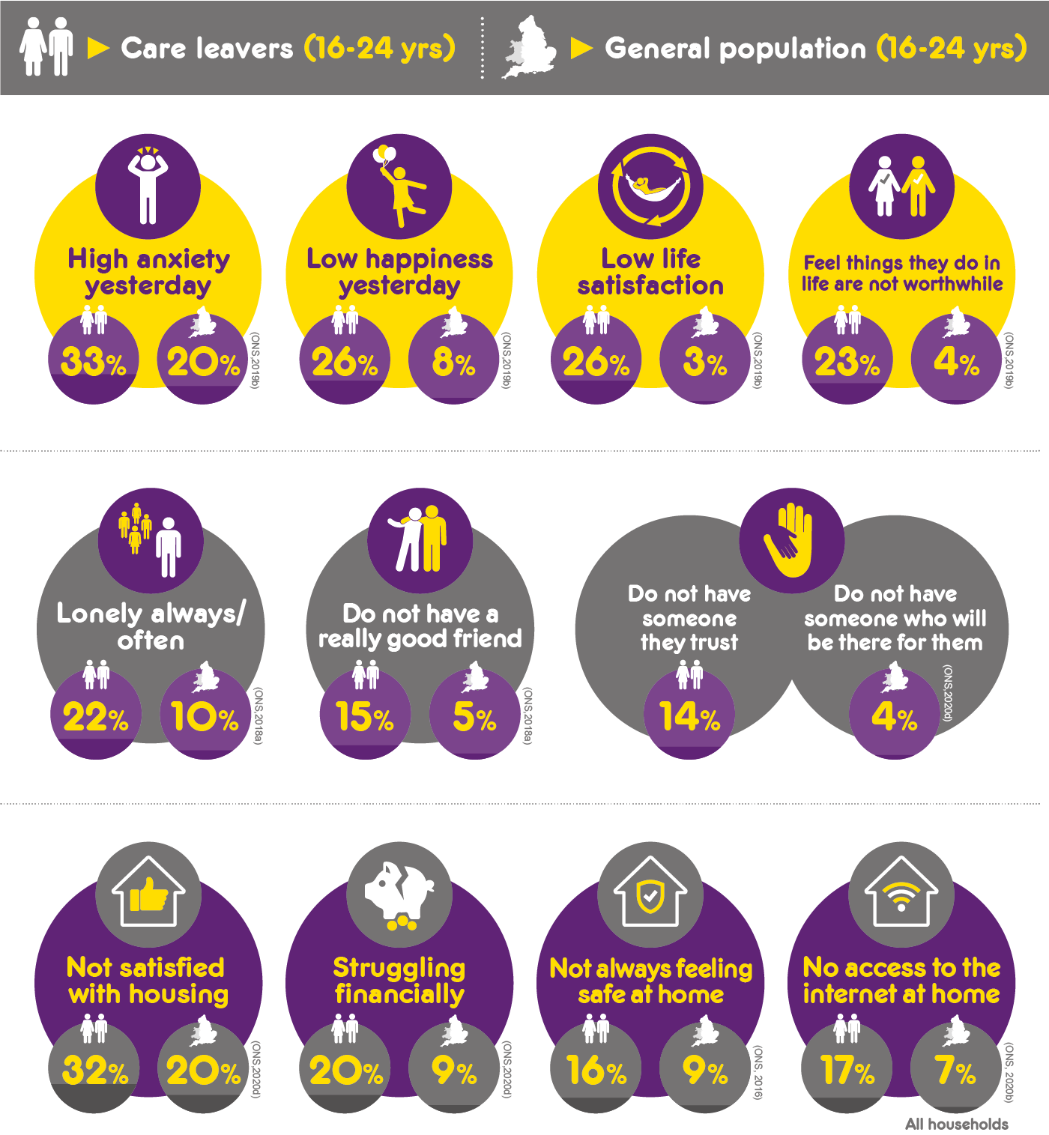
Care leavers did worse than the general population on a range of measures.
For example, more care leavers had higher anxiety, lower life satisfaction, felt lonely and were less likely to have trusted supportive people in their lives
Notes:
Many care leavers do worse than young people in the general population – experience higher anxiety, feel unhappy, dissatisfied with life and that the things they do in their life are not worthwhile.

Slide 21
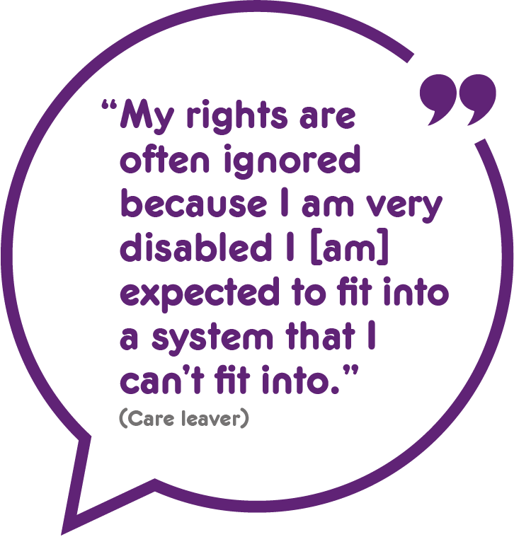
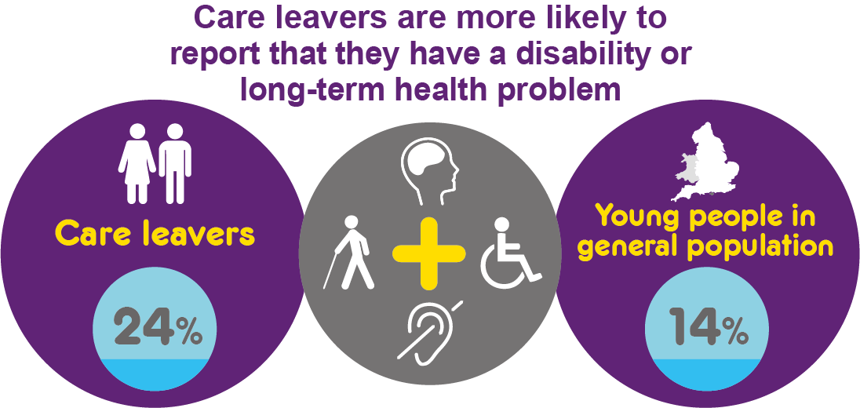
Care leavers who reported that they had a disability or long-term health problem were particularly vulnerable.
They had lower well-being and were lonelier and less likely to have goals and plans for the future. Compared with other care leavers fewer felt safe and settled where they lived and more struggled financially.

Slide 22
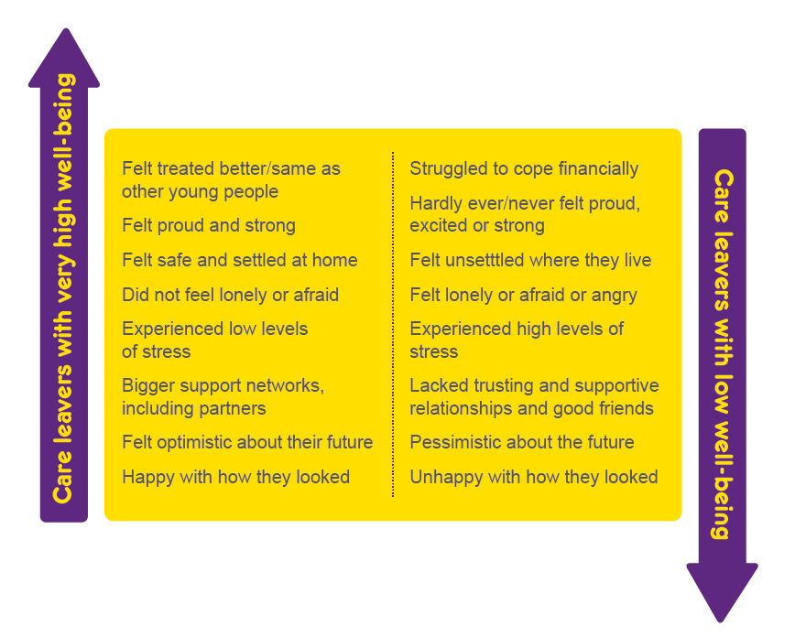
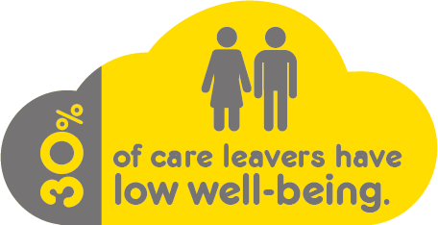
Overall, although a majority of care leavers had moderate to high well-being 30% had low well-being.
Our analysis identified the factors associated with high and low well-being.

Slide 23
Shift in emphasis onto children and young people’s priorities
Are services focusing on what children and young people say is important?
Do children in care and care leavers feel that their lives improved as a result?

Slide 24


Isle of Wight
Community allotment
Why? Access to nature + hobbies & activities can reduce stress & improve well-being; gardening beneficial for mental health.
June 2020
What?
Can be used by all children in care & care leavers
Rent free, materials & plants raised through community fundraising
LA offers award in Horticulture
Accessible: Raised beds for Wheelchairs.
“It’s a lovely space. It’s a wonderful place.”
Leaving care team leader
Next?
therapeutic mental health group
‘shed project’ learn to make things from wood and pallets
Impact: “It’s a place to go where you can socialise, you can learn. It’s a community allotment, so it offers young people the opportunity to meet other people and learn from them.” (Leaving care team leader)
Notes:
Case study for presentations or online video

Slide 25

Sheffield
‘Reality Cheque’
e.
Why? Bright Spots finding: Care leavers 3 x more likely to struggle financially than general population.
June 2020
What?
Care leavers’ ‘Reality Cheque’ project: corporate parents living on average weekly budget for CL
Challenge pack & rules: £24 for 5 days & share progress through social media
Encouraged to send in budget recipes → recipe book for care leavers
Impact: 90+ people took part (incl. DCS); local press attention; raised the profile of care leavers’ money worries & new ideas about what more can be done; Other local authorities want to run in their areas.
Read more: https://bit.ly/2YRJ3NG
Notes:
Case study for presentations or online video

Slide 26
Questions, comments and reflections?

Slide 27
Questions?
Have your services identified what is important for children & care leavers (well-being indicators)?
Thinking about what you heard today…what does it mean for you & your practice?
How might wellbeing be different in your country?

Slide 28

Find out more about the Bright Spots programme https://coramvoice.org.uk/bright-spots-programme/
Findings and practice examples are available here
https://coramvoice.org.uk/resource-library/brightspots/

