Slide 1
Dr Tom Sinclair, Associate professor, Philosophy, Wadham college The environment: philosophical dimensions
5. The value of species / ecologies / biodiversity
6. Climate justice 7. Individual responsibility and collective impact 8. Geoengineering & the ethics of risk 9. The politics of environmentalism
1. The value of nature 2. Nature and morality 3. Future generations and the non-identity problem 4. The beauty and the appreciation of nature

Slide 2
religion, ecology, education
Dr Kate Christopher
Rebecca ostler
Matt pitcher

Slide 3
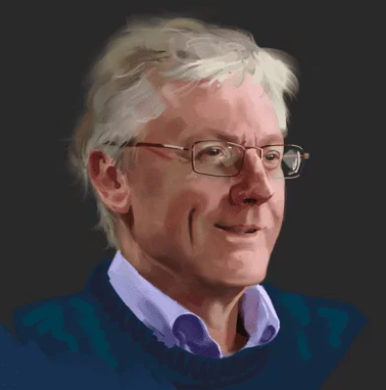
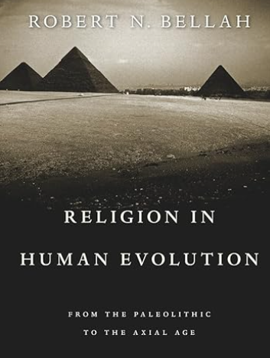
Religion, Ecology and education
Axial Age
800 BE to 300 BCE: a new universalist ethical, communal, spiritual era
Greek philosophy, Jewish monotheism, Hindu Dharma, Buddhist Dhamma, Chinese Dao
In the Axial Age…‘social criticism is combined with religious criticism’
(Bellah, 2011: 577).
Mike Hulme – Professor Mike Hulme's Site
Mythos: stories, myth, narrative, metaphor
Logos: precision, logic, accuracy
(Karen Armstrong, 2000, The Battle for God)

Slide 4
Rebecca Ostler What can we learn by listening to other species? (KS2)
Shifting Baseline Syndrome: Natalia Zielonka and Simon Butler
Rebecca Solnit: Ten ways to confront the climate crisis without losing hope | Climate crisis | The Guardian
“We say that humans have the least experience with how to live and thus the most to learn – we must look to our teachers among the other species for guidance.”
Robin Wall Kimmerer, Braiding Sweetgrass, 2020: p. 9
At School:
Meat- free Mondays
Trips→ wildlife scavenger hunt on a History trip
Links in the news
Spirited Arts → Eco arts
Eco poetry: what is a river?

Slide 5
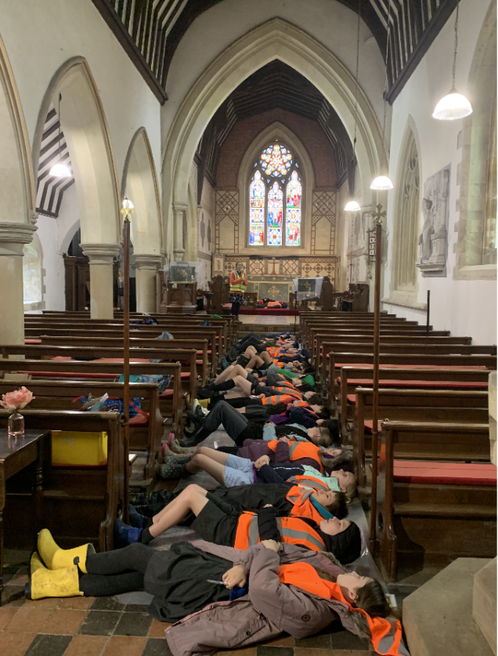

Slide 6
Matt Pitcher whose world it is? Who cares?(KS3)
Areas of Enquiry
Stewardship
Climate crisis
Local: New Forest, Eco Church, school and church links
Global: Christian Aid and climate justice, Buddhism and the global environment.
National: religious groups within XR, faith principles and activism

