Slide 2
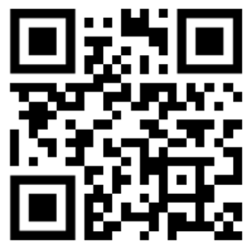
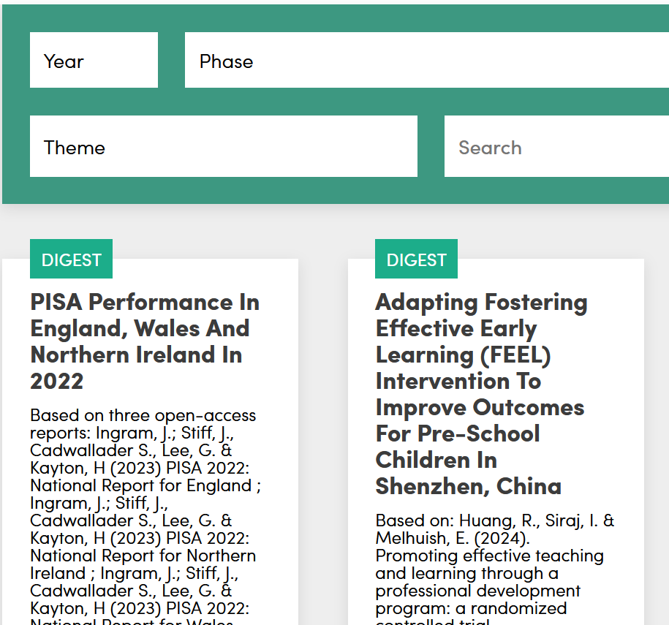
Explore our site
Visit: bit.ly/OxEduDeanery
Digests of research
Resource Packs
Podcast

Slide 3
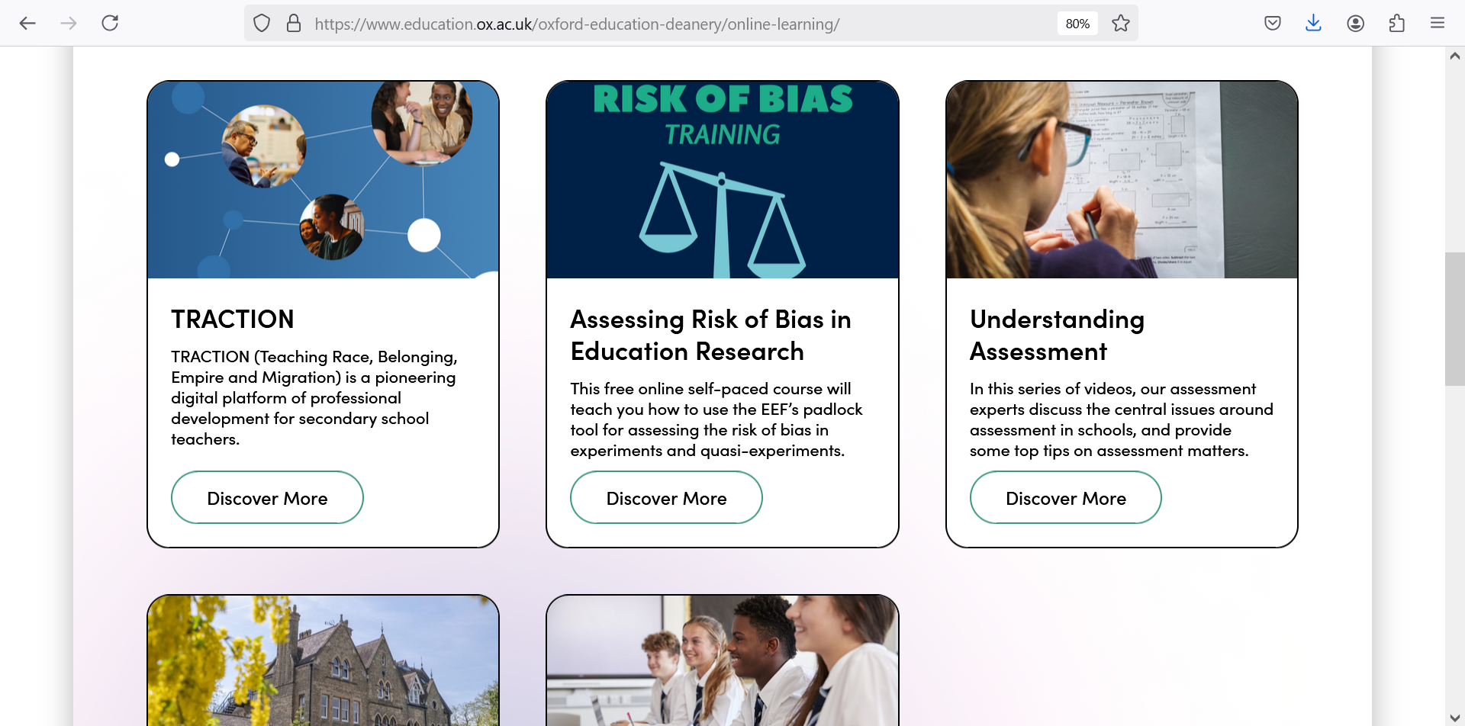
Deanery Online Learning

Slide 4
Upcoming Events

Slide 5
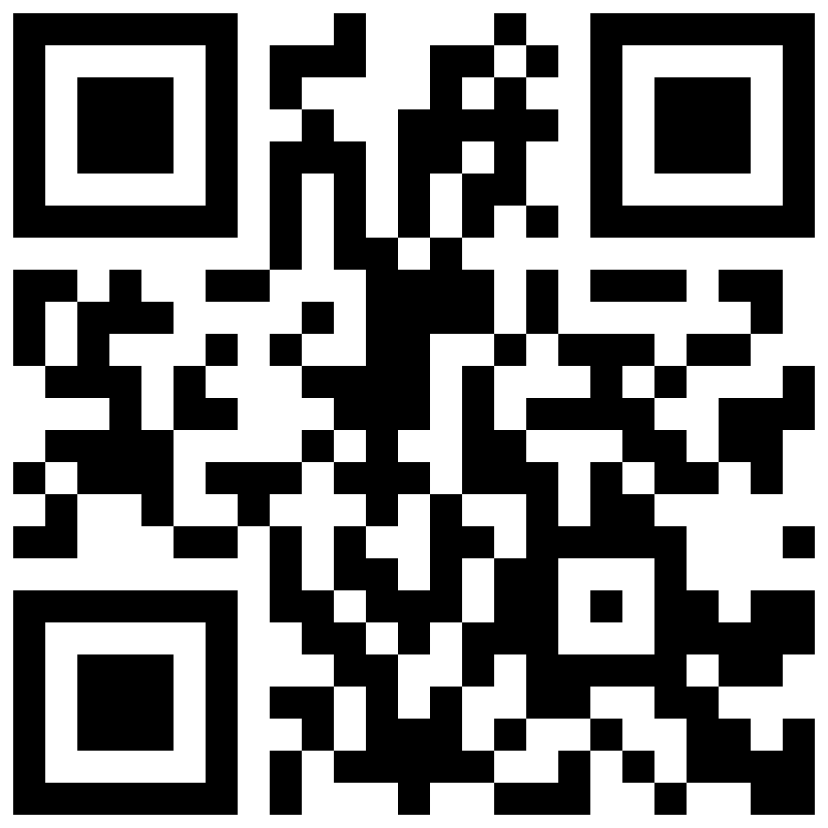
Join our mailing list
Termly Newsletter
bit.ly/OxEduDeanery
Event Notifications

Slide 6
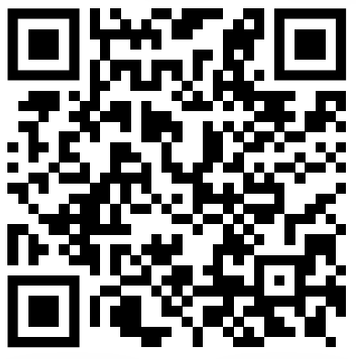
Event Feedback Form
Scan here, or go to
bit.ly/DeaneryFeedbackForm

Slide 7
Stay in touch
oxforddeptofed.bsky
@oxforddeptofed
@OxfordDeptofEd
oxford-deptofed
deanery@education.ox.ac.uk
bit.ly/OxEduDeanery

