Slide 1
Human rights and climate change: Testing 5 lessons tying climate justice, litigation, and attribution science for secondary aged students.

Slide 2
Human rights and climate change: Testing 5 lessons tying climate justice, litigation, and attribution science for secondary aged students.
These lessons are meant to accompany the Right Here Right Now summit at the University of Oxford, June 2025. However, they were designed to be used when exploring similar topics.
The lessons follow 5 arcs exploring how youth rights can be protected in a changing world. Teacher notes are provided before each lesson and answers to questions/pedagogical suggestions are in the speaker notes.
Lessons are meant to take 20-25 minutes at minimum but can be expanded with further discussion.

Slide 3
Human rights and climate change: Testing 5 lessons tying climate justice, litigation, and attribution science for secondary aged students.
Human rights
Climate justice
Climate litigation
Attribution science
Careers

Slide 4
Teacher SESSION ONE: HUMAN RIGHTS
5 mins - register, students recall human rights
2 mins - intro to summit and sessions
5 mins - Slide 7 asks about connecting climate crisis and rights - right to life (e.g. famine), right to property (e.g. flood) , standard of living (e.g. heat resilience), right to free and fair world (e.g. reparations, support for adaptation)
4 mins - Slide 8 - consider how best to facilitate class discussion
5 mins - writing task - have some examples ready to support less confident
Last slide - quick recap can be done as you dismiss class
Resources:
Mini whiteboard - or improvise an equivalent
Human rights
RHRN Summit
Rights of the Child
Notes:
Suggested timings for a 20 minute lesson.

Slide 5
SESSION ONE: HUMAN RIGHTS
Today, we are going to explore your rights as a young person so that we can consider whether the climate and nature crisis infringes upon them.
We are doing this to tie in with a big summit that is taking place at Oxford University right now; a summit which is a collaboration between the University, and the United Nations and Right Here Right Now.
While you wait to start, please note down all the human rights you can think of.
E.g. The right to live in safety
the right to a home
the right to…

Slide 6
Right Here Right Now Oxford Summit
This week….
Opportunities you might be interested in…
The big question we’ll be helping you to explore in 5 short sessions is:
How can my rights be protected in a changing world?
Notes:
Fill given the RHRN summit offerings of interest to your students found here: https://www.ox.ac.uk/news-and-events/right-here-right-now#group-section-Oxford-local-programme-ldpeDAaev4

Slide 7
You have listed some human rights. Who remembered these ones?
Right to life - Everyone has the right to life and to live in freedom and safety. Everyone has the right to life, liberty and security of person. (Article 3)
Right to own property - You have the right to own things. No one has the right to illegally take them from you. (Article 17)
Right to adequate standard of living - You have the right to have what you need so that you and your family do not go hungry, homeless or fall ill. (Article 25)
Right to a free and fair world - To make sure your rights are respected, there must be an order that can protect them. This order should be global. (Article 28)
completely
“The climate and nature crisis is a human rights crisis.”
Task: Looking at the rights listed above, how far do you agree with
this statement? Write a short answer on your whiteboards.
a little

Slide 8
Hopefully you are also aware there is a further set of ‘rights of the child’ (one of your rights as a child is to know about ‘the rights of the child’).
Task: Look at the three rights below and consider:
Where can you express your views?
How are you provided with the best possible healthcare/environment?
Where can you relax and play?
Article 12 (respect for the views of the child) Every child has the right to express their views, feelings and wishes in all matters affecting them, and to have their views considered and taken seriously. This right applies at all times, for example during immigration proceedings, housing decisions or the child’s day-to-day home life.
Article 24 (health and health services) Every child has the right to the best possible health. Governments must provide good quality health care, clean water, nutritious food, and a clean environment and education on health and well-being so that children can stay healthy. Richer countries must help poorer countries achieve this.
Article 31 (leisure, play and culture) Every child has the right to relax, play and take part in a wide range of cultural and artistic activities.

Slide 9
Last task: choose the statement below that best fits your view, copy it out and continue it with four or more sentences explaining why you agree with it.
The climate and nature crisis gets in the way of my daily life.
As a young person, my views on how we should improve the health of the planet should be listened to more.
The climate and nature crisis gets in the way of some young people’s human rights
The climate and nature crisis infringes my human rights.
E.g. The climate and nature crisis gets in the way of my daily life. For example it stops me from having safe housing because.. Worse still, it… For young people in…

Slide 10
How can my rights be protected in a changing world?
Today we have kicked off by thinking about what your rights are as young people. Next time we are going to build on today’s thinking when we ask…

Slide 11
Teacher SESSION TWO: CLIMATE JUSTICE
5 mins (or fewer if you can manage it) - Kiribati is pronounced Kiribass - register, students make suggestions for who is affected
2 mins - intro slides to Kiribati - just read through
2 mins -2 slides on relative and historic CO2e emissions (e+equivalent to cover all GHG) - take them quickly through this - focus is on Kiribati but encourage them to notice the range of contribution over time e.g. China is not main/only culprit
3 mins - slide on how you make it fair
5 mins - moving to local issue of flooding - could bring in your own example here - think about how to facilitate discussion
3 mins - writing task – two options, long and short given time - you can review what they have included that they feel is most important
Last slide - quick recap can be done as you dismiss class
Resources:
Mini whiteboard - or improvise an equivalent
Rights of the Child
Local issue of climate justice
Notes:
Suggested timings for a 20 minute lesson.

Slide 12
SESSION TWO: CLIMATE JUSTICE
Today we are going to investigate the concept of climate justice so that we can ask the question how do we make the situation fairer for young people.
While you wait to start, please look below at the list of challenges in our struggling planet. For each one, make a suggestion of a group of people this challenge will affect most (e.g. economic status, geographical region)
Higher food prices
Heat waves
Increased rainfall
Notes:
Higher food prices - poor people, farmers, drought prone areas
Heat waves - those in poor housing conditions, without air conditioning or ventilation, and with less access to outdoor space
Increased rainfall – those who live on flood plains, farmers, people poor housing vulnerable to damp

Slide 13
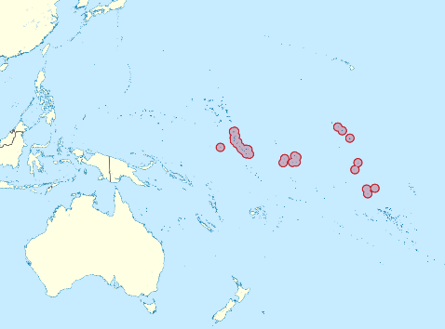
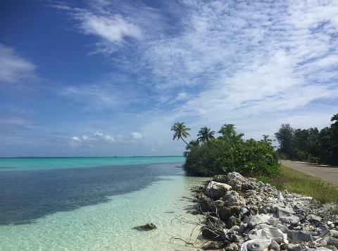
Here is Kiribati, a nation of 33 islands in the South Pacific. The highest parts of its islands sit at an average of 2 metres above sea level (4 metres at its highest points) and it is projected to be the first nation to disappear entirely into the ocean on account of human caused climate change.
Notes:
File:Kiribati in Oceania (small islands magnified) (-mini map -rivers).svg - Wikimedia Commons
Get this image on: Rawpixel | License detailsCreator: rawpixel.com | Credit: rawpixel.com
Kampen mot havnivåstigning Av Kaare Øster. Lisens: CC BY NC SA 3.0
Tekimwau Otiawa from Kiribati's Ministry of Environment is out checking out the newly planted mangrove trees along the low-lying coast of South Tarawa. The mangroves help to stem sea level rise in the island nation, where coconut palms are the highest points on the landscape.
https://interactives.stuff.co.nz/2017/10/kiribati-the-angry-sea-will-kill-us-all/

Slide 14
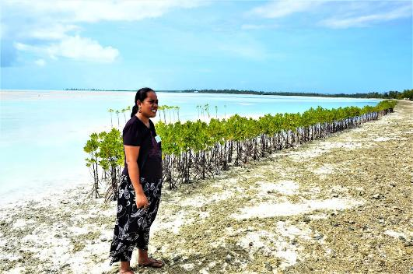
In this photo, Tekimwau Otiawa from Kiribati's Ministry of Environment, is out checking on newly planted mangrove trees along the low-lying coast of South Tarawa. Planting mangroves is one way to help prevent coastal erosion, as their roots hold on to the soil and absorb some of the force of the waves.
The sea around Kiribati has already risen 9cm in the past three decades. NASA projects that it will rise a further 15-30cm by 2050, and 50cm-100cm by the end of the century (2m in the worst-case scenario). In Kiribati people are working hard to mitigate and adapt to the the extreme weather, droughts, storm surges and salination wrought by climate change and sea level rise, even so a steady stream of people feel forced to emigrate every year.
Notes:
Kampen mot havnivåstigning Av Kaare Øster. Lisens: CC BY NC SA 3.0
https://sealevel.nasa.gov/news/276/nasa-sea-level-team-examines-an-island-nation-at-risk/
Tekimwau Otiawa from Kiribati's Ministry of Environment is out checking out the newly planted mangrove trees along the low-lying coast of South Tarawa. The mangroves help to stem sea level rise in the island nation, where coconut palms are the highest points on the landscape.
https://interactives.stuff.co.nz/2017/10/kiribati-the-angry-sea-will-kill-us-all/

Slide 15
Kiribati is one of the nations suffering/impacted most because of human caused climate change.
Task: Look at the average CO2e emissions below, then on your white boards write down how big a part you think Kiribati plays in causing it.
some
Canada
14 tons CO2e per person per year
Kiribati
0.5 tons CO2e per person per year
China
8.4 tons CO2e per person per year
Pakistan
0.8 tons CO2e per person per year
UK
4.4 tons CO2e per person per year
a little
Notes:
https://ourworldindata.org/co2/country/kiribati?country=KIR~GBR~PAK~MWI~USA~CAN
https://www.germanwatch.org/en/cri

Slide 16
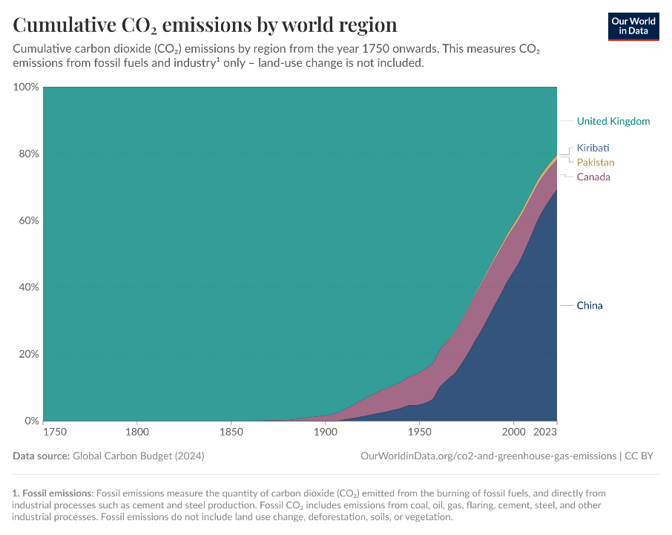
Task: Now look at this graph showing cumulative emissions since 1750.
Does it change your previous answer?

Slide 17
Kiribati is one of the nations suffering most because of human caused climate change, it is also a nation that has played very little part in causing it.
Task: We might say that the situation is unfair. Is there any way we could make it fair? Working with your neighbour, come up with an idea on your white boards again.
Other countries could…
Kiribati could be…
This is the concept of climate justice: it is unfair that people who have played the least part in causing climate change suffer the most because of it. To make things fairer, those who are most responsible for causing it should help those most vulnerable to it to cope with it.
Notes:
https://ourworldindata.org/co2/country/kiribati?country=KIR~GBR~PAK~MWI~USA~CAN
https://www.germanwatch.org/en/cri
Prompts for answers:
- Fund adaptation and mitigation
Offer citizenship to neighbouring countries
Provide less challenging emissions targets given historic contributions

Slide 18
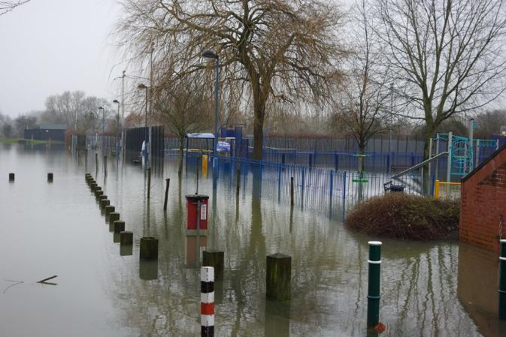
Let’s stick with water but move closer to home. Here’s a picture of a recreation ground in Oxford in one of the increasingly frequent floods.
Discuss: In Oxford, who do you think is most impacted by the floods caused by human caused climate change?
You could factor any of the following into your discussion:
Income
Housing
Mobility
Ethnicity
Age
What is fair or unfair here?
Notes:
https://www.flickr.com/photos/tejvan/12288217856/in/photostream/

Slide 19

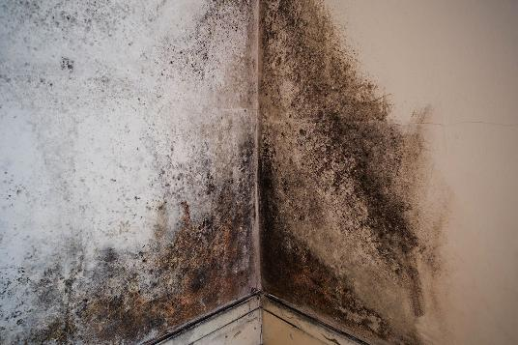
Climate justice is relevant everywhere. Those with least money, power and voice are likely to live in areas hit hardest by human caused climate change and they’ll also have fewer resources to be able to mitigate the impacts, for example by moving to a different area or paying to have their homes damp proofed.
Notes:
Creator: LH Images / Alamy Stock Photo
Copyright: Credit: LH Images / Alamy Stock Photo

Slide 20

Both children and the elderly are especially vulnerable.
Older people are more likely to have existing health conditions and mobility issues that make the strain of extreme cold, heat or damp dangerous for them.
Children are developmentally vulnerable to poor air quality, especially caused by damp and black mould and emissions from cars and heating systems. Damage to lung and brain development in childhood can cause lifelong health problems.
When we think about the justice of this situation, it is relevant that young people cannot be said to have caused the climate change impacting public health.
Is there anyway we can make things fairer for young people today?
What about young people in the future? In 2030, or 2050 or 2100?
Notes:
Creator: LH Images / Alamy Stock Photo
Copyright: Credit: LH Images / Alamy Stock Photo

Slide 21
Last task: write a wishlist for your grandchild, saying what kind of future they deserve.
In the future my grandchild deserves:
Clean…
Access to..
Somewhere to…
…

Slide 22
How can my rights be protected in a changing world?
Today we moved on to thinking about how unfair the climate and nature crisis is for young people. Next time we are going to move on to consider how litigation can work as a process to make things fairer for young people.

Slide 23
Teacher SESSION THREE: CLIMATE LITIGATION
5 mins (or fewer if you can manage it) - register, students make suggestions for how rights are taken seriously – for the sake of their wellbeing don’t just agree with them, we will look at ways youth have power
3 mins - Slide 26, intro to litigation and waves - wave 1 is planning laws, 2 is infringing on rights, 3 is fiduciary duty, legal responsibility to shareholders
3 mins - task, encourage students to notice what is violated or what is claimed
3 mins - Slide 28 think about how to facilitate discussion
1 min - read through, government said provincial policies don’t matter in face of global emissions, court ruled they do, against de minimis argument – still takes a long time
5 mins - writing task - have some examples ready to support less confident
Last slide - quick recap can be done as you dismiss class
Resources:
Mini whiteboard - or improvise an equivalent
Rights of the Child
Local climate litigation suit to serve as example. Consider: Sabin Centre
Notes:
Suggested timings for a 20 minute lesson.

Slide 24
SESSION THREE: CLIMATE LITIGATION
Today we are going to investigate the concept of climate litigation so that we understand a process for making the situation fairer for young people.
While you wait to start, remember Article 12 of the UN Convention on the Rights of the Child. Please note down if and how your views are taken seriously in the climate crisis.
E.g. My views are not taken seriously because … I’m too young to vote
Article 12 (respect for the views of the child) Every child has the right to express their views .. and to have their views considered and taken seriously. This right applies at all times.
Notes:
No, adults make all the big decisions and we don’t get a say.
Sometimes, like when we do school strikes or protests, but not really in law or government.
I think people pretend to listen but don’t actually change anything.
We learn about climate change, but no one actually asks us what we think should be done.
Some kids are doing big things, like suing governments. That’s cool, but I don’t think I could do that.

Slide 25
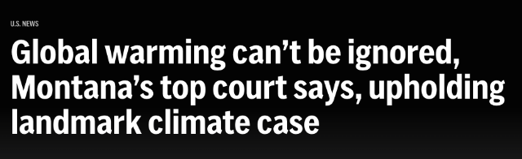
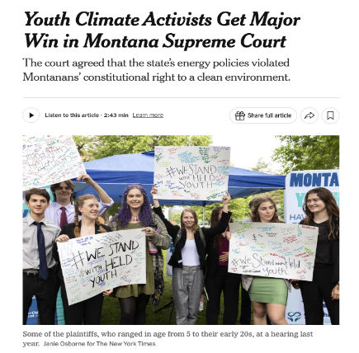
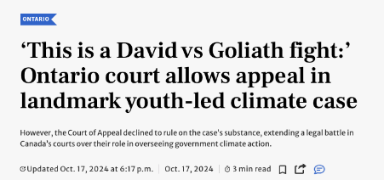
One way youth are being heard around the globe is through climate litigation. Children and youth are suing to hold governments and industry accountable for climate change. Students from 5 to 22 are launching lawsuits and they are starting to win.
Notes:
https://www.cbc.ca/news/canada/toronto/ontario-appeal-court-youth-led-climate-case-decision-1.7354795
https://www.nytimes.com/2024/12/18/climate/held-montana-youth-climate-lawsuit.html
https://apnews.com/article/youth-climate-change-lawsuit-montana-7c4b6261f610d504995743f7320533e8
https://www.thestar.com/news/ontario/this-is-a-david-vs-goliath-fight-ontario-court-allows-appeal-in-landmark-youth-led/article_f765aee6-8c94-11ef-b16e-93428bbd30f6.html

Slide 26
Climate litigation is defined as cases where climate change law, policy or science is a material issue of law or fact. It is a growing field with over 2,600 cases filed, with many occurring after the Paris Climate Agreement in 2015.
The field has followed 3 ‘waves’ of litigation, invoking different arguments and claims.
Wave I: Cases focus on challenging emissions producing projects (like coal mines and pipelines) through environmental & planning laws.
Claimants argue governments or companies did not consider how projects contribute to climate change, or ignored future climate risks.
Wave II: Cases focus on government climate inaction or action which violates basic human rights – like the right to life, health, or culture.
Claimants argue governments are infringing on constitutional rights through weak climate policies.
Wave III: Cases target corporations and investors that ignore or obfuscate climate change facts.
Claimants argue corporations make false and misleading claims about the impacts of climate change on business and investments.

Slide 27
Task: Match the arguments to each wave of litigation on your white boards. Be prepared to explain why.
Wave I: Environmental and Planning
Wave II: Human Rights
Wave III: Corporations and Investors
Argument A: Youth launched a legal challenge against a provincial government’s decision to weaken their emissions target. They argued that the new target violated youth and future generations’ rights to life and security of the person and equality under the Canadian Charter of Rights and Freedoms.
Argument B: Teitiota, a national of Kiribati, claimed that New Zealand violated his rights by removing him to Kiribati, where sea level rise and saltwater contamination caused dangerous living conditions. He argued this was a breach of his right to life.
Argument C: Class action alleged that the Minister for the Environment owed a duty of care to protect Australian children from the emissions linked to a coal mine extension.
Argument D: Investors brought a class action against Exxon Mobil, arguing the company made false statements about how climate change would impact its business.
Notes:
Argument A - Wave 2 - infringe on rights
Argument B - Wave 2 - infringe on rights
Argument C - Wave 1 - policy allowing coal mine
Argument D - Wave 3 - climate impacts of oil producer

Slide 28
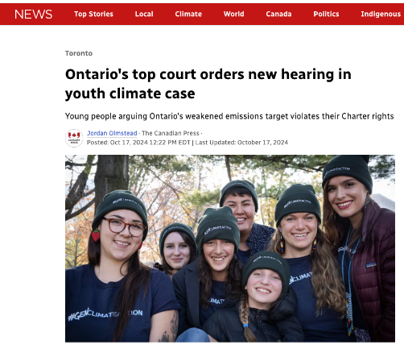
Generally, youth-led climate cases use second wave arguments by showing how some action or government policy infringed on their rights.
Discuss: Why do you think these types of arguments might be especially powerful or relevant when made by youth?
Factor the following into your discussion:
Time left to enjoy rights
Physical vulnerability to harms
Voice in political decisions
Challenge: How might second wave arguments be used for climate refugees?
Notes:
Climate refugees as challenge extension

Slide 29
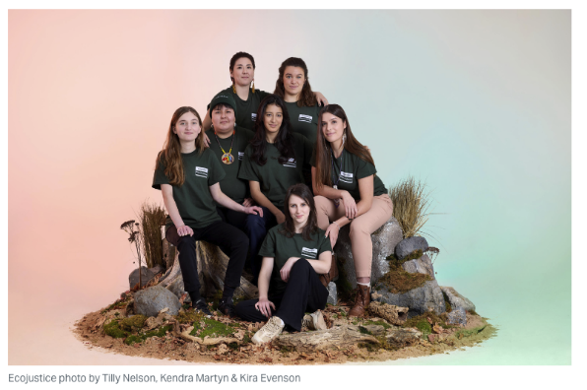
In Mathur v. Ontario, the youth argued that their right to life and security of the person was violated given the real climate harms they were experiencing now, and would continue to experience in the future. They also argued this violated their rights to equality given they would bear the brunt of government policy over time. They would and are being disproportionately harmed by government policy.
Success story: To dismiss Mathur, the Government claimed climate targets were meaningless—court disagreed, ruling they must have real impact.
Realism: The case has gone through a motion to dismiss and an appeal since 2019. Rehearing scheduled for 2025.
Notes:
https://nationalmagazine.ca/en-ca/articles/law/hot-topics-in-law/2024/ontario-s-top-court-says-government-climate-action-subject-to-the-charter

Slide 30
Last task: choose the statement below that best fits your view, copy it out and continue it with four or more sentences explaining why you agree with it.
Climate litigation is an important tool for youth to be heard and protect their rights.
Climate litigation should be used carefully – sometimes it puts too much pressure on young people.
Courts can help, but real climate justice needs more than just legal action.
E.g. Climate litigation should be used carefully, it puts a lot of responsibility on only a few youth. Cases are long, emotional and very public. What’s worse … It’s unfair when …

Slide 31
How can my rights be protected in a changing world?
Today we moved on to thinking about climate litigation as a process for making the situation fairer for young people. Next time we are going to move on to consider how evidence works in a climate litigation case.

Slide 32
Teacher SESSION FOUR: ATTRIBUTION SCIENCE
5 mins (or fewer if you can manage it) - register, students make suggestions for how to prove climate change infringes on rights - will think with answers on next slide
5 mins - Slide 35 plaintiff is one bringing the suit - can add ‘what tricks might defendant employ to cast doubt’
2 min - read through Mathur v Ontario and Dr Matthews - focus on links between government action and climate change
1 min - Slide 38 read through attribution science, focus on BBC diagram of ‘proof’
2 min - counterfactual modelling goes with the normal distribution diagram - question at bottom with line graph – we remain uncertain for many events outside heat waves
5 min - writing task
Last slide - quick recap can be done as you dismiss class
Resources:
Mini whiteboard - or improvise an equivalent
Rights of the Child
Recent attribution science research (e.g., from Nature)
Notes:
Suggested timings for a 20 minute lesson.

Slide 33
SESSION FOUR: ATTRIBUTION SCIENCE
Today we are going to investigate how evidence is used in litigation to prove plaintiffs’ claims and get relief.
Last session, young people went to court in Mathur v. Ontario to say their rights to life and security were being violated by weak climate targets. While you wait to start, recall Article 24 of the UN Convention on the Rights of the Child. Consider: How could we prove that climate change is harming your rights?
E.g. We can prove climate change is harming my right to a clean environment by ….
Article 24: Children have the right to the best possible health, including access to safe drinking water, nutritious food, and a clean and safe environment.
Notes:
“I could talk about more wildfires and smoke in the summer.”
“We could show that scientists say heatwaves are getting worse.”
“I’d say that asthma is worse for people I know when there’s air pollution.”
“Maybe use maps or graphs that show rising temperatures?”
“I don’t know how to prove it exactly, but we all feel it’s worse—there must be a way to show it.”

Slide 34
To justify a legal claim, plaintiffs use evidence that links what governments or companies are doing to the harm they are facing. For example, plaintiffs might argue that more greenhouse gas emissions due to a government policy, means more flooding, which means food insecurity for certain youth.
The plaintiffs have the ‘burden of proof’. They must prove their case by showing that it is ‘more likely than not’ that their evidence and arguments are valid and should be accepted.
Task: What type of evidence did you use to prove climate change is harming your rights? Do you think you have provided evidence that is more likely than not to stand up in court? Why or why not? Working with a neighbour, come up with an idea on your white boards again.
Our evidence was …
It is likely to stand up in court because …
Notes:
Increase severity of asthma, personal experience, with doctors note, and scientific data

Slide 35

In Mathur v Ontario, the plaintiffs used personal experience and expert testimony to argue their case.
In Mathur:
The youth had to testify with personal experience that climate change was harming their right to life and security of the person
Expert witnesses testified about climate change, its impacts, and the links between government actions and climate change
Notes:
https://nationalmagazine.ca/en-ca/articles/law/hot-topics-in-law/2024/ontario-s-top-court-says-government-climate-action-subject-to-the-charter

Slide 36
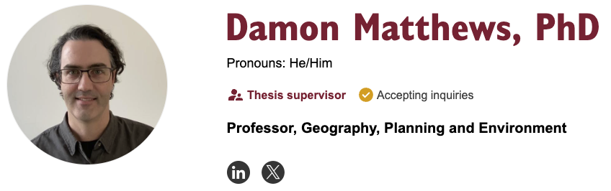
The judge agreed: “By not taking steps to reduce greenhouse gases in the province further, Ontario is contributing to an increase in the risk of death and in the risks faced by the Applicants and others with respect to the security of the person” (Wood, 2024, p. 16)
Dr. Matthews provided evidence that more greenhouse gases would lead to increased wildfires, storms, and flooding in Ontario. He used scientific methods and processes to ‘prove’ harm.
Notes:
Wood, S. Mathur v Ontario: Grounds for Optimism about Recognition of a Constitutional Right to a Stable Climate System in Canada?”(2024). McGill LJ, 69, 3.
https://www.concordia.ca/faculty/damon-matthews.html

Slide 37
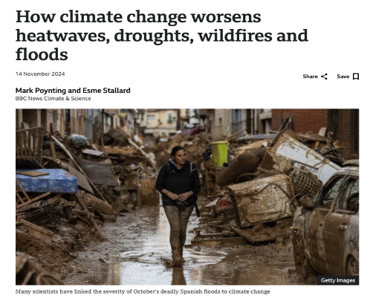
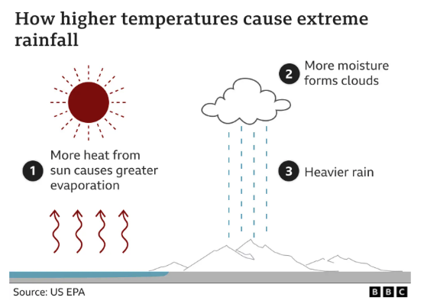
Generally, attribution science is used to establish a causal chain of harm. It can be used to connect plaintiff losses and defendant actions to determine relief.
In other words, “you caused the mess, so you should clean it up.” Scientific evidence is being increasingly relied upon to show …
Notes:
https://www.bbc.com/news/science-environment-58073295
https://www.cbc.ca/news/science/what-on-earth-friederike-otto-1.7233669

Slide 38
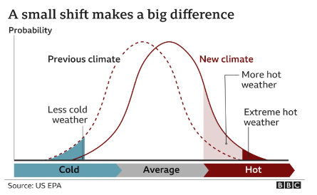
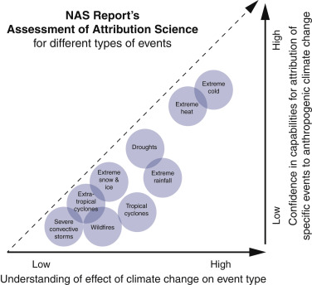
Attribution science studies how climate change increases the likelihood and severity of extreme weather events (like floods, fires or heat waves).
This is done with modeling that compares a world without climate change to the world we have.
This modelling tries to show how much more likely or intense an event (like a heatwave) was because of climate change.
But it is not easy to establish a causal link to anthropogenic climate change for every event.
Notes:
https://www.bbc.com/news/science-environment-58073295

Slide 39
Last task: Using the case study, map out the causal chain of harm from the Minister’s decision to approve the coal mine to the risks facing young people.
Eight teens and their 86-year-old guardian sued the Australian Environment Minister to stop a coal mine extension. They argued the Minister owed young people a duty of care to prevent harm from climate change. The case centered on how emissions from the mine could increase global average temperature and cause real harm. The coal mine was expected to produce 100 Mt of carbon dioxide emissions.
Starting with the approval decision the Minister took action to produce more emissions …
This led to …
Which led to …
Which leads to …
Notes:
Government action → More emissions → Higher global temperatures → More intense heat and potential for wildfires→ Harm to youth health and safety

Slide 40
How can my rights be protected in a changing world?
Today we moved on to thinking how evidence is used in litigation to prove plaintiffs claims and get relief. Next time we are going to move on to explore whether there are any career opportunities in this area that might appeal to you.

Slide 41
Teacher SESSION FIVE: CLIMATE LITIGATION CAREERS
4 mins (or fewer if you can manage it) - register, students write lists - mention that we are shifting to think about this professionally
2 mins - intro to legal training
4 mins - specialising in legal training
2 mins - differentiating solicitors and barristers
3 min - which course for which wave of litigation
2 mins - scientific training and work - 2 slides
3 mins - what course for what case
5 mins - writing task - students reflect on careers they could pursue
Resources:
Mini whiteboard - or improvise an equivalent
Notes:
Suggested timings for a 25 minute lesson.

Slide 42
RATIONAL FOR SESSION FIVE: CLIMATE LITIGATION CAREERS
Notes - The focus of the final session on directions students can go in for further study/careers. This is for a few reasons:
Careers is one of the four components of the DfE Sustainable Education Strategy, so delivering session will go towards meeting their requirements
One way to help students feel able to engage with the climate and nature crisis without weighing them down with worry is to clearly point out interesting and ambitious possibilities in this field

Slide 43
SESSION FIVE: WHO ARE THE PEOPLE WORKING TO PROTECT MY RIGHTS?
Today we are going to talk about the experts working in climate litigation so that we understand what we need to do should we want to pursue a career in this field.
While you wait to start, please make a list of different people who would be involved in mounting a climate litigation case.
E.g.
A plaintiff - for example a young person’
A solicitor..
..

Slide 44
Climate litigation lawyer
To become any kind of lawyer you need to:
Complete an undergraduate degree (for example an LLB or Bachelor of Law) for 3-4 + a one year law conversion course (if your undergrad was not in law)
Begin to specialise:
  If you want become a solicitor you will need to spend a year on a vocational course preparing for the Solicitors Qualifying Examination (SQE)
  If you want to become a barrister you will take a one year Bar Course
Move on to work based training:
  A prospective solicitor goes for two years to a law firm
  A prospective barrister need to secure a year long pupillage (a barrister to train under)
TASK:
How many years does it take to become:
A solicitor
A barrister
Notes:
6-8 years

Slide 45
Climate litigation lawyer
From criminal, to corporate, to human rights, there are many many branches of law you can specialise in. Studying law will make you legally literate and will educate you in the core and most common areas of law. However every trainee lawyer will be thinking about the area of law they ultimately want to practise in and will make choices along the way to get themselves there.
For example they will need to think carefully about:
What subject to study for their undergraduate degree
Whether to undertake an LLM (Masters in Law ) - a postgraduate degree that will deepen your understanding of a particular area of law
Where to apply for work experience
The law firm or chambers you apply to for your final years of training.
TASK: Choose a letter and then suggest an action that might support a career in environmental law.
C work experience in the legal department of Greenpeace
A An undergrad in earth sciences

Slide 46
Climate litigation lawyers:
Barristers and solicitors
Solicitors and barristers both play key roles in environmental law, but their work differs. Solicitors focus on behind-the-scenes tasks—giving legal advice, drafting documents, and helping clients navigate regulations. Barristers, on the other hand, represent clients in court and handle the advocacy side of legal cases.
Solicitors might:
Advise clients on following environmental laws and avoiding legal issues.
Carry out due diligence for large projects, such as checking land for pollution.
Work for international organisations like the UN, advising on treaties and ensuring projects meet legal standards.
Barristers might:
Represent clients in court for serious legal disputes.
Prosecute companies or individuals who break environmental laws.
Work with international courts on high-level disputes or treaty violations.
TASK: Which role appeals to you more?
solicitor
barrister

Slide 47
Wave I: Cases focus on challenging emissions producing projects (like coal mines and pipelines) through environmental & planning laws.
Wave II: Cases focus on government climate inaction or action which violates basic human rights – like the right to life, health, or culture.
Wave III: Cases target corporations and investors that ignore or obfuscate climate change facts.
Remember the three waves?
TASK: Imagine you are training to be a lawyer. Which wave would the courses below be relevant preparation for?
A LLM in Human Rights, Bristol University - In-depth study of global human rights legal frameworks. You will explore international and regional institutions and mechanisms, as well as specialised areas like employment law, health law, and migration law, with a variety of optional units to choose from.
B Transnational Environmental Law, elective unit within LLM at LSE - explores key environmental law issues beyond national borders, focusing on international treaties, corporate responsibility, scientific and indigenous knowledge, rights-based approaches, and the integration of environmental concerns into other legal areas, using case studies on climate change and biodiversity.
Notes:
A - Wave 2
B - All Waves

Slide 48
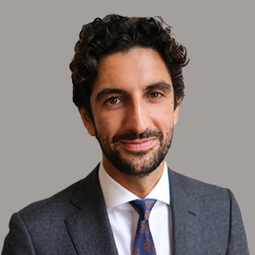
Harj Narulla, barrister at Doughty Street Chambers, specialising in climate law and litigation.
Harj trained in environmental and human rights law, including at the Environmental Defenders Office and as a refugee lawyer in Papua New Guinea and Greece.
He has worked on high-profile climate litigation in over 15
countries and various regions, and before major courts like the
Inter-American Court of Human Rights, the International Court of
Justice, and the European Court of Human Rights. He also advises governments, NGOs,
and the UN on climate law, and researches climate justice at Oxford and the LSE.
Example Cases:
He represented the Solomon Islands in a landmark advisory opinion case at the International Court of Justice, addressing state obligations to prevent harm to future generations from climate change
He represented a Serbian NGO in a complaint against the Serbian government for heavy metal river pollution causing transboundary harm, defending the rights of nature.
Notes:
He studied Law at the University of New South Wales and the University of Oxford, where he completed a Master of Science in Environmental Change and Management and a Bachelor of Civil Laws.

Slide 49

Mireia Ginesta, Postdoctoral Research Associate in the Smith School for Enterprise and the Environment
Dr Ginesta has degrees in Physics and Meteorology. She completed a PhD focused on attributing severe storms in Europe to human-induced climate change.
Currently, Mireia works as a Research Associate in the Smith
School of Enterprise and the Environment in Oxford. Her research
explores the connections between extreme weather events and a changing climate. She focuses on quantifying the damages caused by extreme storms and attributing these impacts to anthropogenic climate change using data from climate models, weather forecasts, and observations.
As an expert on extreme weather event attribution Mireia:
Publishes scientific research papers to further our understanding of the science of extreme weather events
Supports litigation cases to advance accountability for climate-related impacts
Gives interviews to international media to put recent weather events into context

Slide 50
Scientific expert
To become the kind of scientist who might be called on as an expert in a climate litigation case you need to:
Complete an undergraduate degree in maths or a science for 3-4 years
Undertake further study to develop your specialism - most people would spend another year, or several, completing postgraduate degrees
Seek out internships in or work as a researcher for example a summer internship at the Met Office or as a research assistant in a lab or group
Present at conferences and publish scholarly work
TASK:
How many years do you think it takes before you can count as an expert?
Notes:
6-10 years

Slide 51
Scientific expert
Where could you work as an environmental scientist?
Within a university department
You could act as an expert witness in a climate litigation case
You could take advisory roles, for example the IPCC (intergovernmental panel on climate change)
You could work for a government agency like the Met Office or the Environment Agency
You could work for not-for-profit organizations or local communities
TASK: Which role(s) appeals to you more?

Slide 52
1. Serbian NGOs filed legal charges against the Serbian government and mining company, Dundee Precious Metals, for environmental damage and potential ecocide linked to a lithium mining project.
2. Mathur v. Ontario, the youth argued that their right to life and security of the person was violated given the real climate harms they were experiencing now, and would continue to experience in the future.
TASK: Which degree below would be the best preparation for being called as a witness in which case above?
Challenge: Which wave does each case belong to?
A BSc Environmental Science at Manchester University
Study humanity's effect on nature as well as how physical, chemical and biological processes maintain and interact with all life on Earth. Tackle pressing issues such as ensuring that human has access to clean water and air, and the resources required for agriculture and industrial activity.
B BSc Meteorology and Climate at Reading University.
In this course you will tackle the biggest issues facing the planet today, including ozone depletion and climate change, alongside world experts in the UK’s only dedicated meteorology department.
Notes:
Either!
1 is Wave 1, environmental law
2 is Wave 2, human rights

Slide 53
LAST TASK: Imagine you are going to pursue a career in climate litigation. Would you rather be a lawyer or a climate scientist? Write a reflection explaining which and why.
Begin by saying what you would like to be.
If I pursued a career in climate litigation, I would most like to be a …… working in ……
This work would particularly interest me because I would be able to….
I like the idea of…..
It would be amazing to be able to….
….. make important contributions to society because…
Go on to describe the kind of work you’d do and what you would enjoy about it.
Challenge: include a dream scenario e.g. a big win in court or a breakthrough in your research
Finish by saying what is important about this area of work.

Slide 54
Authors
Dr. Travis T. Fuchs
Phoebe Mortimer

