Slide 1



Teaching for Digital Citizenship: Data Justice in the Classroom and Beyond
What has brought you to this event today?

Slide 2
Aims
Understand the context of the Teaching for Digital Citizenship Project
Engage with the Digital Citizenship Education Framework (DCEF) as co-creators

Slide 3
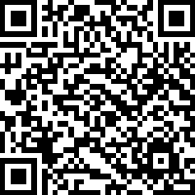
Building Digital Citizens – The Centre for Digital Scholarship, Bodleian Libraries
Four key questions
What are the challenges and opportunities that come with digitalisation in schools?
What is digital citizenship?
How should we think about mobile phones?
What next in digital citizenship?
You can participate in this either as:
A series of webinars (first on Thurs 4th Dec 4-6pm)
An in-person event (Friday 27th Feb 9-4, including lunch and behind the scenes Bodleian tours)

Slide 4
Plan for Today
3:10-3:30 | Education for Citizenship (EfC): Ancestries and Legacies
3:30-3:40 | Introducing the Teaching for Digital Citizenship: Data Justice in the Classroom and Beyond
3:40-3:50 | Introducing the Digital Citizenship Education Framework
3:50-4:10 | Engaging with the Framework
4:10-4:20 | Coffee break
4:20-4:50 | Co-creation and analysis
4:50-5:25 | Feedback of the Framework.
5:25-5:30 | Closing

Slide 5
Education for Citizenship (EfC):
Ancestries and Legacies
COP 2025 Oxford
Bob Davis
Professor of Religious and Cultural Education
School of Education
University of Glasgow

Slide 6


EfC (England) 2025
Notes:
Does the Anthropocene exist?
If so, how do we define it?

Slide 7
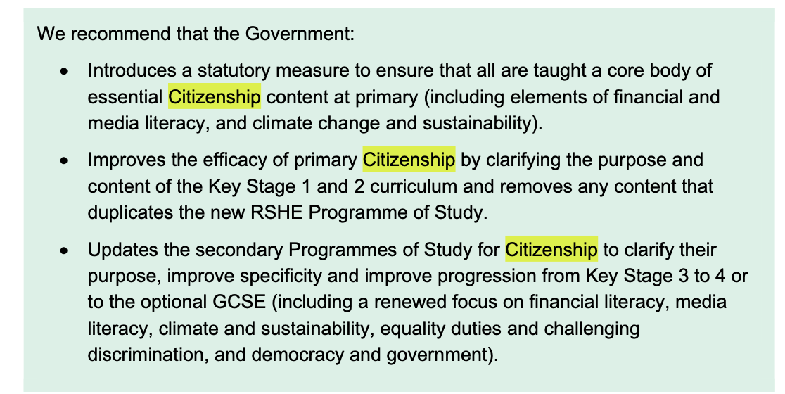
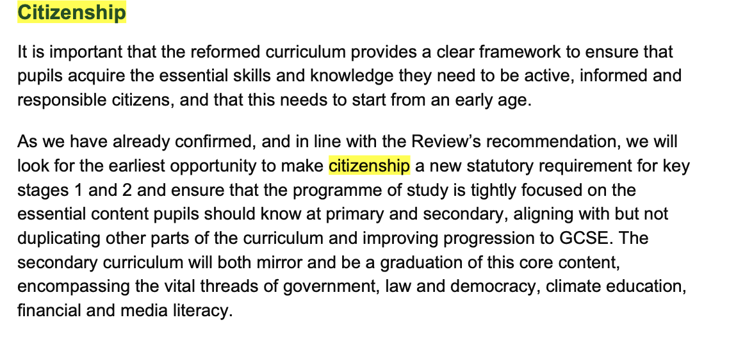
EfC (England) 2025
Notes:
Does the Anthropocene exist?
If so, how do we define it?

Slide 8
EfC & Digital Citizenship:
Backdrop and Foreground
Enlightenment: Reason, Literacy, Useful Learning and Governance (1750-1870)
Citizens, Subjects and Empire (c1870-1918)
Citizenship and Democracy I: franchise, rights and obligations (c1918-1968)
Citizenship and Democracy II: progress, inclusion, diversity, participation (c1968-1998)
Global Citizenship: Citizenship as agency, action and the pursuit of local and global justice (1998-2010)
Digital Citizenship (2010-2025)

Slide 9
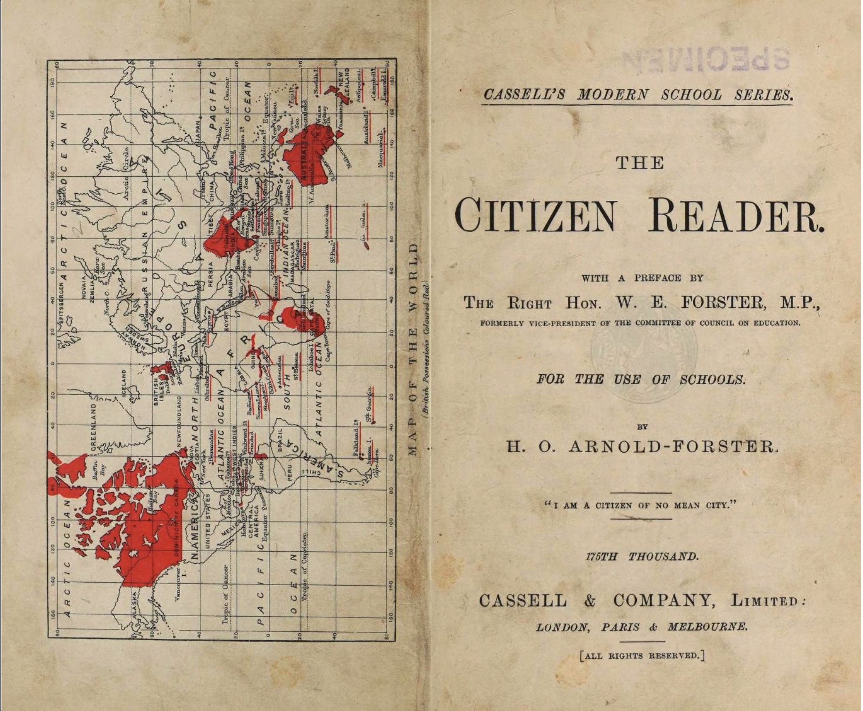


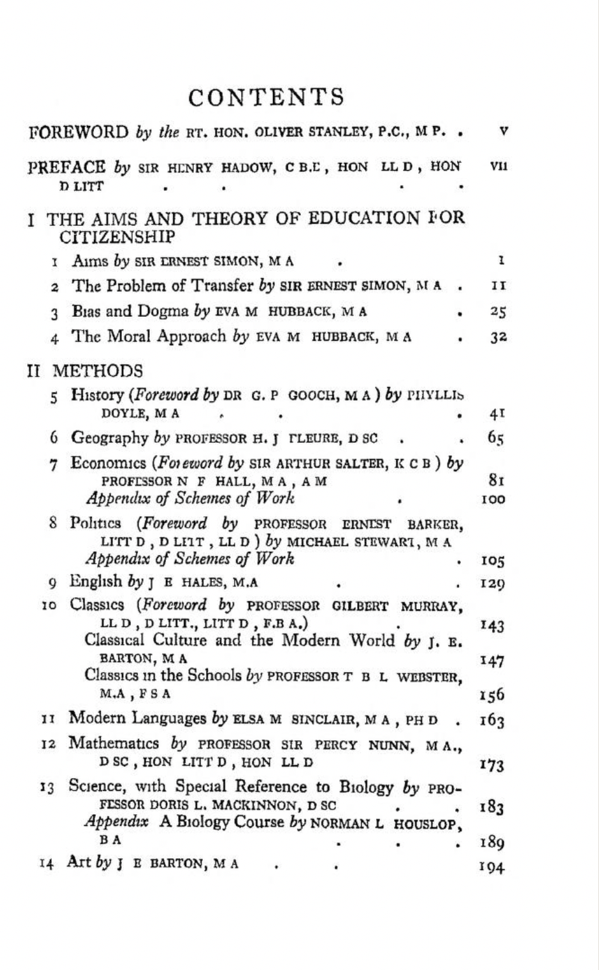
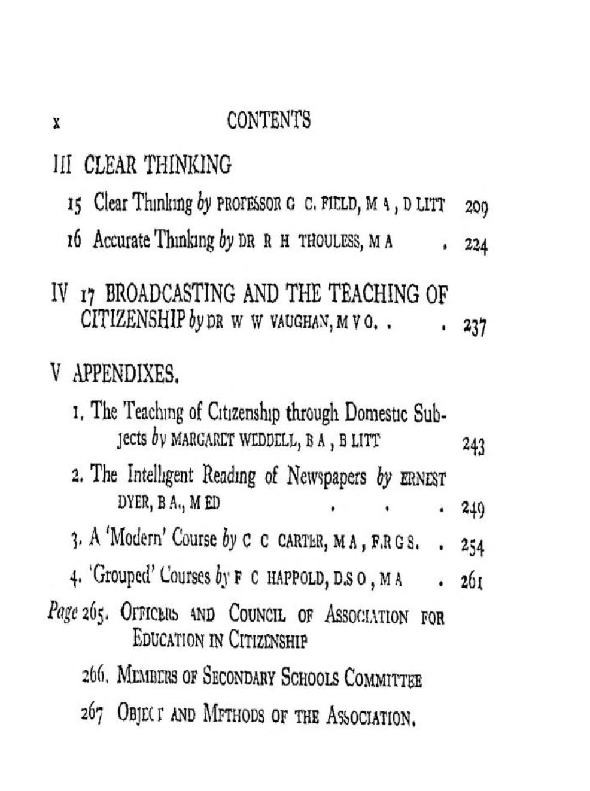

Slide 10
EfC & Digital Citizenship:
Some Recurrent Themes
The Nation State and National Belonging
The Nation State and Social Cohesion
The formation of ‘the democratic self’
The functions of the market economy and the response to corporate power
The school as the site of democratic progress and social justice
The response to crisis: the school as the site of crisis-resolution

Slide 11
Introducing the Teaching for Digital Citizenship: Data Justice in the Classroom and Beyond
Jeremy Knox, Associate Professor of Digital Education, University of Oxford

Slide 12
Digital…
Citizenship?
(Social) Justice?

Slide 13
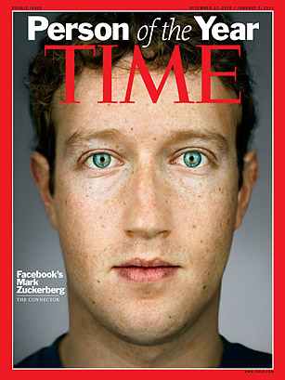
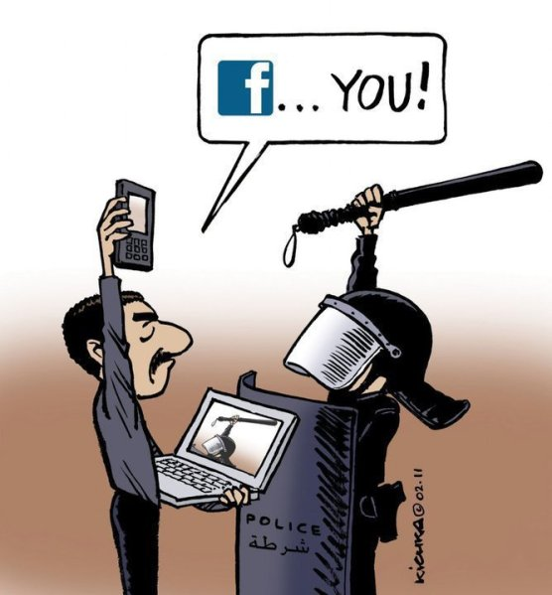

Slide 14


Slide 15
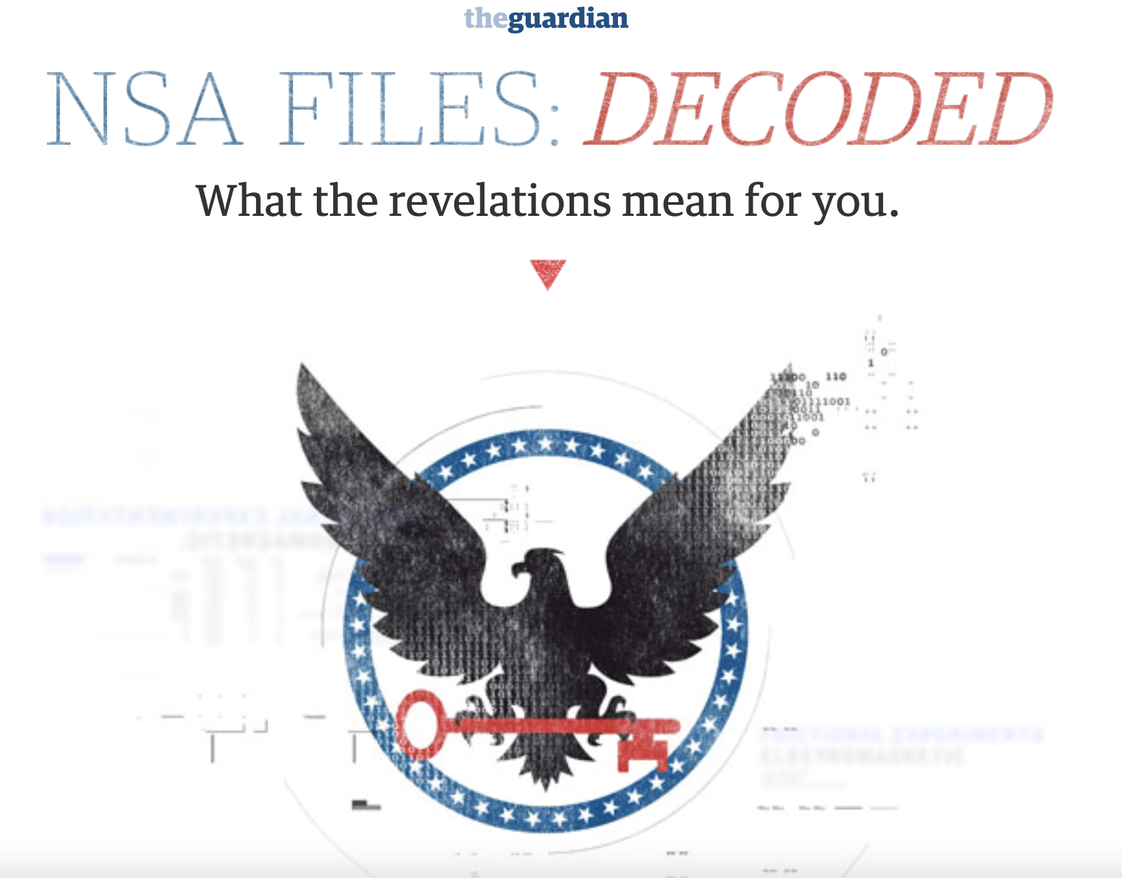


Slide 16


Teaching for Digital Citizenship: Data Ethics in the Classroom and Beyond
David Lundie
James Conroy
Bob Davis
Jeremy Knox
Joao Porto de Albuqeurque
Lee Shannon
Ted Palenski

Slide 17
Project aims:
To understand the aims, challenges and practices of teaching for digital citizenship in secondary schools across the UK
To develop a range of strategies, resources and practices that help school communities shape ethical environments for teaching and learning with technology
To furnish young people with a sense of agency and foster data justice approaches within their digital lives and beyond

Slide 18
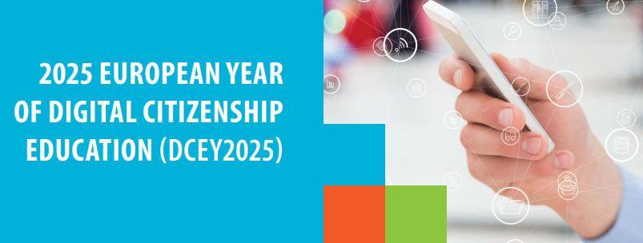
Scoping
Implementation
Impact
  May 2023: Delphi Conference – launched in conjunction with BERA
  Aug 2023: Teacher Survey (n = 9,016)
  Nov - Dec 2023: First school ethnography - England
  Jan – May 2024: Second and third ethnographies in Scotland and Northern Ireland
  Sept – Dec 2024: Fourth, Fifth+ ethnographies in England
  2024-25: Developing a co-design community of practice
  2025-26: Dissemination and ‘launch’ events

Slide 19
Cross-curricular focus: Even with challenges of teacher workload, teaching for digital citizenship should happen early an across all programmes.
School and community scale: A community approach to digital citizenship is necessary, to draw on and inform the development of the community more broadly; it should not be restricted to schools.
Workload concerns: The outcomes should strive not to overburden teachers
Digital and analog: The digital should not be the sole focus: aspects of ‘digital citizenship’ are connected to broader ideas of human flourishing
Empowerment: teachers and educators as ‘stakeholders’ with agency to shape the future
Delphi Outcomes
Post-Delphi survey ‘priorities’:
Good judgment: foster capacity for responsibility
Ability: Young people must know how to respond to threat/danger from ‘bad actors’ online
Uncertainty: new technologies (e.g. AI), upskilling, addressing environmental impacts

Slide 20
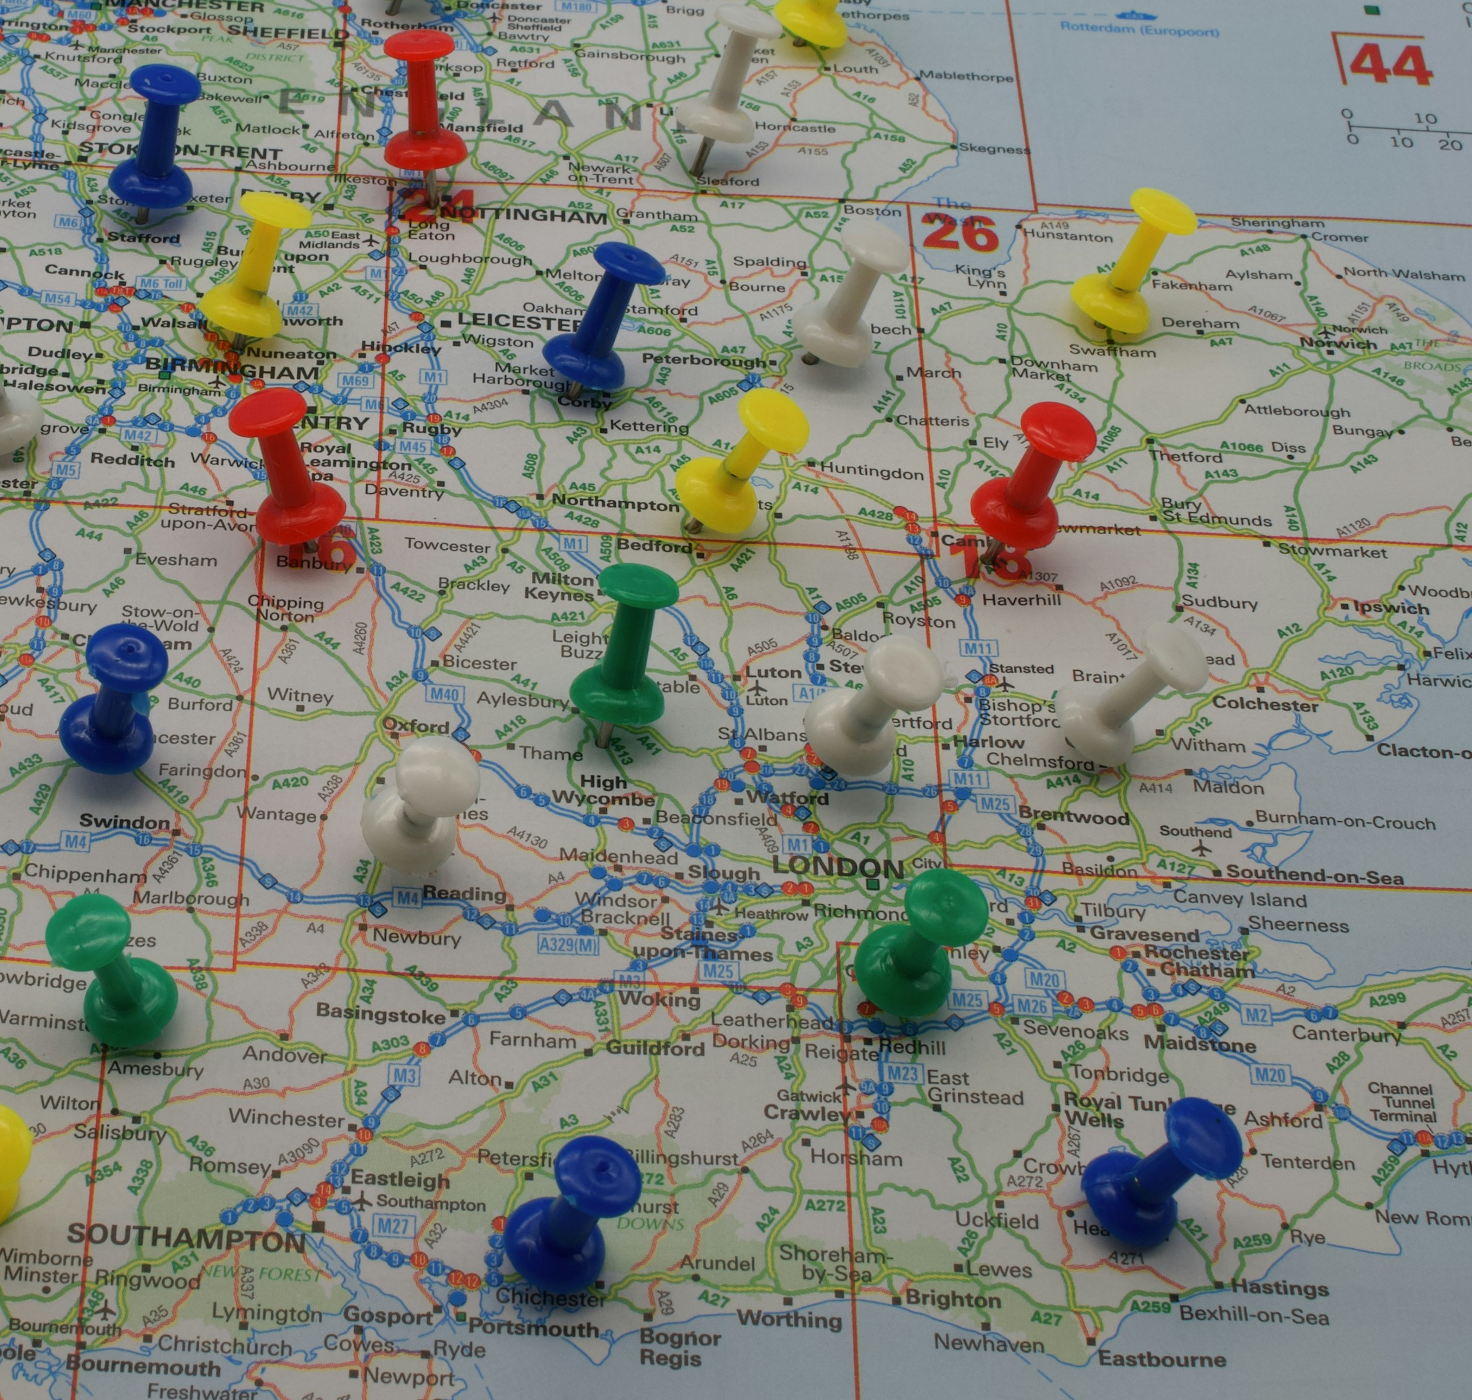
Ethnographic Findings
AI (LLMs) widely used by students and such digital spaces are considered to be integrated feature of everyday experience.
There is significant awareness (and some experience) of exploitation. Some able to navigate these issues but many likely not capable.
Students want to be trusted but recognise the need for regulation and consequences for mis-use.
Students appear clear that the (distinctively analogue) capacity for judgement is fundamental to navigating the digital.
Photo by Paul Marlow on Unsplash

Slide 21
Some key terminology…
Digitalisation
Not to be confused with digitisation (where information is converted into digital formats); digitalisation refers to wider technological change where once offline experiences become part of the digital world.
Datafication
The process where increasing amounts of information is gathered about actions and recorded as data, usually contributing to “big data” sets. This involves turning material actions into numerical, non-material forms. New technologies have allowed this to happen at a far larger scale than ever before.
Artificial Intelligence
Technologies, trained on big data sets, which can perform functions that previously required human intelligence. This can involve machine learning (where AI can train itself) and complex algorithms.
Educational Technology (EdTech)
While this refer to any tool used in education (from a desk to a whiteboard), this generally applies to digital technologies, including devices and platforms.

Slide 22
Introducing the Digital Citizenship Education Framework
The Community of Practice
Purpose of the DCEF
The Digital Citizenship Self-Assessment Tool
Identify Assessor
Complete Self-Assessment
  Institution Provision Self-Assessment
  Benchmark Self-Assessment
Actions and Reassessment

Slide 23
Co-Creation Session
How will we do this?
  Group discussion and annotation
  Each group will have set time for sharing feedback, with time for further discussion
What are the key areas for discussion?
  Is there anything that you would add?
  What potential barriers are there to implementing this in your school?
  Do you have any suggestions for how to overcome these barriers?

Slide 24
Feedback

Slide 25
Building Digital Citizens – The Centre for Digital Scholarship, Bodleian Libraries
Four key questions
What are the challenges and opportunities that come with digitalisation in schools?
What is digital citizenship?
How should we think about mobile phones?
What next in digital citizenship?
You can participate in this either as:
A series of webinars (first on Thurs 4th Dec 4-6pm)
An in-person event (Friday 27th Feb 9-4, including lunch and behind the scenes Bodleian tours)

Slide 26
Final Words
What happens next?
If you have any additional feedback to share, please do email:
Jonathan.Tridgell@linacre.ox.ac.uk
Thank you!

