Slide 1



Setting educational assessment standards
Research on Standards in GCSEs in Wales Project, funded by Qualifications Wales (2024)

Slide 2


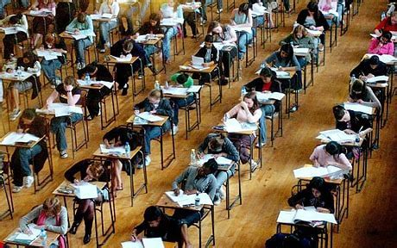

Setting educational assessment standards
Jo-Anne Baird
Oxford University Centre for Educational Assessment

Slide 3
In This lecture SERIES we consider
What are standards & what are qualification standards?
Three different ways to think about assessments – assessment paradigms
How standards differ in philosophy & method in these paradigms

Slide 4
Three paradigms of assessment
Apprenticeships
Vocational qualifications
Outcomes-based
Examinations
Classroom assessment
GCSEs
Curriculum-based
Construct-based
Intelligence tests
Personality tests
psychometrics
Baird, J. and Opposs, D. (2018). Chapter 1 - The Standard Setting Project: assessment paradigms. In Baird, J., Isaacs, T., Opposs, D. and Gray, L. (Editors) Examination standards: How measures and meanings differ around the world.. UCL IOE Press. 2 – 25.

Slide 5
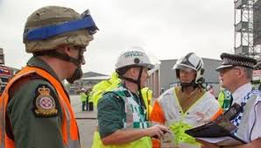
Outcomes-based assessment
Attribute: what is the nature of the thing you are trying to assess?
Competence
Common assessment formats
Practical performances with written assessment criteria in workplace settings

Slide 6
Outcomes-based assessment
Prototypical definition of standards
Results distribution expectations
Criterion referencing
Grades that tell us whether the candidates met pre-determined performance criteria
Emphasis on qualitative information
Blank, W. E. (1982). The competency-based approach to education and training. Handbook for Developing Competency-Based Training Programs. Englewood Cliffs, NJ, Prentice-Hall: 3 - 27.

Slide 7
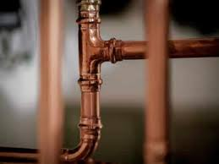
Outcomes-based assessment example
K/505/9403 Understand and carry out pipe fabrication work for domestic pluming systems
The combination unit provides learning in the essential job knowledge and basic skills required to safely fabricate copper pipe for use in domestic plumbing systems. The unit is designed to cover work that is applicable to new-build domestic construction sites and refurbishment work in occupied and unoccupied domestic properties. Upon completion of the unit the learners will:
  Be able to apply Health and Safety procedures during completion of work activities
  Know the hand tools that are used for copper pipe fabrication work
  Be able to safely use hand tools to carry out copper pipe fabrication work
  Know the materials and components used for copper pipe fabrications
  Know the procedures for completing basic copper pipe fabrication processes
  Be able to carry out basic copper pipe fabrication processes
….
Learning Outcome 2 - Know the hand tools that are used for copper pipe fabrication work
Assessment Criteria
2.1 List the hand tools that are used for the following copper pipe fabrication work activities:
  Measuring and marking out
  Cutting and de-burring
  Bending
  Jointing by mechanical means
  Jointing by use of heating equipment
2.2 State how to safely use and look after hand tools that are required for copper pipe fabrication work

Slide 8
Debates on outcomes-based assessment
Multiple approaches
Assessment when ready
Different learning and assessment environment
Inter-rater reliability
Bureaucratic tick box
Assessment replacing learning (Torrance) - transparency

Slide 9
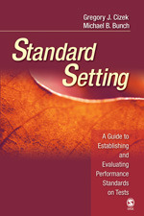
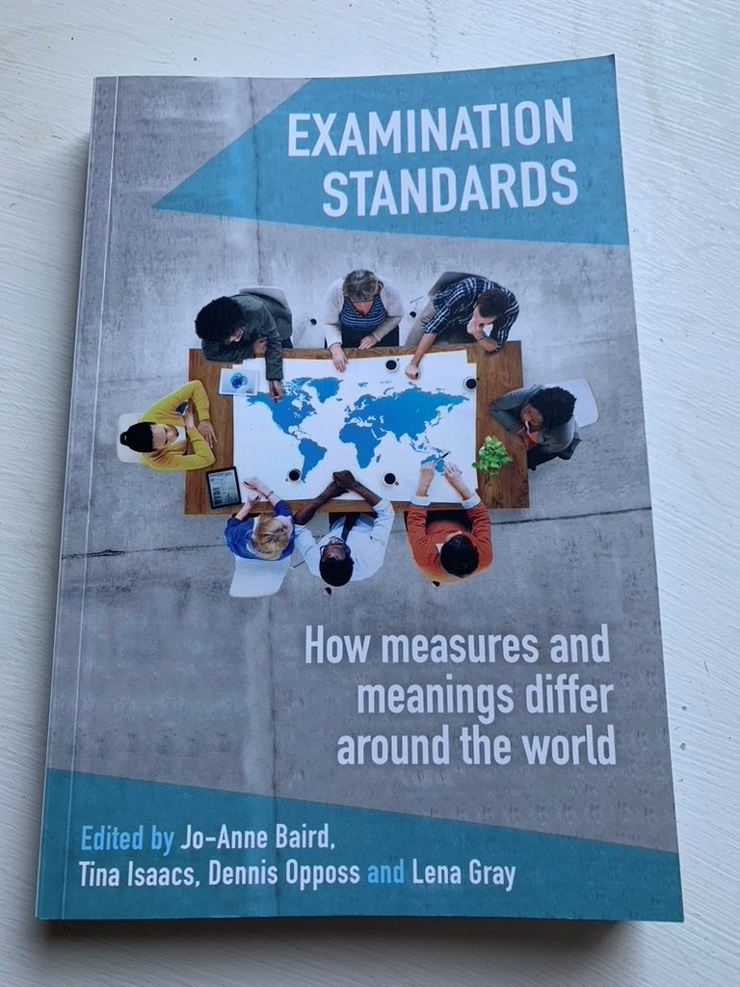
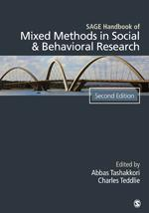
Additional references used in this lecture
Cizek, G., & Bunch, M. (2007). Standard Setting. SAGE Publications. https://doi.org/10.4135/9781412985918
Baird, J., Isaacs, T., Opposs, D. & Gray, L. (2018). Examination Standards: How Measures and Meanings Differ Around the World. UCL IOE Press.
Tashakkori, A. and Teddlie, C. (Editors) (2010) SAGE Handbook of Mixed Methods in Social and Behavioural Research. 2nd Edition. Thousand Oaks, California: Sage Publications.

Slide 10
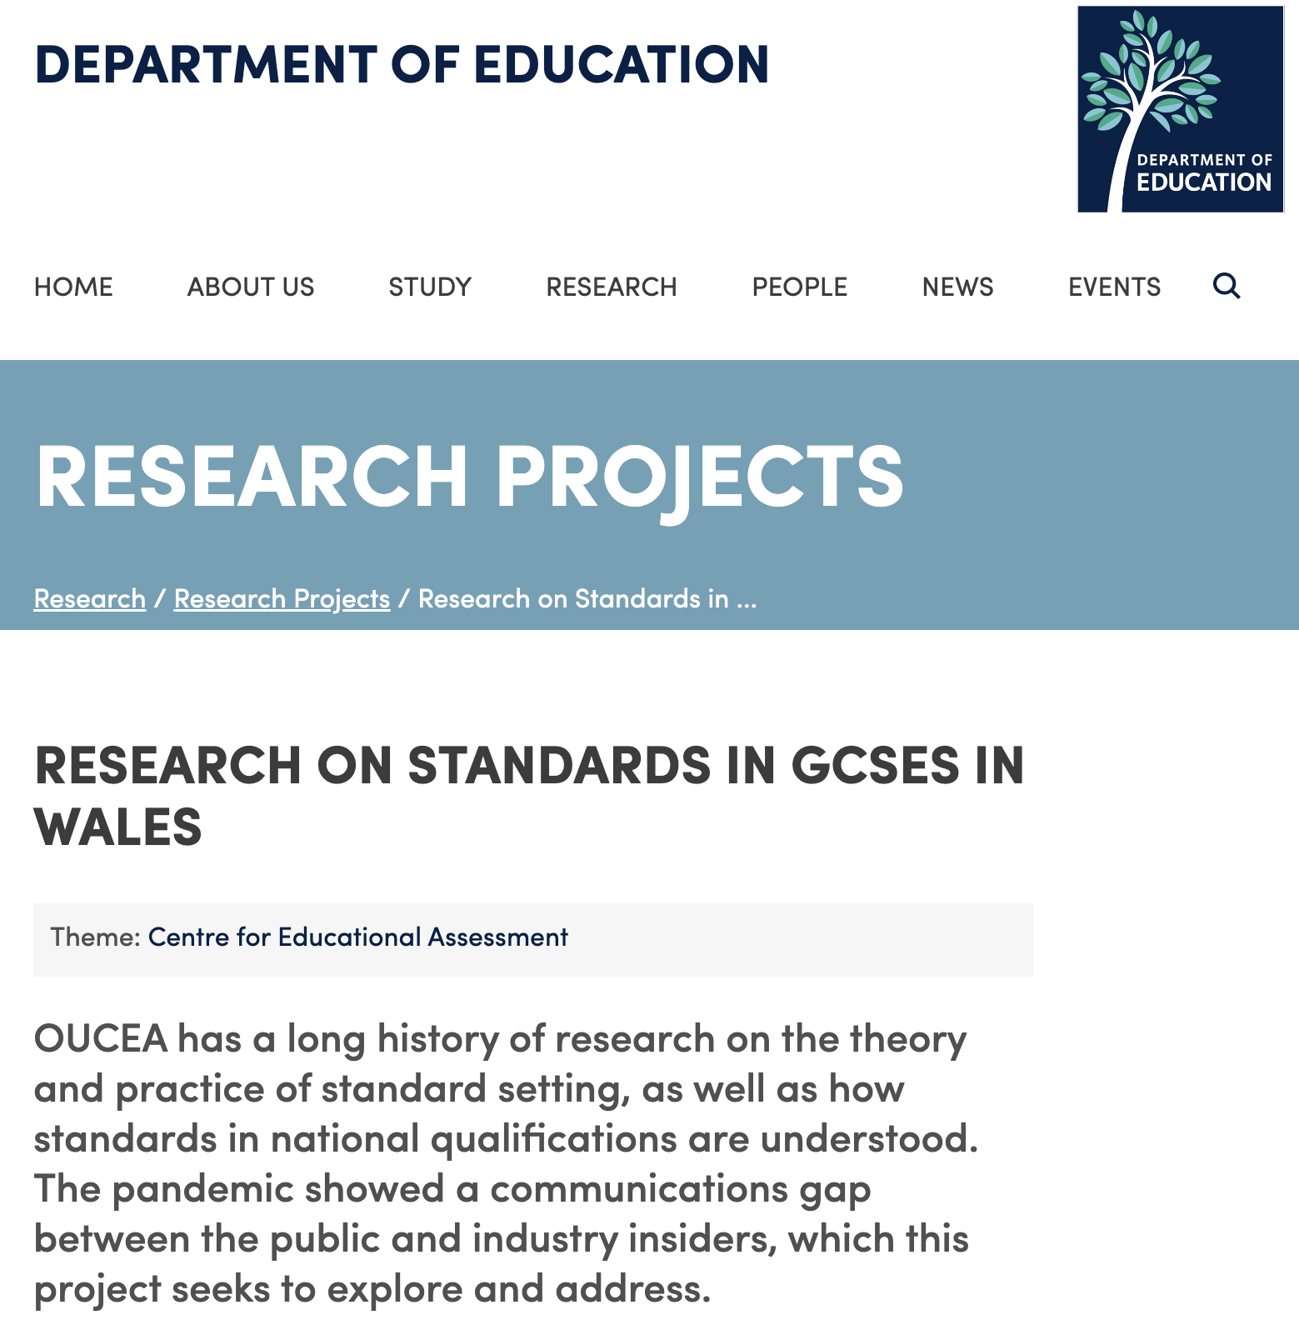

FIND OUT MORE
Oxford University Centre for Educational Assessment (OUCEA)
https://www.education.ox.ac.uk/research/research-on-standards-in-gcses-in-wales/
Home of the

